Slide 1



Nairobi Roar
Newsletter of the U.S. Embassy, Nairobi, Kenya
August 19, 2021
Issue 21-31
In This Issue:
Letter from the Editor 2
Photo Contest Winner 3-5
Kiswahili Corner 6 Embassy Resources 7-8
Employment 9
Embassy Notices 9-11
CLO Updates 12-13
AEA Updates 14
Community Pages 15-17
GCLO Weekly 18
Mission Classifieds 19-26
The Roar Newsletter is distributed only to immediate members of the U.S. Mission to Kenya. Please do not share or forward it to anyone not authorized to receive it. If printed, please shred before disposing.
Roar Editor
NairobiRoar@state.gov
IMPORTANT CONTACT INFO
POST ONE
020-363-6170
0722-204-445
Duty Officer Phone
0722-515-083
Medical On Call
0722-513-323
Maintenance Supervisor
On Call 0724-255-603
Feature Story:
Our Sharepoint Photo Contest
Winners | August 19th , 2021
Cover photo: My Diani by Mike Regal
18
1

Slide 2
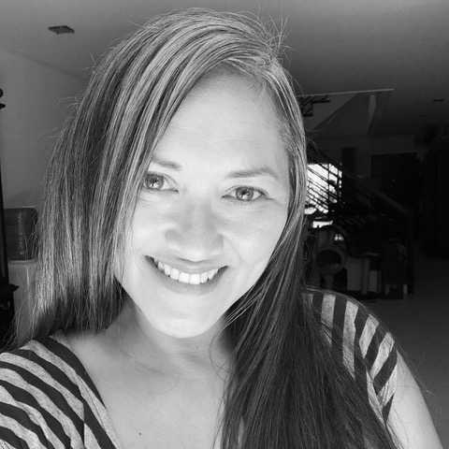
LETTER FROM THE EDITOR
for Bloomberg BNA while living in Accra, and a Senior Editor for CNN Philippines while in Manila.
I love exploring new cities, and I also love doing anything creative, from cooking and baking, to crafting and sewing! In fact, I love sewing so much, I teach sewing classes out of our garage (maybe you’ve seen my ad in The Roar), and take great pleasure in passing on knowledge of this valuable life skill. Since our first overseas post as a family was in Ghana, I have a rather impressive collection of West-African Ankara and have been enjoying adding Kitenge and Kanga to it. You’ll often see me walking the halls wearing bright colored prints, beads or something I’ve designed and sewn myself – stop me and say hello!
If you have any questions about ROAR content, or suggestions for stories, please contact NairobiROAR@state.gov, or stop by the CLO office (I sit in the back corner office).
A letter from the editor...
Dear Readers,
I would like to take a moment to introduce myself, for those who don’t know yet know me. My name is Diosa Woods, and I’m the new Editor-in-Chief of THE ROAR.
I arrived in Nairobi from Manila, the Philippines in September 2020, with my husband and two children. Due to COVID, we did a direct post-to-post move, and our son Bronson, who had recently graduated high school, came with us and did his first year of college online. (Some of you may have gotten to know him already, as he’s become the guy most embassy families call for help with boosting their WiFi range and setting up VPNs, and other tech services.) Our daughter Julia is 16 and is in grade 11 at ISK.
I have a BA in English from UMBC with a concentration in journalism.
I have always loved and appreciated the importance of storytelling. I grew up dreaming about being the next Barbara Walters or Oprah, and first decided around age ten that I wanted to become a journalist when I read about the amazing and brave investigative reporting done in the late1800s by a woman I highly admire, Elizabeth Cochran, aka “Nellie Bly”. If you don’t know about her brave reporting work and inventions, she’s a worthwhile read – definitely look her up.
I have worked for Military Living Magazine, as well as various publications from Rhode Island to Guam, and thanks to our life in the foreign service, I also had the amazing opportunity to work as the West-African Correspondent
-Diosa
2

Slide 3
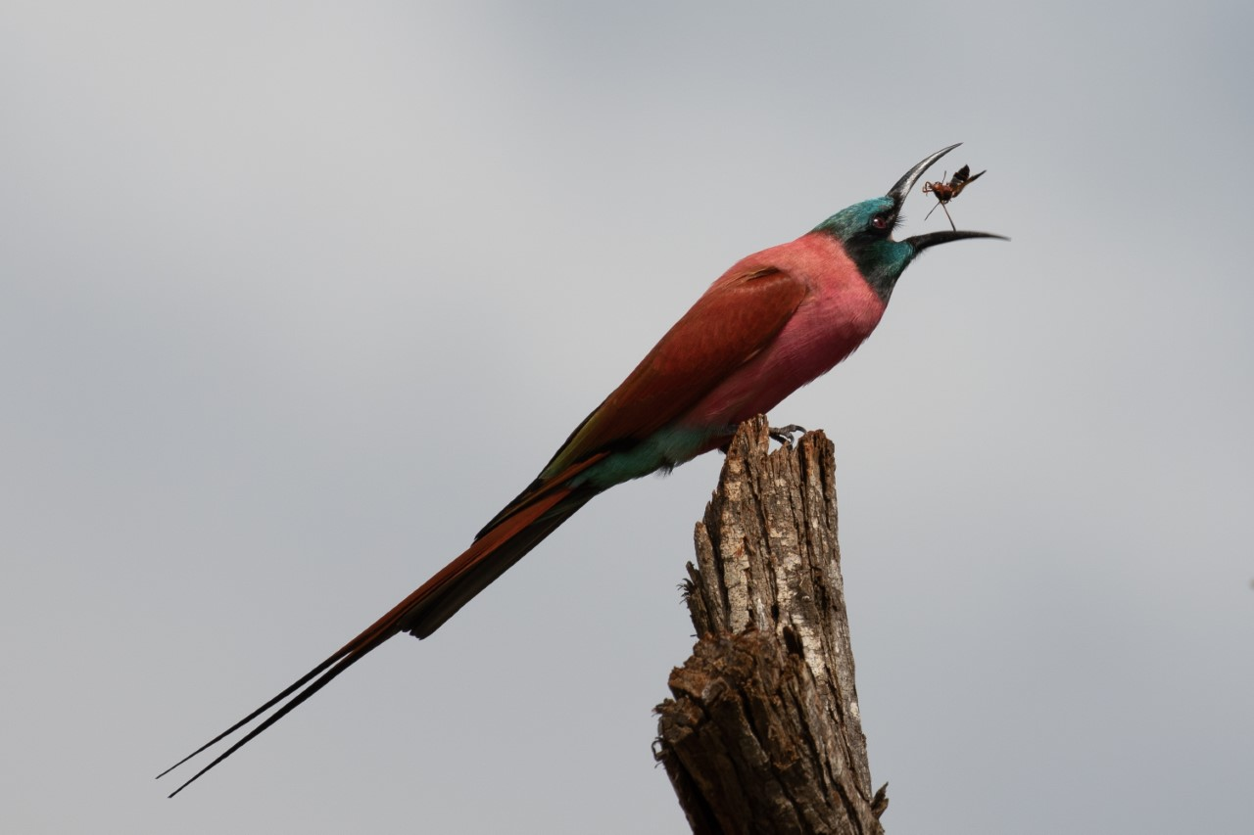

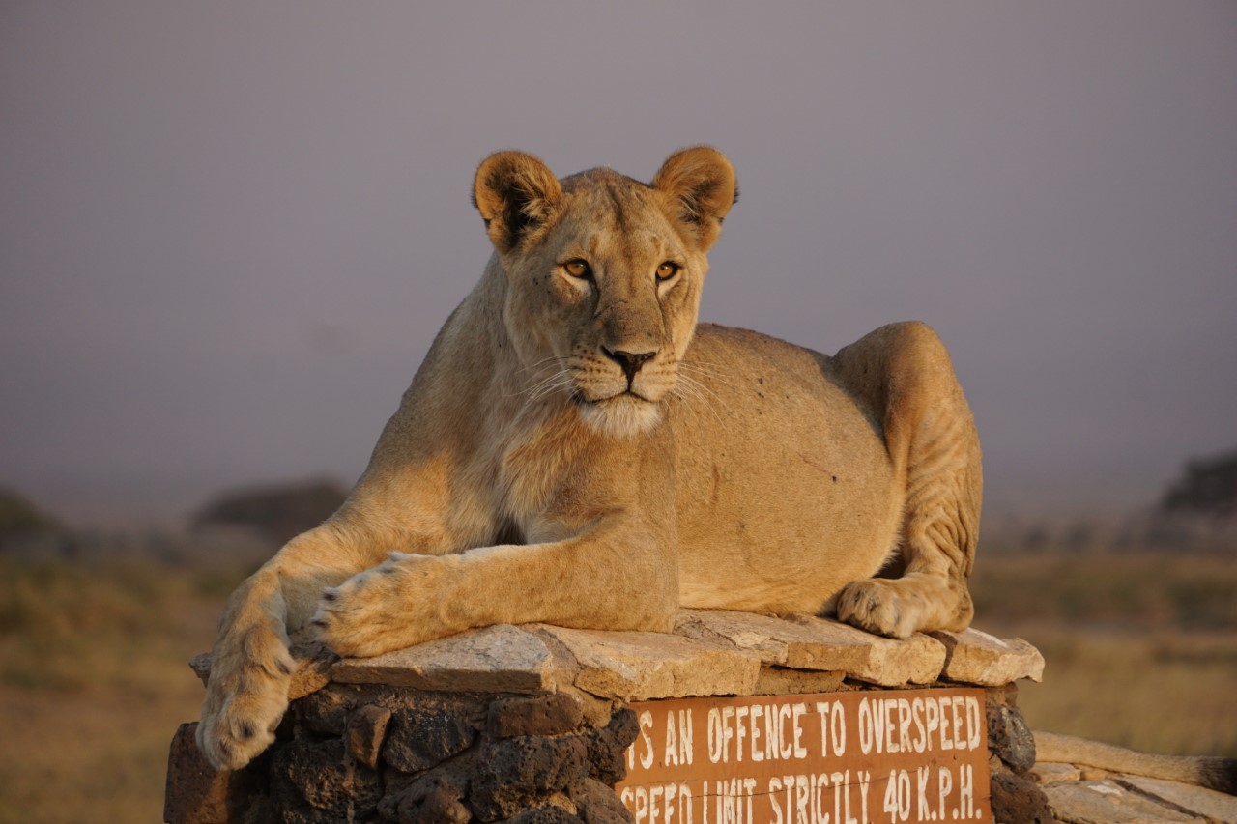
EMBASSY PHOTO CONTEST WINNERS
Congratulations to all our winners! And many thanks to all who participated!
Thank you to all who submitted photos for our Sharepoint photo contest, and a special thank you to our judge, Deputy Management Counselor Gerry Thibodeau! It was a blind judging, and since these photos are for the CLO Sharepoint site, photos were selected to show the diversity of Kenya as well as for color and visual impact.
Congratulations to Mike Regal for submitting the favorite, "My Diani," chosen based on its vibrancy and clear nod to a favorite Kenyan spot.
They say a picture is worth a thousand words, so we will let the winners featured here speak for themselves; we hope you’ll enjoy these beautiful glimpses of Kenya that follow.
Stay tuned for the next photo contest...
OVERALL WINNER – Mike Regal, “My Diani”
“Bee-eater (I eat wasps too!)”
Photo credit: Keith Swindle
“Sunset Repose”
Photo credit: Patricia Diego
“Chania Falls, Aberdare National Park, Kenya”
Photo credit: Kristi Law
Blind rhino at DSWT Orphanage, by David Staples
3

Slide 4
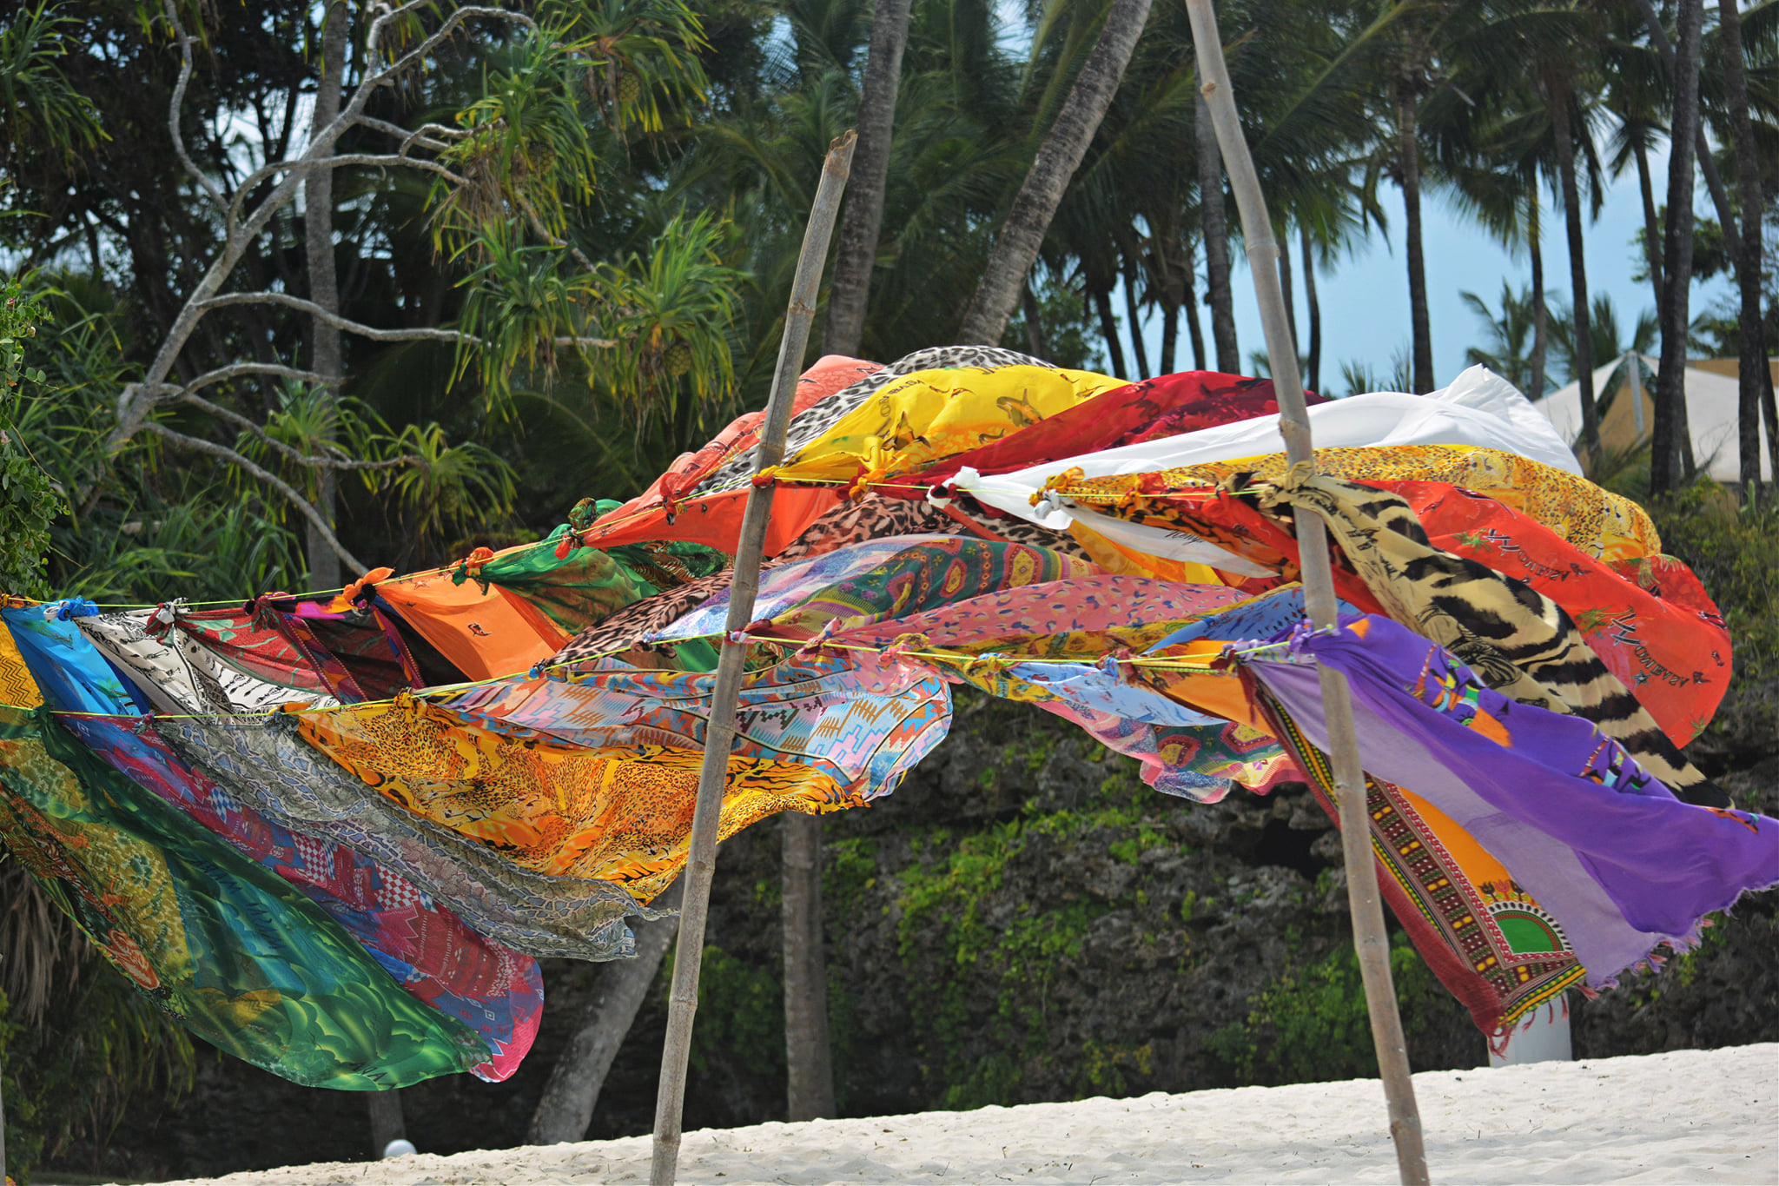
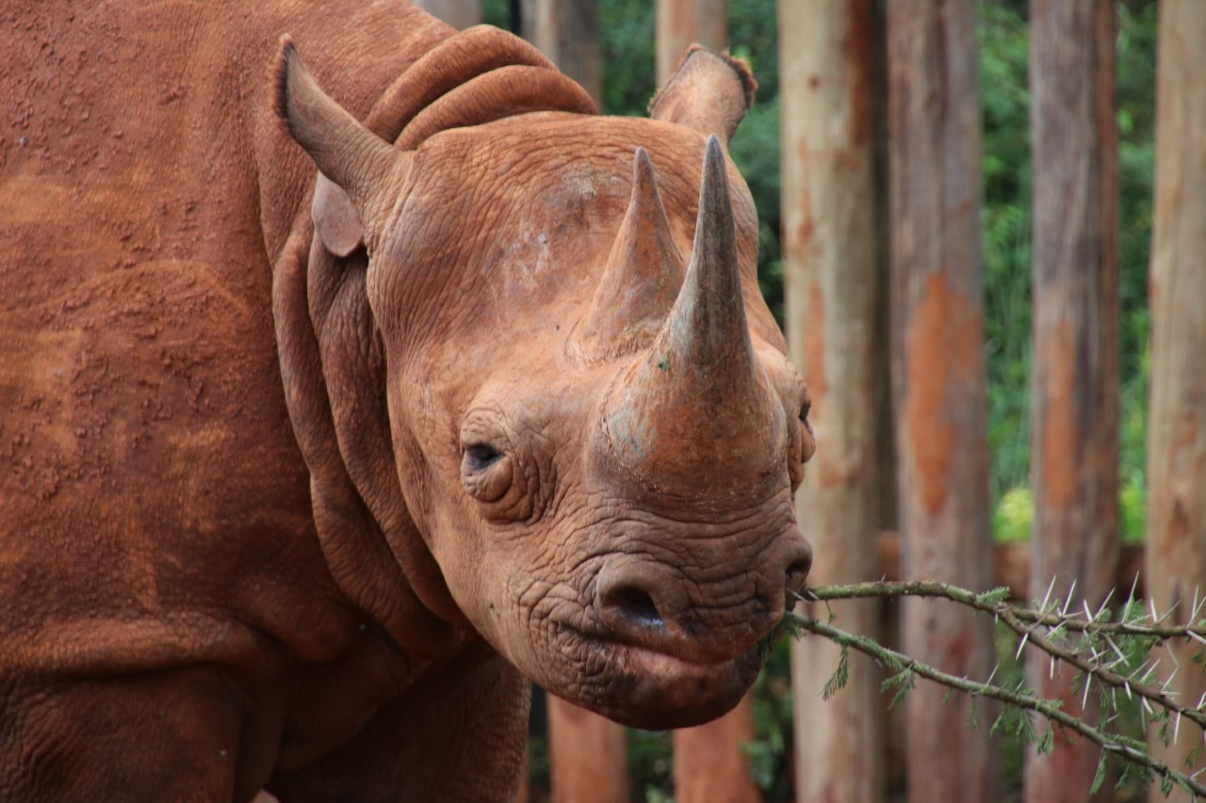
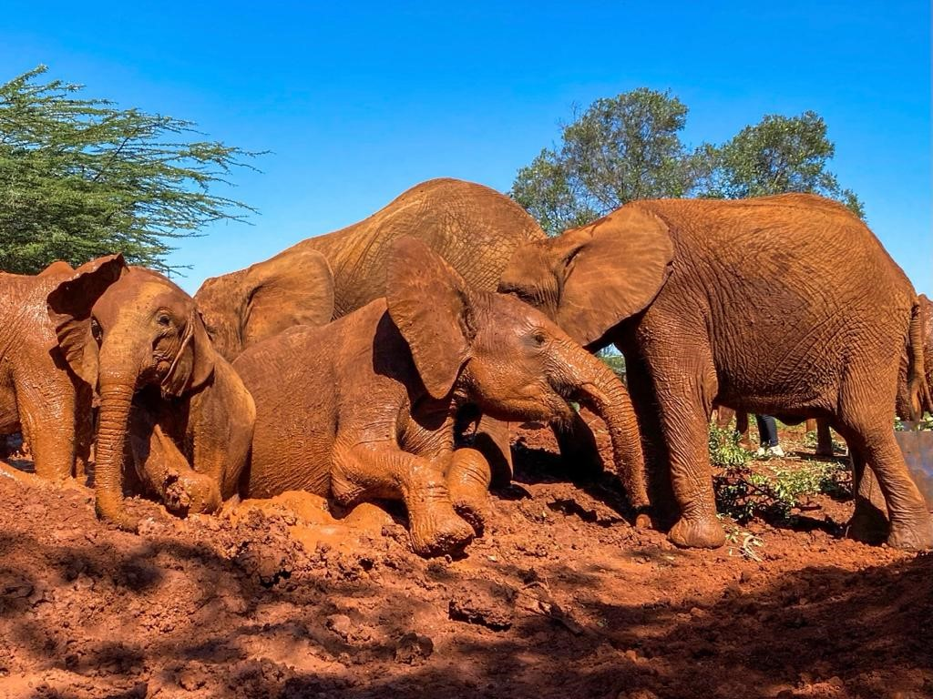


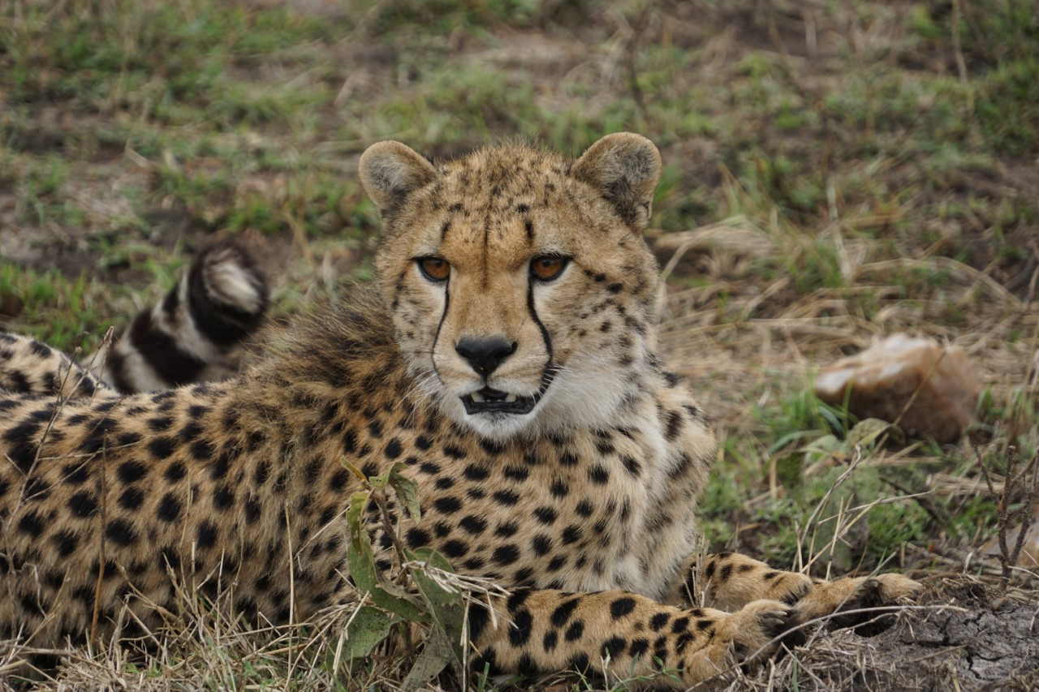
EMBASSY PHOTO CONTEST WINNERS
“Sarongs”
Photo credit: Gillian Regal
“Blind Rhino at DSWT Orphanage”
Photo credit: David Staples
“The Elephant Winners”
Photo credit: Kevin Strong
“Kenya Commute”
Photo credit: Keith Swindle
“View of elephant and Kilimanjaro from Amboseli”
Photo credit: Eric Hunsperger
“Looking for Mum”
Photo credit: Patricia Diego
4

Slide 5
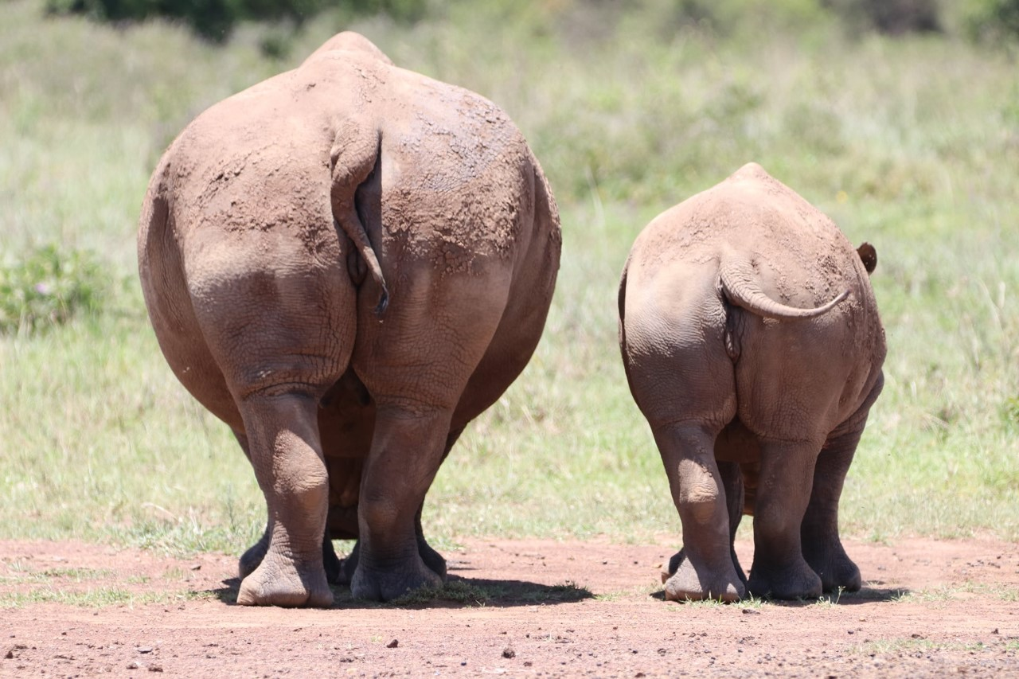



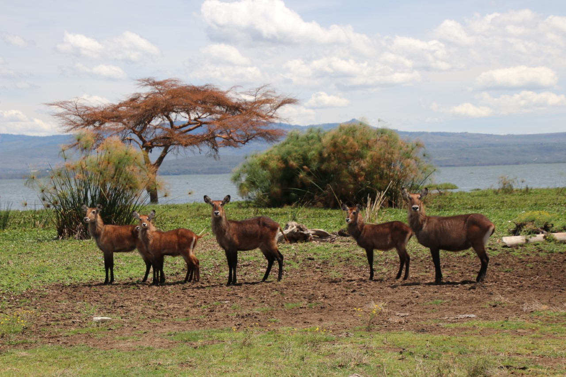
EMBASSY PHOTO CONTEST WINNERS
“I'm not engaging today”
Photo credit: Sarahjean Harrison
“Country Bike”
Photo credit: Mike Regal
“A New Dawn”
Photo credit: Laura Merz
“Dappled Morning Light”
Photo credit: Laura Merz
“Waterbuck on Crescent Island”
Photo credit: David Staples
5

Slide 6




Kiswahili Corner
CULTURAL NORMS & FUN KENYAN SLOGANS
Technological or Legal situations in the country, but the individual’s relationship with the country even though one may not be happy with many aspects in the country. Still, there is a lot to be done as an individual. In fact, some common wanainchi (normal citizens) in Kenya changed the concept of ‘Najivunia Kuwa Mkenya’ to ‘Najihurumia Kuwa Mkenya’ (I pity myself for being a Kenyan) which is predominantly seen in the crazy Matatus. These are Kenyans who were not happy with the Governor’s slogan and decided to reverse the meaning from being proud to feeling sorry for themselves. This group is the majority, and they feel that only the affluent people (5% of the population) should be ‘Proud to be Kenyan’, while the rest (95%) should pity themselves to be Kenyans.
Some of the common phrases you may see in public places include:
Usikojoe Hapa – “Do Not PEE Here.” (Mostly meant for our dear brothers)
Usipige Picha – “Do Not Take Photos” (mostly near the government’s premises)
Usipige Simu – “Do not make calls” (mostly in the banks)
Usivute Sigara – “Do not smoke”
Usipige Kelele – “Do not make noise”
Usitupe Takataka – “Do not litter”
Hakuna Maegesho – “No Parking”
Chinua Achebe once said, “A patriot is a person who loves his country. He is not a person who says he loves his country. He is not a person who shouts or swears or recites or sings that he loves his country. He is one who cares deeply about his country and all its people”.
By Mwalimu Rose Nalo
Kenya (mostly a feminine name in some countries), officially known as Jamhuri ya Kenya (The Republic of Kenya) in Kiswahili, is a gorgeous African country.
It is famous for its white sandy beaches (which is stereotyped as ‘lazy afternoons out’, where people bask in the sun and enjoy cold beer as they gaze upon an amazing landscape) and many tropical weather seasons:
Jun – Aug: Kenyan winter
Sept-Nov: short rains/autumn
Dec – Feb: Kenyan summer or dry season
Mar – May: long rains or spring
Kenya is also known for the marvelous The Great Rift Valley, diverse wildlife habitats, prolific bird life, huge volcanoes, rich cultures and artifacts, diverse communities and languages, including the most beautiful language; Kiswahili, the land of the greatest marathon of the modern era, a land of a diverse music with multiple of folk music, and so on. Jamhuri ya Kenya is an amazing country.
Kenya (mostly a feminine name in some countries), officially known as Jamhuri ya Kenya (The Republic of Kenya) in Kiswahili, is a gorgeous African country.
It is famous for its white sandy beaches (which is stereotyped as ‘lazy afternoons out’, where people bask in the sun and enjoy cold beer as they gaze upon an amazing landscape) and many tropical weather seasons:
Jun – Aug: Kenyan winter
Sept-Nov: short rains/autumn
Dec – Feb: Kenyan summer or dry season
Mar – May: long rains or spring
Kenya is also known for the marvelous The Great Rift Valley, diverse wildlife habitats, prolific bird life, huge volcanoes, rich cultures and artifacts, diverse communities and languages, including the most beautiful language; Kiswahili, the land of the greatest marathon of the modern era, a land of a diverse music with multiple of folk music, and so on. Jamhuri ya Kenya is an amazing country.
“Nyayo” means footsteps in Kiswahili (This was the second president’s slogan). Did you know that in Kenya there are some things that the “nyayo kids” (those who went to school during the late President Moi’s regime), who drank “Nyayo” school milk and sang “Tawala Kenya, tawala” in mass choirs or those who are also currently known as the analog kids will never forget? No matter where they reside, to them, every insecticide in Kenya is called DOOM,
every detergent is OMO, every toothpaste is COLGATE and every cooking oil is KIMBO!
‘Najivunia Kuwa Mkenya’
(I am proud to be Kenyan).
This is a political campaign slogan that was launched by Governor Dr. Alfred Mutua. I think everyone in Kenya needs to have this slogan on his or her windowpane, wall, website, signature of email, or car’s bumper. Although I know this is next to impossible because many Kenyans only see the half full glass, as far as Kenya is concerned. They do not know that ‘I am proud to be Kenyan’ has nothing to do with the contemporary Economic, Political, Social, Environmental
Please sign up for Kiswahili Lessons!
Contact Mwalimu Rose Nalo at +254 733 774 178 or NaloR@state.gov and cc roselynnnalo@gmail.com
6

Slide 7








EMBASSY RESOURCES
EMBASSY RESOURCES
Nairobi Roar
Nairobi Roar
EMERGENCY
POST ONE: 020-363-6170 or 0722-204-445
RSO: Call Post One
020-363-6170 or 0722-204-445
Duty Officer: 0722-515-083
Main switchboard: 020-363-6000
USAID Main switchboard: 020-862-2000
After Hours Dispatcher: 0728-608-284
Please note that all service hours are subject to change.
Photos & Story by Jill Chiasson
Photos & Story by Jill Chiasson
MISSION KENYA OFFICE HOURS
Official Office Hours: 7:15am to 4:30pm Monday through Thursday with 30 minutes for lunch, and from 7:15am to 12:15pm on Friday.
Please be aware that office hours are subject to further adjustments at any time to meet Mission requirements.
BANKING
Monday-Thursday: 8:30 am-3:30 pm, Friday: 8:00 am- 2:00 pm
TRAVEL
Express Travel Office: 020-363-6229 or 020-363-2415
Emergency Hotlines - after office hours & Airport Office: (open 24 hours): +254 709 195 400
MEDICAL
Med Unit Duty Officer:
0722-513-323
Reception: 020-363-6633 7:15 am - 4:30 pm Email: NairobiHealthUnit@state.gov
Walk –in Hours: M-F, 7:30 – 9:00 am
Mission Kenya AA
Meetings every Wednesday at 7:30 pm,
Rosslyn Ridge
Email: missionkenyaa@gmail.com
BANK HOURS:
UPDATED CASHIER HOURS:
Chancery Lobby
Monday-Wednesday: 8:00 am – 11:00 am & 12:00 pm – 2:00 pm; Thursday: 8:00 am – 1:00 pm; Friday: 8:00 am – 12:30 pm
USAID Annex Lobby
Monday-Tuesday: 8:30 am – 12:00 pm & 1:00 pm – 2:30 pm; Wednesday: 8:30 am – 1:00 pm; Thursday/Friday: 8:00 am – 12:30 pm
CONSULAR SERVICES
Consular Section: General Info: 020-363-6011 The office is closed on all American/Kenyan holidays and the last Wednesday of the month.
American Citizen Services (Mission Personnel): The consular section can process U.S. passport (both official and personal) applications, Consular Reports of Birth Abroad, and provide notarial services for Mission employees and their families. To schedule an appointment for any of these services please email Kenya_ACS@state.gov or call ext. 6451. For specific American Citizen Services questions, please contact ACS Chief Robyn Luffman at LuffmanRN@state.gov.
American Citizen Services (General Public):
Please note that while service appointments have resumed, wait times are extensive. Passport and notarial services are available for the general public here. For Consular Report of a Birth Abroad appointments, email the ACS unit at Kenya_ACS@state.gov. For after-hour emergencies, contact 020-363-6170. For other services, email Kenya_ACS@state.gov.
Non-Immigrant Visa: https://ke.usembassy.gov/visas/
Immigrant/Diversity Visa: https://ke.usembassy.gov/visas/
DHS Citizenship & Immigration Services (CIS):
363-6111; Fax: 363-6103
Mission Personnel Email uscis.nbo.public@uscis.dhs.gov for an appointment. General Public Tues & Thurs: 1:30-3:30 pm; Wed: CLOSED; Fri: 9-11 am
UPDATE TO CONSULAR SERVICES
MAINTENANCE
Maintenance Supervisor
During Office Hours: 020-363-6443
After Hours On Call: 0724-255-603
MAIL
Customer Service Hours
Monday- Wednesday: 8am – 4pm; Thursday: 8am – 12pm; Friday: 8am – 12:30pm
Currently there is NO outgoing DPO; outgoing mail pouch only (urgent parcels only).
Updated Hours/Services
UN FUEL STATION
Updated Hours:
Mon-Fri: 7 am-6 pm
Sat-Sun: 9 am–5 pm
Questions about obtaining/renewing a UN fuel sticker? Contact GSO Customs and Shipping: NairobiGSOCustomsAndShipping@state.gov.
7
2

Slide 8


HIGHLIGHTS:
New Facility Guidelines
Other service and facility notices below still apply.
Please Take Note:
Mail Room
Mail Room hours are currently: Mon-Wed, 8am-4pm, Thurs, 8am-12pm and Friday, 8am-2:30pm. We’ll continue to send out notifications to customers who receive packages. Contact info: NairobiMailroom@state.gov. No outgoing DPO; please restrict outgoing (via pouch) to urgent parcels only.
Mission External Facilities
With the recent increase in COVID-19 cases in and around Nairobi, we appreciate everyone's cooperation in adhering to the guidelines for use of shared community facilities in order to keep the facilities accessible and safe for all community members. Pools and playgrounds will remain open without reservation or capacity constraints from Mon-Sat. The current reservation system will be in effect on Sundays only. Tennis courts will still require booking. The Rosslyn Ridge field and basketball court are available for general use on a daily basis without reservation, but if you require the whole field or court for a specific reason, please reach out to CLO to reserve (we’ll add you to that calendar). Access facility calendars via Google calendar. Click this link https://forms.gle/EopRdz2QdSjbR6Wr7 to let CLO know which Google calendars you want to be invited to (there's a calendar for EACH FACILITY). Be sure to add your reservation to the correct calendar (so it does not default to your personal google calendar).
General Guidelines:
Outside guests are not permitted at this time to use any shared facilities.
For those days/facilities requiring advance booking, bookings may be made up to 2 weeks in advance. Reservations outside this window will be deleted.
Unvaccinated community members must wear a mask if physical distancing is not possible when using shared facilities.
Do not use the facilities if you are sick or exhibiting COVID-19 symptoms.
Health Unit
The Health Unit will be offering walk-in service for urgent care from 7:30 - 9:00 a.m. daily. Do not use the walk-in service if you are experiencing fever or respiratory problems. In these cases, call first so the health unit staff can assess by telephone and give appropriate guidance. This time slot is not intended for ongoing or routine care. For medical concerns, immediate or otherwise, feel free to call or email us for guidance. Naturally, we will respond immediately to all serious emergencies. The Health Unit numbers are: Regular Embassy hours: 020 363 6633
Med Duty Officer on-call: 0722 513 323
Group Health Unit email: NairobiHealthUnit@state.gov
GSO/Facilities
Domestic Employee Access to Houses/Compounds:
We recommend house staff with close, continued contact with you or your family (nannies, daily housekeepers, tutors, etc.) live in with you. Suppose you choose not to have house staff live in with you. In that case, we recommend that 1) you screen house staff by phone as to illness before their arrival (temperature, headache, cough, cold/flu symptoms), 2) they do not use public transportation to and from your residence, 3) they wash hands, or use an alcohol-based hand sanitizer upon arrival, 4) wear a mask, and 5) maintain a minimum 6-foot distance.
We recommend keeping a contact log for all non-family members entering your home.
If you have additional questions, please contact NairobiGSOWarehouseAdmin@state.gov for property issues or Nairobi FM Team Leaders NairobiFMTeamLeaders@state.gov for facilities issues.
Swimming Pool Guidelines
Swimming Pools are closed for cleaning DAILY from 8:00 – 9:30am
Adult swim (for lap swimming only) at RR is M-F 6-8am.
Up to 10 people may use the pools at one time on Sundays. Each individual may spend a max of 2 hrs at the pools on this day. No capacity limits apply Mon-Sat.
Maps: Rosslyn Ridge Pool: https://goo.gl/maps/VLaANE31L2qJnnDf7 R-2 (former CMR) Pool: https://goo.gl/maps/RM9ntvZwU4v6ztWU7 Shanzu Gardens Pool: https://goo.gl/maps/4NgNCrZPwwZa4knj8
Playground Guidelines
Effective immediately, kids age 12 and under must wear a mask covering their nose and mouth at all times while using the playground since it is difficult for younger kids to physically distance in this area.
Up to 10 people may use the playground at one time on Sundays. No capacity limits apply Mon-Sat.
Gyms
Banking/Cashier Hours:
NCBA hours will be Monday-Thursday: 8:30 am-3:30 pm, & Friday: 8:00 am- 2:00 pm; Chancery Lobby-- Monday-Wednesday: 8:00 am – 11:00 am & 12:00 pm – 2:00 pm; Thursday: 8:00 am – 1:00 pm; Friday: 8:00 am – 12:30 pm USAID Annex Lobby-- Monday-Tuesday: 8:30 am – 12:00 pm & 1:00 pm – 2:30 pm; Wednesday: 8:30 am – 1:00 pm; Thursday: 8:00 am – 12:30 pm; Friday: closed.
Anyone needing reverse accommodation exchange (changing Kenya Shillings into USD) must obtain prior approval from the FMO by emailing RasingMJ@state.gov. All requests must be supported by a detailed rationale.
The Chancery Indoor, Outdoor and USAID gyms are available for all to use. Maximum occupancy in the gym is 5 people. Masks must be worn when using the indoor gyms. Shower and changing areas will remain open for all.
Americans who would like access to the gym calendars should click here: https://forms.gle/EopRdz2QdSjbR6Wr7
LE Staff who would like access to the gym calendars should click here: https://forms.gle/96YZMfeU7EySixPg8
Cleaning schedule:
The Chancery indoor gym is closed for cleaning DAILY at the following times: 10:00-11:00 am; and 3:00-4:00pm
The USAID Gym is closed for cleaning DAILY at the following times: 7:15 – 8:00am; 10:45 – 11:00am; and 3:00 – 3:45pm
The Chancery Outdoor Gym is closed for cleaning DAILY at the following times: 9:00 – 9:30am; and 1:00 – 1:45pm one time.
8

Slide 9
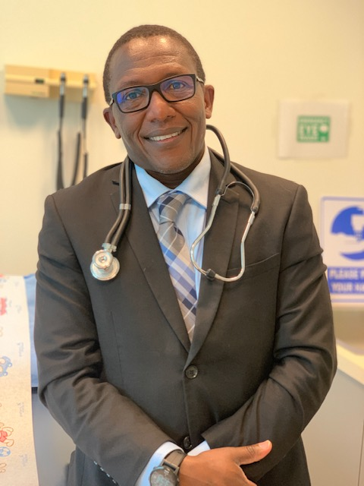
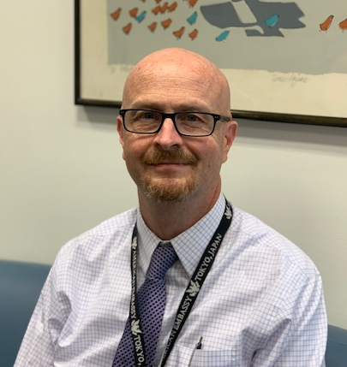
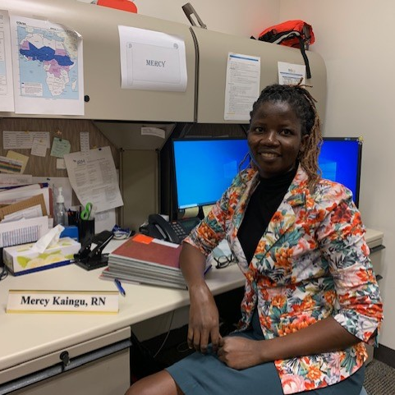

EMBASSY NOTICES
NEW IN THE HEALTH UNIT
Meet our new Health Unit Staff!
We have several new staff members who have joined our health unit. Take a moment to familiarize yourself with these new friendly faces! Stop by and offer them a warm welcome.
Dr. John Njenga, MD
Dr. Richard Morse, MD
Mercy Kaingu, RN
EMPLOYMENT
Current Vacancies
Upcoming Vacancies
Position Title: Visa Assistant (Consular Section) – All Interested Applicants
Announcement Number: Nairobi 2021-055
Series/Grade: LE 1415 7 (USEFM FP 7)
Clearance: Public Trust (background investigation) Hours: Full Time, 40 hours per week
Closing Date: 08/24/2021
For more information or to apply, visit the ERA website: https://erajobs.state.gov/dos-era/ken/vacancysearch/searchVacancies.hms
Diplomatic Courier Escort – Opening in late August. Full Time: 40 hours.
The Diplomatic Courier Escort provides support to incoming and outgoing Diplomatic Couriers. Meet the couriers at the airport. Supervise the loading and unloading of the diplomatic pouch at the aircraft. Exchange pouches with the courier and ensures the proper receipt and accountability of the pouches, liaise with airport and airline officials as needed, and keep the IPO, IMO, and other personnel informed of any issues or concerns. Provide direct safeguard of classified pouches during transfer to the airport for onward shipment. During courier departures, the Courier Escort will remain at the airport until after the airplane is airborne. This position requires great flexibility and the incumbent will incur a significant amount of overtime.
Please Note: Given the current situation, as and when interviews are scheduled, they may be conducted remotely for ALL candidates for a specific position. *Closing dates are written Month/Day/Year.
Questions? Reach out to NairobiHRAmericanServices@state.gov
9

Slide 10



EMBASSY NOTICES
Nairobi Diplomacy Strong Status: Phase 1
This has been a difficult week for our Mission as we grieve the passing of our colleagues and friends, Francis Kavulu, George Mwangi, and Charles Obungu. Condolence books will be available in the chancery and USAID building lobbies for the next week.
It is with profound sadness‎ that we also announce the death of Gianna Wanja Mungai, daughter to Bilha Nyoike of CDC – OD Nairobi.
Gianna Wanja passed away on Sunday, August 15th 2021.
Messages of condolences and encouragement can be directed to Bilha Nyoike on 0723 542 393.
Kindly remember Bilha and her family during this time of bereavement.
If you’re struggling with this news, please know that you are not alone, and that counseling services are available
COVID-19 Weekly Snapshot
Note to readers: This chart from the Health Unit is a weekly snapshot of COVID-19 cases directly involving the US Mission. The numbers include US Direct Hires, Eligible Family Members and Locally Engaged Staff. We hope this will provide readers with a good idea of the extent of the C-19 outbreak currently active in our community, as well as from the start of the pandemic to date.
Mission Summary August 18, 2021
 | 98
 | 18
Current positives in home isolation | 5
Current positives hospitalized | 1
Current contacts in quarantine | 0
Total put in quarantine to date | 152
Total put in isolation to date | 94
Total hospitalized to date | 10
COVID-19 Deaths | 3
Total Persons testing positive for COVID-19 to date
Fully vaccinated positives
August 15th – August 28th, 2021
Hails
Monica Winchester (POL/RA) and daughter Scarlett
Scott Miller (MRU) and family
Farewells
Amanda Roth (MRU)
We wish you all the best in your next adventure!
10

Slide 11




EMBASSY NOTICES
Facilities
Corner
Picking up keys?
If you are sponsoring an incoming officer, or moving from TQ to your permanent residence, you can pick up keys in the Facilities (FAC) Office located on the 2nd floor of the Chancery. GSO Leasing will send you an email letting you know what day. Note that the Cleaning and Furniture Teams complete their work between 4 PM – 6 PM. Please do not enter the residence before 6 PM on the day you are given access as you may interrupt their work.
Key Pickup Times:
Monday – Thursday 12:00 -4:00 PM
Friday before 12:00 PM
Departing Post?
Every household is provided with two sets of keys. FAC will collect one set of keys during the Final Exit Inspection of your residence which occurs 5 – 10 days before your departure. You will be provided with an envelope to deposit the second set of keys and any copies you made. Give this envelope to the motor-pool driver who takes you to the airport.
For any questions, please email NairobiFMTeamLeaders@state.gov.
21N-149: Town Hall on COVID-19, Vaccines and our Community
Please click on the link below for a recording of the COVID-19, Vaccines, and Our Community Town Hall yesterday (Wednesday, August 18th)
https://www.youtube.com/watch?v=6cGUquE7GC8
Mission Nairobi’s Diversity and Inclusion Council plans to hold its next quarterly meeting on Thursday, August 19th 2021 from 2pm – 3pm at the Amphitheater. Join in the conversation. Feel free to reach out to the below co-chairs for additional information.
Shobhit Kumar, KumarS16@state.gov
Katharyn Havens, HavensKE@state.gov
Sandra Jansen, sjansen@usaid.gov
Lilly Bekele-Piper, lpiper@usaid.gov
Ryan Scott, ScottRR1@state.gov
Tito Wawire, twaw@loc.gov
11

Slide 12


CLO UPDATES
CLO UPDATES
CLO UPDATES
Personal Vehicle Insurance Reminders:
Madison Insurance:
eric.ngundi@madison.co.keanthony.mwangi@madison.co.ke
francisca.wamugunda@madison.co.ke
UAP/Old Mutual Insurance:
Beth Maina: BMaina@UAP-GROUP.COM
Alice Wachaga: awachaga@UAP-GROUP.COM
Sarah Wairimu: SWairimu@UAP-GROUP.COM
Rodney Chege: RChege@UAP-GROUP.COM
Patricia Kiarie: pkiarie@UAP-GROUP.COM
Newly arrived and in the process of purchasing a vehicle? Remember that you are required by law to have third party liability insurance for your personal vehicle, with the sticker clearly displayed on the windshield at all times. You will need your vehicle's log book (a.k.a. title) to start this process. Contact your GSO Customs and Shipping assistant who will provide you with the appropriate paperwork.
Don't forget to check the expiration of your insurance stickers! If your insurance is expired, you can be stopped by the police. To renew, contact your insurance provider directly. They can process your renewal and email you a copy of your new sticker to print and affix to your front window. If you need a sticker to attach it to the windshield, we have some available in the CLO office (and on the
coffee table in the outer CLO lounge area).
11
14
12

Slide 13



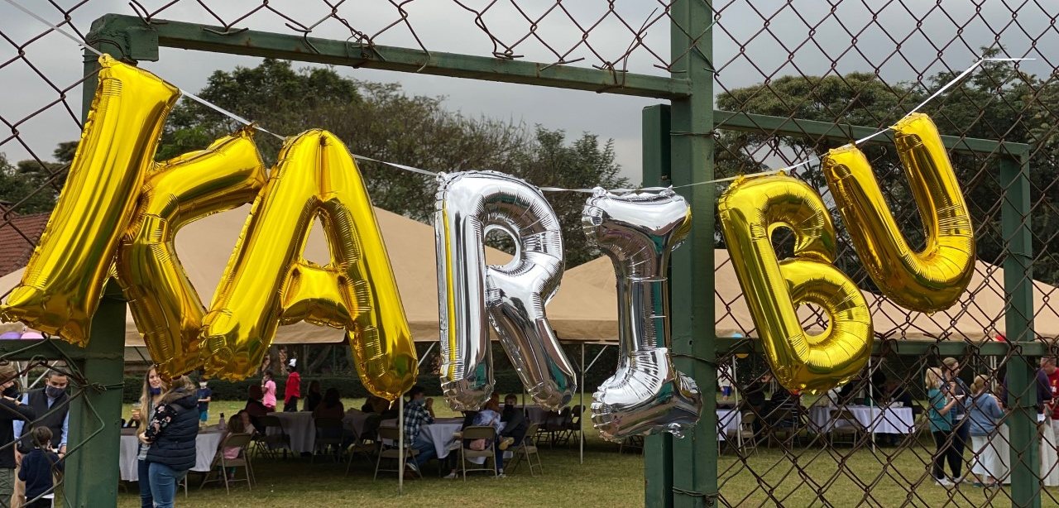
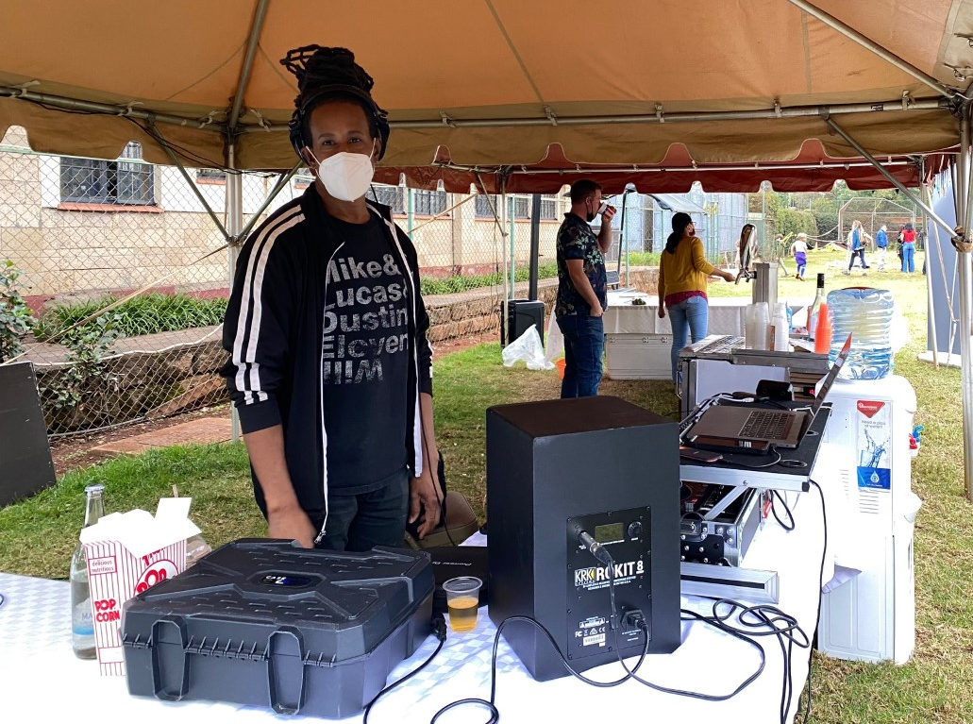

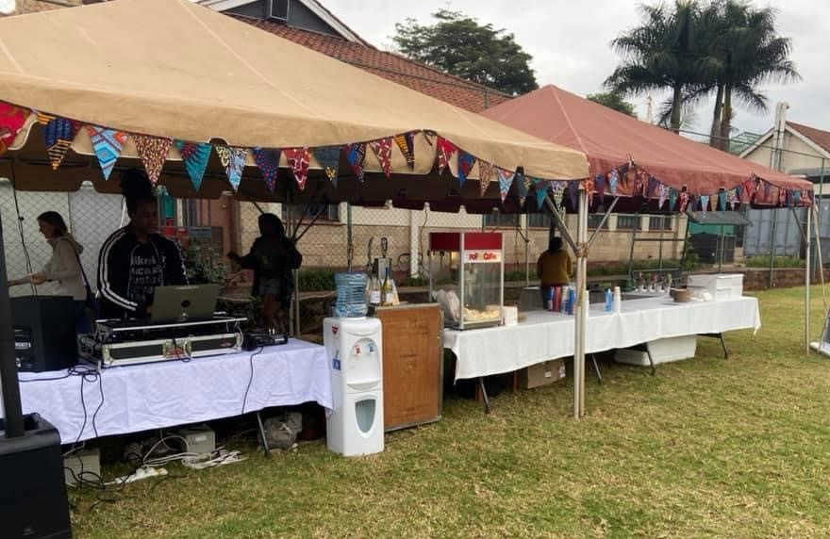

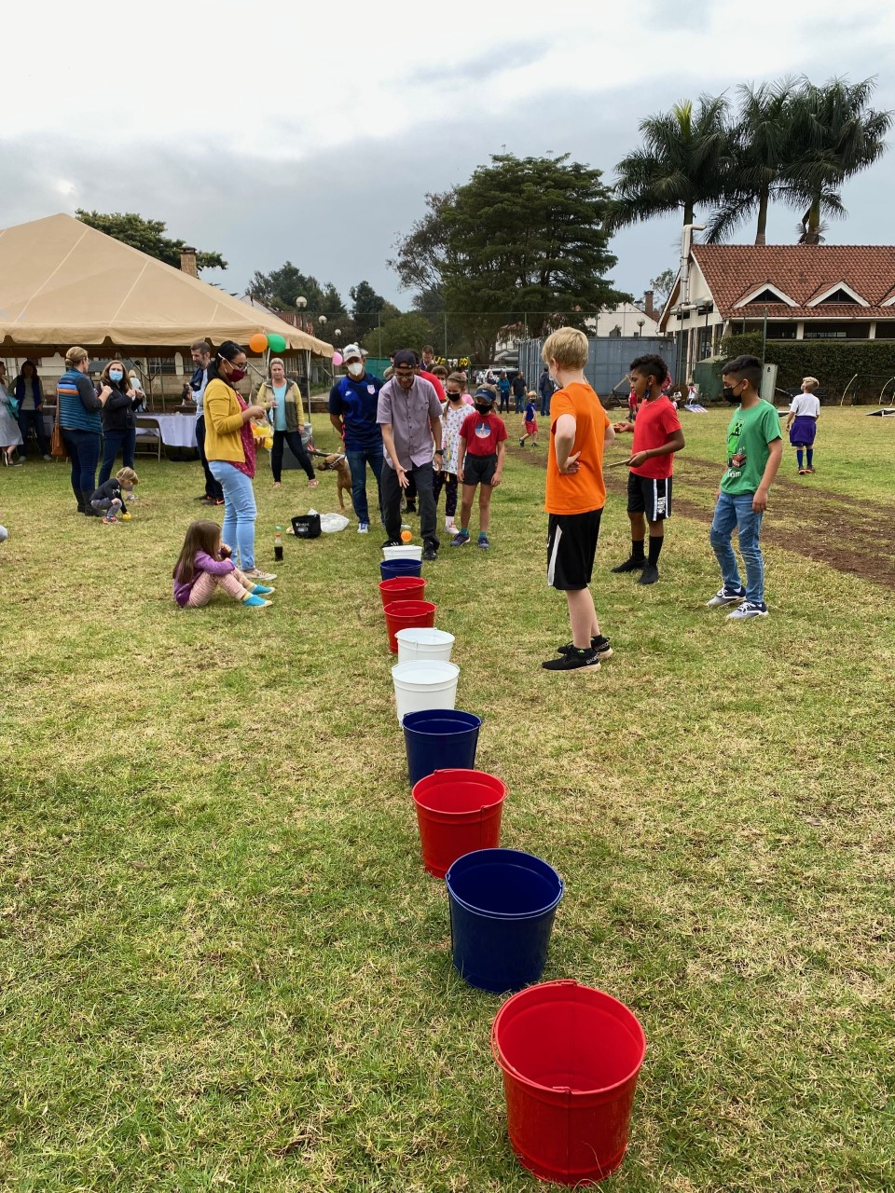
CLO & AEA UPDATES
CLO UPDATES
CLO UPDATES
Community Welcome Event
Trivia is back, and this time with two guest hosts from last month's winning team, Kevan Higgins and Mike Regal!
Team captains can register their teams here: https://forms.gle/3Qp3cAhPf9V55JTv8. See flyer below for more details.
Interested in participating but don’t have a team? Email CLONairobi@state.gov and we’ll do our best to find you a team or create a team!
Thanks to all those who joined us for our community welcome event last Saturday! It was great to see so many community members turn out. The kids were fierce competitors in our field game contests (once they realized candy prizes were on the line)...
A special thank you goes out to Adam Darby (aka DJ Black Sunshine) for providing the tunes, Johana Silva for all her help organizing and supporting the event, CLO's
summer hire Haile Ubamadu, and Beth Greene for helping AEA debut its new pickleball courts. Stay tuned for our next community event!
11
14
13

Slide 14


AEA UPDATES
Chancery Commissary / AEA Morale Store
Contact: 020-363-6182 or 020-363-6272
Hours: Mon-Thurs, 8:30 am – 4:30 pm Fri, 8:30 am – 2 pm
Rosslyn Ridge Commissary
Contact: 020-363-6799
Hours: Wed, Thurs & Fri, 11:30 am – 6:30 pm
Sat and Sun,
10:30 am – 5:30 pm
Watering Hole Contact: 0112 145 720 or 0706 311 516 thewateringhole2019@gmail.com
Hours: Tues-Sunday, 10 am – 8:30 pm Closed Monday
*in-person alcohol sales end at 6:45pm- only take-away afterwards.
View the Watering Hole Menu here!
AEA Facebook Group https://www.facebook.com/groups/274130230857993/
Stay up to date on all AEA, cafeteria and Watering Hole happenings!
News & Updates
If you placed a special order and have not yet collected it, please pass by the Rosslyn Ridge commissary.
A reminder to all AEA Members.
Please note that the July outstanding balances are due for settlement by the 20th of August 2021. All those accounts not settled by this date will attract the 15% late fee. Please ensure that your account for July 2021 is fully paid.
Payments can be made at the Embassy or RR Commissary.
If you have already settled your account, please disregard this message. We are grateful for your patronage.
14

Slide 15







… who’s interested? …
…in Learning Self-defense?
How do you protect yourself from an attacker? Read on. I would like to put a Krav Maga class together to be held once a week. If you are interested, please send me your name and contact information. The class will be limited to 5 participants due to COVID. Please send interest emails to Kumar Lakhavani at Lakhavanink@aol.com.
Bulletin Board
…in an 11-15 year old girls soccer team?
Learn more about Krav Maga here: http://www.kravmagakenya.com/
I would like to put a 11-15 year old girls soccer team together for girls to learn/play soccer. Right now, looking at Saturday afternoon meet. If you are interested in either coaching or joining in, please send an email to Kumar Lakhavani at Lakhavanink@aol.com.
Looking for something to do
with your beautiful
African fabric?
Sewing class is
back in
session!
Now offering quilting class too! Sign up today for either virtual or in-person instruction (outdoors) in Runda.
Class Schedule:
Tues/Thurs PM
Sat AM
Class Fees: 3000 KSH for adult classes (2 hours); 1500 KSH for kids (1 hour). Contact Diosa on WhatsApp: 0746 966 323, or visit www.deladiosa.com
15

Slide 16

16

Slide 17




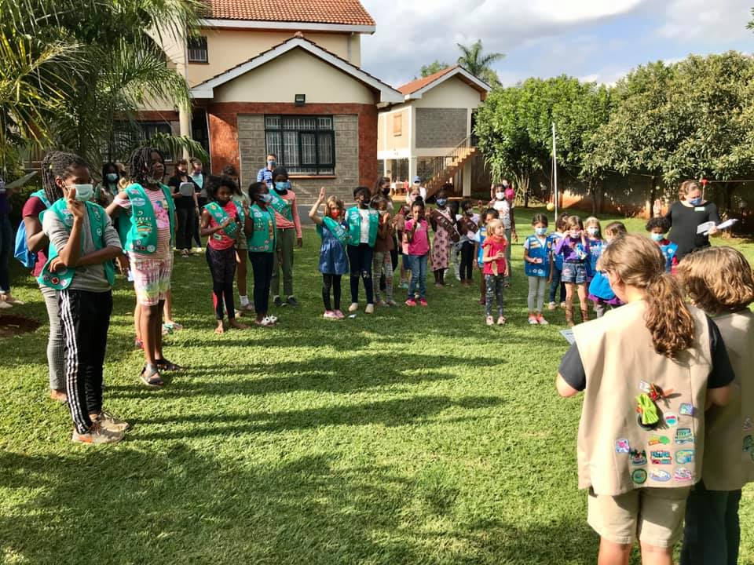
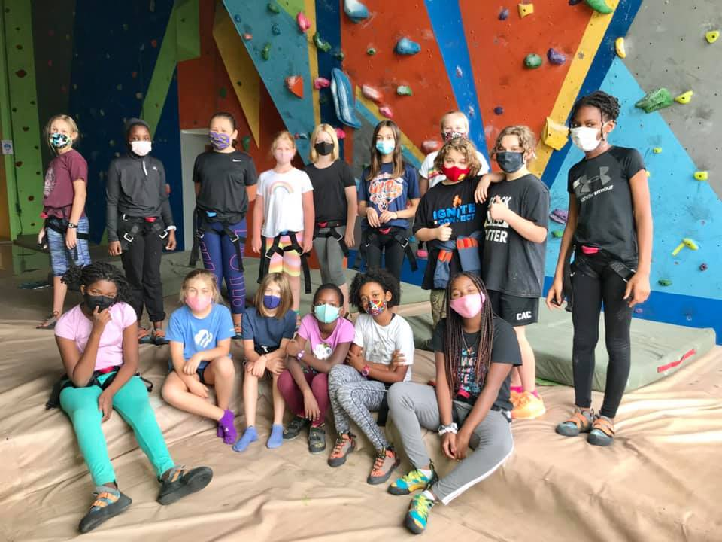
GIRL SCOUTS! We are so excited about the 2021-22 GS year! If you are new to Nairobi or want more info, please visit https://forms.gle/fKxdSrsF2VwPetUz5 or email nairobigirlscouts@usagso.org! We’d love for your daughter to join us
17

Slide 18





GCLO Weekly Newsletter
August 16, 2021
Connect with Your Community Liaison Office
Welcoming, Orientation, and Departures; Employment; Education; Community Liaison; Crisis Management; Guidance and Referral; Communication and Outreach; and Events Planning. Learn more about the CLO Program and these eight areas of responsibility on GCLO’s Community Liaison Office Program webpage. Don't have the contact information for your CLO Coordinator? Reach out to GCLOaskCLO@state.gov.
FSI Virtual Course: Employment Tools for EFMs
The Foreign Service Institute (FSI) is hosting a virtual career planning workshop specifically for eligible family members (EFMs). This two-session virtual course will be held on Thursday, August 19. Part I is scheduled from 9:00 - 10:45 am, and Part II is from 1:00 - 3:15 pm. This course is open to all foreign affairs agency adult eligible family members (EFMs) and Members of Household (MOHs). For questions about the seminar and how to register please email coordinators at FSITCTraining@state.gov. For more information about other Transition Center programs and training classes for personnel, family members and members of household, visit the FSI website.
Global Employment Advisors’ ProTips for Family Members
GCLO’s Global Employment Initiative (GEI) helps family members explore employment and professional development options overseas and when returning to the U.S. The initiative’s 20 Global Advisors create a worldwide network of employment coaches who know the unique employment landscape facing Foreign Service family members. Over the next few weeks, GCLO’s Facebook page will feature employment “ProTips” from GEAs, so follow to get the inside scoop.
It’s transition season! If you are moving to a new post this summer, now is the perfect time to connect with your future Community Liaison Office (CLO) team. Many CLOs are working remotely, but even from a distance, they are fully engaged in supporting communities during a time of transition. CLOs are available to advocate for and support government employees and family members of all agencies assigned to U.S. embassies and consulates abroad, providing programming across their eight areas of responsibility:
Call GCLO at 800-440-0397 or 202-647-1076 | Subscribe to GCLO Weekly at eepurl.com/6iYlr
18

Slide 19
CLASSIFIEDS
The ROAR makes a conscientious effort to accept domestic staff advertisements for those who have parted in good standing with their American employers. It is the responsibility of the hiring individual to make certain that the prospective employee has positive references from their prior employer. It is always best policy to contact as many of the referencing previous employers as possible. If there is a break between positions that cannot be explained, be suspicious and do your research. Background checks from FSNI/RSO are required for domestic staff. Contact the FSNI office to initiate the process: call 020 3636 295 or email NairobiRSOFSNI@state.gov, or visit the FSNI office located on the second floor of the chancery building.
Roar Classifieds Policy:
Ad length should not exceed 400 characters, not including spaces (not 400 words).
Ads must include the full name and contact information of the seller/referrer and domestic employee.
Please specify currency when denoting a price.
Ads will run for 8 weeks. If your ad is still active after this period, please email NairobiROAR@state.gov to relist your ad. If no email is received, your ad will be removed. NEW ads will be highlighted in blue the first issue in which they are published. Please submit your ad by COB on Monday to be included in that week’s publication.
To place an ad or ask a question, email NairobiRoar@state.gov, not the CLO office.
Additional considerations when placing a domestic ad…
Would you hire your domestic employee again or recommend to a friend based on quality of work? If the answer is no, please don’t refer them to the embassy community.
Avoid exaggeration. Be honest in your assessment and highlight their best qualities!
Be brief! Ads should not exceed 400 characters (not including spaces). It’s okay if you don’t use full sentences- these are classifieds, after all. Cover your basics: how long they worked for you, overview of their work/duties, highlight any special qualities or relevant experience/trainings, availability, and whether RSO-badged.
Do they prefer to live-in/live out? Please be sure to mention special requirements/preferences.
Make sure you can be contacted as a reference after you depart post! Use a personal email address in the ad if you are departing (or have departed) post and may not have access to your work email.
Looking to sell your vehicle?
Make sure you have the necessary permission from the embassy to sell your vehicle.
Include the most relevant information about your vehicle. Include the make/model/year, selling price (noting whether duty has been paid or not), mileage, any special features of the vehicle (e.g., roof rack, 7-seater, leather interior, extra tires, etc.), any work done (or improvements) on the car, when the vehicle is available, and the full name and contact information for the seller.
Include one photo. Send one jpeg photo to be included with your ad. We can publish an image which contains a collage of photos as long as it’s one jpeg, but remember, the ad photos are quite small.
19

Slide 20
FLO and the bureau of Global Talent Management Talent Services (GTM/TS) created an informative video to assist in the application process. Get more details and prepare for open enrollment by visiting FLO’s FSFRC webpage.
Please direct any questions that you may have to FSFRC@state.gov.
Upon acceptance to the FSFRC, AEFMs are appointed into a position without compensation or benefits, allowing the Department of State to improve efficiency in the hiring process when filling positions at posts abroad.
FLO and the bureau of Global Talent Management Talent Services (GTM/TS) created an informative video to assist in the application process. Get more details and prepare for open enrollment by visiting FLO’s FSFRC webpage.
Please direct any questions that you may have to FSFRC@state.gov.
Upon acceptance to the FSFRC, AEFMs are appointed into a position without compensation or benefits, allowing the Department of State to improve efficiency in the hiring process when filling positions at posts abroad.
FLO and the bureau of Global Talent Management Talent Services (GTM/TS) created an informative video to assist in the application process. Get more details and prepare for open enrollment by visiting FLO’s FSFRC webpage.
Please direct any questions that you may have to FSFRC@state.gov.
Upon acceptance to the FSFRC, AEFMs are appointed into a position without compensation or benefits, allowing the Department of State to improve efficiency in the hiring process when filling positions at posts abroad.
FLO and the bureau of Global Talent Management Talent Services (GTM/TS) created an informative video to assist in the application process. Get more details and prepare for open enrollment by visiting FLO’s FSFRC webpage.
Please direct any questions that you may have to FSFRC@state.gov.
Upon acceptance to the FSFRC, AEFMs are appointed into a position without compensation or benefits, allowing the Department of State to improve efficiency in the hiring process when filling positions at posts abroad.
FLO and the bureau of Global Talent Management Talent Services (GTM/TS) created an informative video to assist in the application process. Get more details and prepare for open enrollment by visiting FLO’s FSFRC webpage.
Please direct any questions that you may have to FSFRC@state.gov.
Upon acceptance to the FSFRC, AEFMs are appointed into a position without compensation or benefits, allowing the Department of State to improve efficiency in the hiring process when filling positions at posts abroad.
FLO and the bureau of Global Talent Management Talent Services (GTM/TS) created an informative video to assist in the application process. Get more details and prepare for open enrollment by visiting FLO’s FSFRC webpage.
Please direct any questions that you may have to FSFRC@state.gov.
Upon acceptance to the FSFRC, AEFMs are appointed into a position without compensation or benefits, allowing the Department of State to improve efficiency in the hiring process when filling positions at posts abroad.
FLO and the bureau of Global Talent Management Talent Services (GTM/TS) created an informative video to assist in the application process. Get more details and prepare for open enrollment by visiting FLO’s FSFRC webpage.
Please direct any questions that you may have to FSFRC@state.gov.
Upon acceptance to the FSFRC, AEFMs are appointed into a position without compensation or benefits, allowing the Department of State to improve efficiency in the hiring process when filling positions at posts abroad.
FLO and the bureau of Global Talent Management Talent Services (GTM/TS) created an informative video to assist in the application process. Get more details and prepare for open enrollment by visiting FLO’s FSFRC webpage.
Please direct any questions that you may have to FSFRC@state.gov.
CLASSIFIEDS
DOMESTIC EMPLOYEES
Nanny/Cook/Housekeeper: Agnes Wangari Mweru is an exceptional nanny, cook, and housekeeper. She provided childcare four our two children for nearly four years. As a housekeeper, she kept the house very tidy and clean. She attended a cooking course and cooked meals for the family. She is kind, positive, and a
good communicator. She has worked on Rosslyn Ridge for two families over six years. She can be reached at +254 729 348 597. Contact Molly Byrne with questions mollyhbyrne@gmail.com
Nanny/House Manager: Catherine Nzioka is an exceptional nanny and house manager. She provided childcare for our two children over a two-year period. As a house manager, she was an incredible self-starter who worked quickly and efficiently. She took exceptional care of our home and dog. She has worked on Rosslyn Ridge for multiple families. She can be reached at +254 078174386. Contact Molly Byrne with questions mollyhbyrne@gmail.com
Housekeeper: Grace Njema is an excellent (badged) housekeeper. I give her very little direction and she always goes above and beyond. Employed with me for 6 months she works for me 3 days a week and is looking for more work on the other days. Grace is dependable, honest, and is hygiene conscious including leaving shoes at the door, masks, and consistent handwashing. She cooks, cleans, does laundry, and irons. She is also available for babysitting. Contact Grace at +254 723 889 336. Ref: Garrett Garza at +254 729 629 689.
Housekeeper: Rose Mutasia has been our housekeeper for the past two years and has been employed by embassy families for 8 Years. Rose is an extremely hard worker, very reliable, trustworthy, keeps the house spotless, is self directed and can shop, run errands and cook.
Rose is RSO cleared and takes Covid very seriously. Please contact Rose at 0723 465 512. If you have any questions feel free to call me (Diane Jones) at 0705154592.
Housekeeper/Cook: Brenda Otunga worked for our family for 2 yrs. Hard-working, never missed a day of work,
kind-hearted, and good natured. Took good care of our family and little dog. A self-starter, she doesn’t need much supervision. Cleans, does laundry, irons well. Makes SE Asian food and can also cook Western and Kenyan food. Ready to start her new job
immediately. Prefers live-out. RSO Cleared. Contact her (whatsapp or call) + +254 705 955203. Ref: Zarina Chanmugam ranazarina@gmail.com, 0711888387.
Housekeeper: Rose Muliolo has worked for CDC and State families for several years. She cleans, cooks, and is happy to learn new skills. Rose can be reached at 0714 064 129.
Reference: Simon Hankinson at ext.6037.
Gardener/Housekeeper: Patrick Isalamba was our favorite former security guard, always greeted us with a smile. He’s now looking for a position in line with his experience working as a landscaper at Kaimasi Inst Tech & hotel industry.
Hardworking, responsible, trustworthy, and good with pets. Contact him @ 0715 775 338 or isalambapatrick@gmail.com Ref: Greg Bollrud, bollrudgr@state.gov
Cook: Chris Khayega is available as a cook for your family beginning July. He has worked with our family for 3 years and expats many years before. He excels in light, fresh meals and Italian cuisine, and can handle recipes from any ethnic cuisine. He is comfortable with gluten free meal prep, and handles weekly shopping based on the week's menu. He is always smiling and happy to work!
NANNIES/HOUSEKEEPERS/COOKS
Housekeeper/Nanny/Cook (P/T): Interested in sharing a FANTASTIC nanny/housekeeper/cook on Rosslyn Ridge? Rose Ndonye is a trustworthy, warm, hardworking woman who became like family to us when she worked for us previously for 3 yrs. Kept our house immaculately clean and is great with kids! We will be in the townhomes so hoping she can live in with you (we would furnish). Rose has worked for COM families for decades and is RSO-cleared. Contact (Jill Schroeder) on Whats App 17034005488 if interested.
Housekeeper/Nanny: Angelina Mawaka worked for me for 4 yrs & 22 yrs between two other expat families which speaks to her stability & trustworthiness. She is excellent with pets & kids. She handled cleaning, laundry, shopping, & cooking. She also stayed with my kids when I was out of the country, handled minor emergencies & kept me informed. I could always count on her to be at work. She helped alleviate much of the stress of being at post as a single parent. Call Angelina at 0722780977. For reference WhatsApp +1865 801-7626, or Kayle.Prince@gmail.com.
Cook/Housekeeper: I highly recommend Lydiah Gitau for FT/PT cook/housecleaner. In short, I can honestly say she was the best cook/housecleaner we have had in 16 years (five different posts). We have been extremely impressed with her work ethic, her proactiveness, her cooking skills and ability to always keep our house spotless. Please contact her directly at 0721-784-661, and if you would like any further information, please contact me, Stephen Fitzpatrick, at stepfitz4@gmail.com.
20
Join the FLO Team - Communications and Outreach Officer Vacancy Announcement
If you are in the DC area or will be soon, you may consider applying for the FLO Communications and Outreach Officer (GS-12) position. The incumbent for this position serves as the team lead, reports to the Division Chief, and is responsible for management of the Communications and Outreach portfolio in FLO. This includes developing and implementing new communication and outreach strategies and plans, content development and management for all platforms, and program evaluation. The incumbent advises FLO management on the best means to communicate with FLO’s diverse worldwide client base. The position is located in Washington DC, and may require some travel. The application deadline is 11:59 p.m. EDT, June 1.
Expeditious Naturalization of Foreign-Born Spouses
FLO worksU.S. Citizenship and Immigration Services (USCIS) to help U.S. Department of State foreign-born spouses navigate the naturalization process.319(b) naturalization, spouses do not need to meet residency requirements and may be eligible to apply for naturalization immediately after obtaining Lawful Permanent Resident (LPR) status. FLO’s assistance is limited to Department of State spouses.agency spouses should contact their respective Human Resources offices for possible assistance with 319(b) naturalization.liaisons with questions regarding the process may reach out toFLOAskNaturalization@state.govguidance.more information visitFLO’s Naturalization of Foreign-Born Spouses webpage.
AP vs. IB - A Practical Comparison for Your Child’s Education
The task of choosing between schools offering different educational objectives with long-term impact can present a challenge for Foreign Service families. This is the case when families are presented with the choice of Advanced Placement (AP) or International Baccalaureate (IB) coursework. Inpastof The Foreign Service Journal, FLOKristen, a featured college preparation speaker at conferences in the United States and abroad, explore some of the most frequently asked AP vs. IB questions.Read the online articlelearn how both programs offer strong preparation for higher university education - with differing approaches.
￼
￼
￼￼
￼
￼
￼
￼
￼
￼
￼
￼
￼
F￼
￼
￼
￼
￼￼
￼
￼
￼
￼￼
￼
￼
￼
￼
￼
￼
￼
￼
￼
￼
￼
￼
￼
￼

Slide 21

CLASSIFIEDS
DOMESTIC EMPLOYEES
(CONT.)
returned after AD b/c we wanted our son to be w/ her. She is smart, punctual & self-organized, needing no oversight. She came to us w/ the highest recommendations from previous expat families. If you want the best possible care for your kids & an organized home. Ref: Sarah Samuel (sasamuel@usaid.gov/0708 844 391).
Nanny/Housekeeper/Cook: Maximilla Sabwa has expertly cared for our 3yo twins since they were 3 mos old. Also an excellent housekeeper and can do light cooking/ prep work as needed. Works with limited supervision, and is attentive to guidance and schedules. Dependable, trustworthy, flexible on
overtime, and takes COVID very seriously. Has worked for many COM families, comes with a long line of glowing recommendations, including ours. Ref: Martina Bennett martina.bennett@gmail.com, or contact Max at +254 725 837 600
Housekeeper: Grace Kamau (Zitoon) has been working for us as a housekeeper/cook and we have been extremely pleased with her honesty, work ethic, and eagerness to learn. Cleans, does laundry, grocery shopping, and cooks Kenyan and Indian dishes. Speaks good English. RSO badge pending (interview date is 6/15). We highly recommend her! Available after June 17th. Ref: Ghazi Mehmood at gm0895-nbo@yahoo.com, or contact Grace directly at 0922851093.
Nanny/Housekeeper: Hellen Aduvaga is a DREAM! She is a self-starter, efficient, thorough, and drama free. We have 3 young boys and they all adore her. She is patient and kind, yet firm when needed. She requires minimal direction and always has a positive attitude. I truly do not know what I would have without Hellen! She is willing to live-in and has done so throughout COVID. Embassy badged. Available now. Hellen +254-798-530-350, Reference: Mary Boese - maryeboese@yahoo.com.
Housekeeper/Cook: Phanice Anduku is a wonderful housekeeper and cook. Phanice has kept our home clean and orderly—which is no easy task with 3 young boys – and her cooking is delicious! She anticipates what you may need and does it without having to be asked. She is smart, patient, kind, and my kids love her. She is willing to live-in and has done so throughout COVID. Embassy badged. Phanice +254-721-902-969. Reference: Mary Boese - maryeboese@yahoo.com. Available now.
Nanny/Housekeeper: Florence Ong'ayo is extremely meticulous with housework and very punctual; self-organized, establishing day/week/month cleaning routines with little oversight. Conscious of good hygiene including handwashing, changing and cleaning of shoes when
entering household, etc. A good cook, she prepares Kenyan and European dishes, and bakes fresh bread. Can live in and work eves/weekends as needed. Contact Florence Ong’ayo, 0729541359. Ref: Peter Young, +16178719939/
buynada@yahoo.com.
Housekeeper/Cook: Florence Syokau Kiswii is a housekeeper who previously worked for a U.S. Embassy Nairobi family until the summer of 2020 when the family departed Kenya. She can cook and clean and is very trustworthy. She is available for work full- or part-time. Reach Florence at +254720590990. Ref: Kavita Kannan
Kannan.kavita@gmail.com.
Please contact Mark Harlan: markdavidharlan@gmail.com or +1-202-644-3852.
Housekeeper (P/T): Catherine Omwamba is available for work 2 - 3 days a week. She is my housekeeper 3 days a week but needs more work. Catherine is dependable and honest and has experience cleaning, doing laundry, ironing, shopping for groceries, caring for children, and dealing with Embassy staff for home repairs. She has worked for Embassy families for 15 years and is RSO Badged. Contact Catherine at 0726 895 649. Ref: Diana Fernandez at 0797 549 033.
Babysitter/Tutor: Beatrice Thinwa has tutored my kids and is both patient and smart. She offers babysitting, homeschooling, and tutoring services for kids age 4-16. Contact Beatrice, +254 717 676 039 or wangarithinwa@gmail.com. Reference: Annette Smith, +254 0758 696 888.
Housekeeper: Elizabeth Wamaitha Njoroge has been our housekeeper for the past 6 yrs. She’s punctual, meticulous and works without supervision (after you explain what you want done). Can also prep food and has training to work as server at your events. Trustworthy with your house and belongings, pets and children. Can clean, cook, and do laundry/ironing. Available to work Tues/Thurs. (and weekend events). Contact Elizabeth, +254 726 136 455 (WhatsApp) or
Elizabethwamaithan@gmail.com. Ref: Patricia Bacchi, patricia.bacchi@otatreas.us.
Nanny/Housekeeper: Our AMAZING nanny Rose Kainga (0720 203 706) has been w/ us for 3 years. We trust her 100%. Our son adores her. She is kind, patient, fun & loves young children. We
21

Slide 22



CLASSIFIEDS
DOMESTIC EMPLOYEES
(CONT.)
Housekeeper/Cook/Gardener: My domestic staff, Janet Momany is outstanding and available for work 2-3 days a week. Janet has taken great care of me and the house the last 4+
years. She does it all: cooks, cleans, cloths, shopping, Zuku internet, and yard/gardening. Janet knows the Embassy GSO/housing team well for home repairs. RSO Badged. I’d really
like for her to get more experience (hopefully open future opportunities). Contact Janet, 0704.025.553. Ref: Doug Shaffer (ShafferDN@state.gov; 0729.982.785.
Housekeeper: Loise Mburo has worked for our family for two and a half years. She does all house cleaning, irons, and laundry. She is honest,
responsible, diligent, and loves to
sing. She has several years of experience working for expats and U.S. Embassy families. She is available full-time, part-time, live-in or not, and RSO-badged. Highly recommended. Contact her: +254 798 401 409 (cell/ WhatsApp). Ref: Alessandra McCormick, mccormackclan@icloud.com.
Nanny/Housekeeper: Jane Lucy Kamau- outstanding nanny/ housekeeper! Experience w/ newborns, twins, all ages. Good balance of love, structure, and discipline. Trustworthy and level-headed. Exercised good judgement. Works very hard. Takes direction well. Our house was spotless. Made healthy snacks, and was available for errands and babysitting on weekends. Reliable, direct, reasonable. Contact Jane, +254 723 869908. Ref: Abby Townsend, Abzergaila@gmail.com.
Nanny/Housekeeper: For 4 years, Rhoda Kiura Wawira has been at the center of our busy family's life. She has kept our house sparkling and our kiddos safe and happy, allowing both me and my husband to work full-time without drama or worry. Rhoda is loyal, hard-working, and a quick learner. She didn't
miss a beat when our daughter was born! Rhoda is available immediately. Please contact her directly at +254 725 177 924, or email me (Sarah Kraegel) at sarah.lynn.smith1@gmail.com.
Housekeeper/Nanny/Pet-Sitter: Eunice Omondi Owiti is available for full-time nanny/housekeeping work starting in early July. She’s a quick learner, a problem-solver, a pro with the iron, and she never passes up a good game of hide-and-seek or a trip to the pool with the kiddos. She's also a great pet-caretaker and dog-walker. Please contact her at +254 721 832 567 or email me (Sarah Kraegel) at sarah.lynn.smith1@gmail.com.
Housekeeper: Phieta King'oo beautifully managed our busy household for the last 3 yrs. Cleans, does laundry, shops for groceries, washes fruits/veg, cooks on request, and generally takes care of the many details we miss. Extremely hard-working and trustworthy, has stayed with our children for a weekend on occasion. Knows how to get things done, worked for USG families for a decade+. RSO-cleared. Ref: Heather Schildge, hschildge@aol.com or 0746510772 (WhatsApp); contact Phieta directly at 0720405908.
Housekeeper/Nanny: Ruth Njeri is completely trustworthy and incredibly kind-hearted. Has worked for 2 COM families. Our elementary children adored her. Cleans, does laundry, and irons very well. She was trusted with money for grocery shopping and always had exact change with a receipt. Can follow a recipe for Western food with some guidance. Makes excellent Kenyan
food. RSO Cleared. Good with dogs.
Contact her (whatsapp or call) +254 718 286 521. Ref: Chris Coffey, chrisdcoffey9999@gmail.com
Housekeeper (Part Time): Grace Njeri is the ultimate low-maintenance, high-performing
Housekeeper/Cook/Pet Sitter: Maurine John is an excellent housekeeper who also cooks, shops, and pet-sits. I am her first Embassy employer, but she previously worked for Indian diplomats. She follows instructions well and is reliable and trustworthy. When she pet-sits, she send photos daily so I am confident in my cat’s happiness. She is available for work 2-3 days a week and is RSO-badged. Reach Maurine at +254738095620. Ref: Kavita Kannan, kannan.kavita@gmail.com.
Housekeeper/Cook: Moses Angehi Elegerizoa hard-working, honest, caring and professional house worker available immediately for fulltime or part-time work. Completely
trustworthy! He has a long history of working for many COM families, with many letters of recommendations. Available immediately for full or part-time work. Contact Moses @ 0721540548 / 0112611757, Ref: Christian Leighton at calmma97@gmail.com
Nanny/Housekeeper: Emily Omondi's been the glue that kept our home running this tour. Fantastic with our school-aged sons, created a warm and nurturing environment. Kept our home immaculate and organized, excellent with meal prep, cared for dogs. Extremely observant, well-briefed on COVID, minimizes risks. We’re truly sad
to part ways. RSO-badged, available May/June. Previously worked for UN families. Contact Emily, 0724 459 471 Reference, Cherisse Wilson, wilsontravel2018@gmail.com.
22

Slide 23

CLASSIFIEDS
DOMESTIC EMPLOYEES
(CONT.)
Housekeeper/Nanny/Cook: Trustworthy & happy house help! Catherine Thanga has 22 yrs with COM families. We’ve employed
Catherine for 3 yrs & trust her character; she is part of our family. Wonderful with kids for babysitting, helps them stay on task for school,
helps with animals, food prep & recipes, too. Worked with Americans for a long time so she understands the culture. RSO badged, live-out. Available July 2021. Contact Catherine, 0723353465. Reference, Susan Munz, 0711893238.
Housekeeper: Dorine Ragot has provided house care services for us since last yr. She has been employed by Embassy personnel for many years; highly recommended by families. She has an outstanding work ethic; goes above and beyond. She is
trustworthy, attentive, and reliable. Her duties/responsibilities includes sweep/mop, laundry, and upkeep of rooms. Available days are Mon– Thur. She can be contact at: 0729079343. Ref. Keith Eblamo, keith.eblamo@yahoo.com.
Housekeeper/Cook/Nanny: Winny Chonelwa is a hard-working, honest, caring and professional domestic employee available immediately for fulltime or part-time work. Recently worked for a COM
family who relocated, meticulously
maintaining a large home and performing a wide range of cooking duties including minor grocery shopping. Dedicated and willing to live in if required. Contact Winny, +254714144706 (she can provide professional reference letter from last employer); personal reference Jon Foster, fosterusmc@hotmail.com.
Nanny/Housekeeper: Josephine Ayuma has worked with us for a year
and with COM families for almost 2
decades. Has a wonderful dry wit and does a great job of taking care of things around the house. Very on top of things, but also receptive to suggestions/ requests. Cautious about all things COVID, and has been live-in since we returned from AD. Josephine is available live-in or -out beginning in March. Reach Josephine at 0723 371 760. Ref: Amanda Robertson 0728 510 652 and arobertson80@gmail.com.
Nanny/Housekeeper: Sheila Kaleha was a wonderful nanny to our 4yr old boy for 2 years. She kept our house clean, cooked excellent meals, and was great with our 75lb dog. She is honest, fun, hardworking, and an all-around special person. She has worked for USG families for 8 years and Indian families before that. She is RSO cleared, available full time. Contact Sheila at +254 713-215-800 (also on whatsapp). Reference, Maria Lantz, maria.placht@gmail.com; 202-725-2038.
Nanny/Housekeeper: Teresia (“Terry”) Wairimu is the best nanny ever! Far exceeded our expectations and made a lifelong impact to our home and lives of our children. Self-motivated, reliable, innovative, and warm. She helped our 2-yr old learn her letters & numbers, toilet train and how to compete daily tasks around the house. She is EXCELLENT with our older children as well. Terry is an exemplary employee who gives her best and is passionate about her work. Contact Terry, 0722989518. Reference, Michelle Perkins, msdickson84@gmail.com.
Housekeeper: Miriam Amisi is honest, reliable, hardworking and conscientious. Worked for us from 01/2015 – 01/17. Very accommodating, and amazing cleaning. She kept our house
sparkling, did some shopping, and all food prep. Can cook and will follow a recipe, but willing and eager to learn
housekeeper. Takes care of all of our inside cleaning needs, laundry/ironing, and wonderful with pet care. Organizes vegetable delivery from local markets and manages other admin tasks as requested. Extremely trustworthy & reliable– watches our dogs when we go away. Prefers work in Spring Valley/Shanzu area; available Tues/Thur. RSO cleared. Reach her at 0726 997 140. Ref: Jennifer Wilson
gdcollierwilson@gmail.com.
Housekeeper: Agnes Nambuye Burare is available for full-time work. Very detailed with housework, punctual, self-organized and incredibly conscious of good hygiene. Established day/week/month cleaning routines that worked around our schedule. Reliable, honest and responsible. Open to feedback and offers helpful advice to take care of our space. An excellent housekeeper. Contact her on WhatsApp at: +254 710 154063. Reference, Tina Byenkya at abyenkya@usaid.gov.
Housekeeper: Recommended with pleasure, Jenniffer Mukonyo Mwangangi, full or part-time. Jenniffer is a meticulous cleaner, does laundry, irons and folds clothes, and takes up other tasks at her own initiative. She has served Americans for years, and she cooks American and local dishes. She does shopping as directed. And she is willing to tend to children.
Please phone Jenniffer 07 10 820 722. Reference, Maarit Alvarez 011 490 40 79.
23

Slide 24


CLASSIFIEDS
DOMESTIC EMPLOYEES
(CONT.)
buses. First aid training. Contact him @ 071 138 3931 or lmwangi4@gmail.com Ref: Greg Bollrud, bollrudgr@state.gov
Gardener: Claude Ochieng worked for us as a gardener when we lived at the Stone House. He is a punctual, meticulous and knowledgeable gardener and is also good with dogs. We are happy to recommend him. Claude can be reached at 0707703973. We are happy to answer any questions at atieno.taraz@gmail.com (Atieno or Taraz Samandari).
Driver: Reliable, safe driver. Jake Ayiro has driven for several EMB families, now looking for a new position. He is smart, reliable, and safe. Reach him at 0723511044. Reference: Heath Bailey (Nairobi ’15-’17) baileydh@state.gov / dheathbailey@gmail.com, +1(702)430-1919.
Driver/Gardener/Helper: Philip Menja is a driver/gardener/kid-whisperer extraordinaire! Philip has only worked for us for a short time and my biggest regret is not hiring him sooner. He is a safe driver and meticulous gardener/house helper. He is one of the hardest working people I have met. My boys race to greet him in the morning. He is calm and kind. You won’t be disappointed! Embassy badged. Philip +254 720 617 499, Reference: Mary Boese - maryeboese@yahoo.com. Available July.
Gardener: John Momanyi has been my part-time gardener (two days a week) since I arrived to post last July. He has many years of experience working for the Embassy community. John is punctual, courteous, and attentive to your outdoor wants. He has managed our very large yard keeping it tidy and clean; in addition to keeping our vehicle spotless. John is registered with the U.S. Embassy RSO. Contact John on 0701-388-231. Personal
reference: Doresa Robinson, RobinsonDT1@state.gov.
Driver with own vehicles: New to post without a vehicle? Don’t feel like taking on Kenyan roads yourself? Robert Kimumu has his own vehicles (large and small), is a safe driver, and is wonderful with kids. He is great for bringing people around Nairobi for errands or airport runs. He drove “the bus” of kids from Rosslyn Ridge to Lasona Preschool in 2019 and then drove our pod teacher this past year. He can be reached at 0721 248 502. Contact Stephen Law at stephenlaw@gmail.com for any questions or more information.
Gardener: Pauline has been a gardener for embassy families for years. She is badged, extremely reliable, and has maintained large yards with perfection. Pauline is a female head-of-household, supporting a disabled husband and four children. She is available immediately for part-time and will be available for full-time (or two part-times) in December. I highly recommend her and am happy to provide references. Contact me at danielrhicks@msn.com.
more. Her mimosas are the best! She was excellent with our boys (9 and 13) who she watched and cared for occasionally. Available full time. Contact Miriam at (0)725-127-54. Reference, Dan Kimberly, dwk1000@hotmail.com.
Housekeeper(P/T): Beth Wanjiru is available for work Tues & Thurs. She has been my housekeeper for 2 yrs working M, W, F. She is honest, dependable, cleans thoroughly, does laundry/ironing, uses good hygiene and covid safety practices, and deals with Embassy maintenance staff. Beth can follow any recipe, and her food is delicious. She has childcare experience and loves children. Has worked for USG families for 7 yrs; is RSO badged. Beth: 0721-921-293 . Ref: Marisa Parente at 0705-147-398.
GARDENERS/DRIVERS
Housekeeper/Manager: Daniel Ayoti worked for my wife and me at the Chief of Mission Residence from 2012-19 (he was first employed at the house in ’06). Daniel is a superb
housekeeper, cleaner, barman, and much more. He also assumed responsibility for managing the house and other staff, and worked at many events for us, both large and small. Daniel is extraordinarily hardworking, diligent, thorough, honest, thoughtful, and gracious. Flexible hours and workdays. Contact Daniel at 254-72-099-6066 or danoyoti@gmail.com. Reference, Bob Godec, rfgodec@Hotmail.com or godecrf@state.gov.
Driver/Mechanic: Lawrence Wangui is our housekeeper’s adult son who loves to drive. He holds category B, C, & E licenses since 2008 and is a highly trained driver/mechanic with experience driving and repairing most types of vehicles in the region including large matatus and school
24

Slide 25
CLASSIFIEDS
DOMESTIC EMPLOYEES
(CONT.) Gardener/Driver: Ibrahim Odindo took great care of all my landscape and keeping my truck always clean. Trust him make your yard brilliant. Washes car weekly. Responsible, trustworthy & takes pride in his work. RSO-badged. Available ASAP full or part-time. Contact him @ 0726 6799. Ref: Christian Leighton at calmma97@gmail.com. 2nd ref: Dan Carl at 0729 983 040.
Gardener: Bonface Amogola has been working for us as a part-time gardener for almost four years. He is a highly-recommended with years of experience working for U.S. Embassy
staff. He has kept our big lawn in great
shape, washes our car and managed a small vegetable garden. Bonface has a RSO-issued badge and is available from June 16, M/W/F. Contact Bonface at 0720346812 or amogolabonface6@gmail.com. Ref: Ghazi Mehmood (gm0895-nbo@yahoo.com).
Gardener/Dog Walker/Driver: Barton Saiga is a dependable gardener, dog walker and drives frequent errands for me. He’s worked for several Embassy families and is trustworthy with shopping, errands and maintained our yard and garden.
He’s very amiable and would be a great addition to your home’s needs.
Contact Barton directly: 0721-981-578, Available end June. Ref: Kathryn Begeal, KBegeal@gmail.com or 011-190-663.
Gardener/Driver/Pet Sitter: Jackson Koiyange takes great care of our huge plot of plants, grass & big veggie garden! Former prof truck driver & extremely safe. Washes car weekly. Loves pets & took care of our dog for 6 mo while we were on AD! Responsible, trustworthy & takes
pride in his work. Prefers to live in &
has own equipment/housing items. RSO-badged. Available late June, but we are flexible. Contact him @ 0726 759 420. Ref: Daniel Gaines at rdanielgaines@gmail.com.
Driver/Gardener: John Bandi is a safe and reliable driver that is also great with kids. Drove our kids 45+ min to school each way, every day and I have never doubted their safety with him. Years of experience working both with families and with CEOs of companies navigating Nairobi traffic. So sweet with the kids and keeps them engaged while in the car. Extremely dependable and routinely shows up around an hour early to work each day. Did not garden for us but is able to do so for as needed. Available now. John: 0722-843-653. Ref: Michelle Di Ionno michellediionno@gmail.com
Gardener/Driver: James Omondi is a great gardener and a safe driver. He previously worked for an embassy couple from Aug 2018 to March 2020. Has a current Kenyan license. He’s dedicated and diligent, eager to help and will work weekends. Available 1 May 2021. Contact James, 0724-771-903, jamesonomondi@gmail.com. Ref: Helen Pace, apple.pace@gmail.com.
Gardener (P/T): If you need a P/T gardener I highly recommend John Mugwe. John has been working for us part-time for two years and over ten years for other Embassy families. John is available on T/W/F (we’re flexible if you need him other days). John is a hard worker, responsible, kind, and honest. He’s never missed a day, never been late, and keeps the yard looking great! John is badged and RSO cleared. If you need more info, please contact tatiana.pak@gmail.com or John directly 0720746620
Gardener/Driver: Dominic Mwaniki is an excellent driver and gardener who has worked for US Diplomats for 10+ yrs. Our yard and car were
immaculately maintained. Safe driver and good navigator, trusted to run errands alone or with the housekeeper and to drive children to school & activities. Likes dogs and our dog loved him. He often cared for the dog when we were away. Available FT after 1 May. RSO cleared. Contact him, phone/whatsapp: +254 721 796 212. Ref: Chris Coffey, chrisdcoffey9999@gmail.com.
Driver (Full or Part Time): Fredrick Shanda Mwosh has been driving for COM staff for many years. Flexible and reliable to meet your needs, whether daily or on demand, errands in town or for road trips across Kenya. He can either drive your car or can organize a
hired car. Extremely kind, friendly and low-drama -- excellent with children and pets (he has taken our pets to the vet on his own many times). RSO cleared. Reach him at 0721 981 079. Ref: Jennifer Wilson, gdcollierwilson@gmail.com.
Gardener (Part Time): Bernard Murunga Makumba is available to work in your yard and vegetable garden 2-3 days/week. An excellent yard man, knows his job well and
needs little instruction. Manages
everything outside and takes pride in a neat and tidy garden. Learning about vegetable gardening and will plant and tend whatever veg/herbs you like. Can manage small
construction and carpentry tasks. Enjoys playing with our dogs. RSO cleared. Reach him at 0722 510 901. Ref: Jennifer Wilson, gdcollierwilson@gmail.com.
25

Slide 26




CLASSIFIEDS
DOMESTIC EMPLOYEES
(CONT.)
recommended by all. Our kids love “helping” him work and he is so patient and kind. Looking for full or part-time work. RSO-badged. Available immediately. Edwin: 0763 913 238. Ref: Michelle Di Ionno, michellediionno@gmail.com
Gardener/Pet-Care: Looking for a reliable, trustworthy green thumb who’s pet-friendly? Pauline Waiti has been our gardener for 3 yrs. Always prompt and keeps our large compound impeccable. Helps care for
our 9-yr old Goldendoodle, including
feeding, bathing, walks and dog-sitting. Available part-time now, full-time in July/Aug. RSO-badged (previously worked as embassy landscape contractor)/ Contact Pauline at +254725444947. Reference, Manu DeSisti, +254743030771.
Driver: Peter Asamba is the best driver around! Worked for COM families since 2004. Strong work ethic, safe driving and kind nature can’t be beat. We always felt safe, even in crazy Nairobi traffic! In 3 yrs, we never washed the car, filled it with gas,
checked tire pressure or drove it to a mechanic; Peter takes care of everything. RSO-badged. We can’t recommend him highly enough. Available now. Contact Peter at 0722841434. Reference, Adam Steckler, adamsteckler@gmail.com
Driver/Gardener: Daniel Gathage is an experienced and careful driver having worked for us for 5 years. He kept vehicles clean and in safe condition. He is flexible – doing airport pickups, driving staff and child to appointments, running errands, and driving us for many out-
of-town trips. He worked extra hours whenever needed, and maintained grounds when not driving. I recommend him highly. Call him at 0722443873 or 0748151002. Ref: Peter Young buynada@yahoo.com.
MISCELLANEOUS
FOUND: Are you missing an assortment of Pyrex because you left your lunch behind? The CLO office has it…come see us or send us an email CLONairobi@state.gov.
Moving Sale: 20% off remaining items! Pick-up in Spring Valley. https://sites.google.com/view/nbomoves
Mechanic: Nicholas Mbai is a highly qualified mechanic that has served many embassy families. He is incredibly reliable, responsive, thorough and honest. Such a great resource to have in Nairobi!
He makes a point to clearly document
what needs to be done and provides detailed invoices. He will even come to your house! You can reach out to him directly at: 0735884473.
Ref: Emily Todd – 0110005434.
Treadmill/Elliptical Service & Repair: Michael Kimani is super knowledgeable and professional, and will keep your equipment running smoothly at a reasonable price.
Contact Michael, 0712 058 040 or sethm0911@gmail.com.
Driver: Robert Nyaga is available for work immediately. He is reliable, safe, and knows the city very well. He has 10 Years of experience working for US Embassy families. He is excellent with kids and pets. I trust him to take
my boys to their activities and friends' houses. He was also our puppy handler, teaching him tricks and walking him daily. He also cut the
grass and trimmed the bushes. Please contact Robert at 0713 876 977. Reference, Sandra Jansen, sjansen1214@gmail.com.
Nanny/Housekeeper: Jane Kamau- outstanding nanny/housekeeper! Experience w/newborns, twins, all ages. Good balance of love, structure, and discipline. Trustworthy and level-headed. Exercised good judgement. Works very hard. Takes direction well. Our house was spotless. Made healthy snacks, and was available for errands and babysitting on weekends. Reliable, direct, reasonable. Contact Jane directly at +254 723 869908
Reference: Abby Townsend Abzergaila@gmail.com
Gardener/Driver (Part-time): Cosmus Muthiani has been a hard-working and reliable gardener for us for 3 years. He follows directions well, helps with animals and is great with our children too. He is up for any task and has maintained a wonderful vegetable garden for us. Contact Cosmus, 0724930155. Reference, call/text Susan Munz at 0711893238.
Gardener: Edwin Kisanyanya is a lovely person and great gardener. Turned our yard from an empty dirt patch into a beautiful, lush space. Tends to our vegetable garden, built a fence and chicken coop, and does odd jobs around the house. Worked for several COM families before us; highly
26

Slide 27
Publishing
The Roar will be published every Thursday. To have your information or announcements considered for inclusion, please submit by COB on Monday the week of publication.
Advertising
The classifieds ad section of the Roar is intended for use by staff and families of those serving under Chief of Mission Authority. It is not a public bulletin board and with the exception of an occasional item to be considered of general interest, it is not open to commercial advertisements. Inclusion of an ad does not imply an endorsement from CLO or post.
Inclusion of any commercial advertisement in the Roar does not constitute an endorsement by CLO, the Department of State or the U.S. government. Nor does inclusion constitute any endorsement of any opinions or positions expressed by any advertising entity.
CLO reserves the right to not publish announcements that are inconsistent with the Mission’s Code of Ethics.
CLO reserves the right to not publish classified ads that do not conform to the Roar classifieds policy.
Community Submissions
Contributions to the Roar are welcome from all members of the community. The views and opinions expressed in the Roar are those of the authors and do not necessarily reflect the official policy or position of any agency of the U.S. government.
CLO reserves the right to vet and/or edit submissions.
Photography
All photos depicting community members are used with the express permission of those pictured therein.
Photos taken/submitted by the community will be attributed to the photographer.
Distribution
The Roar is distributed only to immediate members of the U.S. Mission to Kenya. Please do not share or forward it to anyone not authorized to receive it. If printed, please shred before disposing.
Environmental
Please do not print this newsletter unless it is necessary. It helps to keep the environment forested and litter-free.
Roar Disclaimer
Image Attribution: This newsletter was designed using resources from freepik.com, vectorstock.com, pngegg.com, and other websites as noted underneath images.
27

