Slide 1
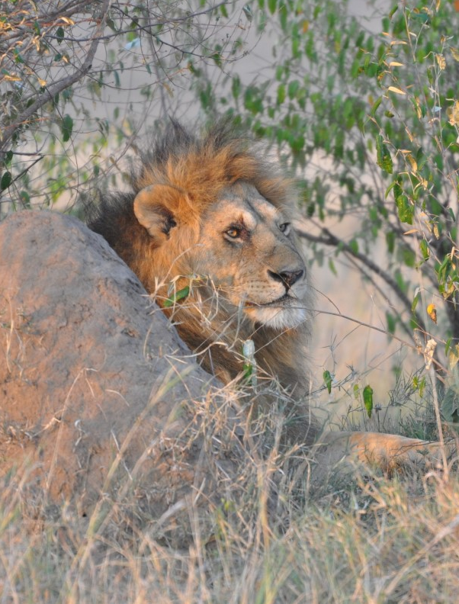

Nairobi Roar
Newsletter of the U.S. Embassy, Nairobi, Kenya
September 16, 2021
Issue 21-35
In This Issue:
Embassy Calendar 2
Embassy Resources 3-4
RSO 5
Embassy Notices 6
Mara Day Article: Conservancy Fees 7-8
Kiswahili Corner 9
GCLO 10-11
CLO & AEA 12-13
Community Pages 14-16
Employment 17
Mission Classifieds 18-25
The Roar Newsletter is distributed only to immediate members of the U.S. Mission to Kenya. Please do not share or forward it to anyone not authorized to receive it. If printed, please shred before disposing.
Roar Editor
NairobiRoar@state.gov
IMPORTANT CONTACT INFO
POST ONE
020-363-6170
0722-204-445
Duty Officer Phone
0722-515-083
Medical On Call
0722-513-323
Maintenance Supervisor
On Call 0724-255-603
Photo Credit: Kevin Chiasson
18
1

Slide 2
CALENDAR
SEPTEMBER/OCTOBER 2021
SUN | MON | TUES | WED | THURS | FRI | SAT
12 | 13 | 14 | 15 | 16 | 17 | 18
19 | 20 | 21 | 22 | 23 | 24 | 25
26 | 27 | 28 | 29 | 30 | 1 | 2 MSG Fitness Challenge 9-10:30am
3 | 4 | 5 | 6 | 7 | 8 | 9
10 | 11 | 12 | 13 | 14 | 15 | 16
Sept 15: NAT’L HISPANIC HERITAGE MONTH
MARA DAY
EFM Coffee
10am – 11am
Oktoberfest!
11am – 3pm
Yom Kippur (Sept 15/16)
Sukkot
(Sept 20 - 22)
CLO Trip: Amani Ya Juu
12pm – 4pm
September Equinox
(10:21pm, Nairobi)
Trivia Night!
6pm-7:30pm
WORLD TOURISM DAY
This week’s Kiswahili Vocabulary
2

Slide 3








EMBASSY RESOURCES
EMBASSY RESOURCES
Nairobi Roar
Nairobi Roar
EMERGENCY
POST ONE: 020-363-6170 or 0722-204-445
RSO: Call Post One
020-363-6170 or 0722-204-445
Duty Officer: 0722-515-083
Main switchboard: 020-363-6000
USAID Main switchboard: 020-862-2000
After Hours Dispatcher: 0728-608-284
Please note that all service hours are subject to change.
Photos & Story by Jill Chiasson
Photos & Story by Jill Chiasson
MISSION KENYA OFFICE HOURS
Official Office Hours: 7:15am to 4:30pm Monday through Thursday with 30 minutes for lunch, and from 7:15am to 12:15pm on Friday.
Please be aware that office hours are subject to further adjustments at any time to meet Mission requirements.
BANKING
Monday-Thursday: 8:30 am-3:30 pm, Friday: 8:00 am- 2:00 pm
TRAVEL
Express Travel Office: 020-363-6229 or 020-363-2415
Emergency Hotlines - after office hours & Airport Office: (open 24 hours): +254 709 195 400
MEDICAL
Med Unit Duty Officer:
0722-513-323
Reception: 020-363-6633 7:15 am - 4:30 pm Email: NairobiHealthUnit@state.gov
Walk –in Hours: M-F, 7:30 – 9:00 am
Mission Kenya AA
Meetings every Wednesday at 7:30 pm,
Rosslyn Ridge
Email: missionkenyaa@gmail.com
BANK HOURS:
UPDATED CASHIER HOURS:
Chancery Lobby
Monday-Wednesday: 8:00 am – 11:00 am & 12:00 pm – 2:00 pm; Thursday:
8:00 am – 1:00 pm; Friday:
8:00 am – 12:30 pm
USAID Annex Lobby
Monday-Tuesday:
8:30 am – 12:00 pm & 1:00 pm – 2:30 pm; Wednesday: 8:30 am – 1:00 pm; Thursday/Friday:
8:00 m – 12:30 pm
CONSULAR SERVICES
Consular Section: General Info: 020-363-6011 The office is closed on all American/Kenyan holidays and the last Wednesday of the month.
American Citizen Services (Mission Personnel): The consular section can process U.S. passport (both official and personal) applications, Consular Reports of Birth Abroad, and provide notarial services for Mission employees and their families. To schedule an appointment for any of these services please email Kenya_ACS@state.gov or call ext. 6451. For specific American Citizen Services questions, please contact ACS Chief Robyn Luffman at LuffmanRN@state.gov.
American Citizen Services (General Public):
Please note that while service appointments have resumed, wait times are extensive. Passport and notarial services are available for the general public here. For Consular Report of a Birth Abroad appointments, email the ACS unit at Kenya_ACS@state.gov. For after-hour emergencies, contact 020-363-6170. For other services, email Kenya_ACS@state.gov.
Non-Immigrant Visa: https://ke.usembassy.gov/visas/
Immigrant/Diversity Visa: https://ke.usembassy.gov/visas/
DHS Citizenship & Immigration Services (CIS):
363-6111; Fax: 363-6103
Mission Personnel Email uscis.nbo.public@uscis.dhs.gov for an appointment. General Public Tues & Thurs: 1:30-3:30 pm; Wed: CLOSED; Fri: 9-11 am
MAINTENANCE
Maintenance Supervisor
During Office Hours: 020-363-6443
After Hours On Call: 0724-255-603
MAIL
Customer Service Hours
Monday- Wednesday: 8am – 4pm; Thursday: 8am – 12pm; Friday: 8am – 12:30pm
Currently there is NO outgoing DPO; outgoing mail pouch only (urgent parcels only).
Updated Hours/Services
UN FUEL STATION
Updated Hours:
Mon-Fri: 7 am-6 pm
Sat-Sun: 9 am–5 pm
Questions about obtaining/renewing a UN fuel sticker? Contact GSO Customs and Shipping: NairobiGSOCustomsAndShipping@state.gov.
3
2

Slide 4





Mission External Facilities
With the current volume of COVID-19 cases in and around Nairobi, we appreciate everyone's cooperation in adhering to the guidelines for use of shared community facilities in order to keep the facilities accessible and safe for all community members. We will continue to run a hybrid system of reservations and free use at all facilities, but have implemented a mask policy for unvaccinated children under 12 on the playgrounds, and all children 6 and under must be supervised at all times by an adult (18+) on residential compounds, including playgrounds and common areas.
We hope these changes will help continue to keep our community safe Pools and playgrounds will remain open without reservation or capacity constraints from Mon-Sat. The current reservation system will be in effect on Sundays only. Tennis courts will still require booking. The Rosslyn Ridge field and basketball court are available for general use on a daily basis without reservation, but if you require the whole field or court for a specific reason, please reach out to CLO to reserve (we’ll add you to that calendar). Access facility calendars via Google calendar.
Please Take Note:
General Rules & Regulations for Facilities:
Outside guests are not permitted at this time to use any shared facilities.
For those days/facilities requiring advance booking, bookings may be made up to 2 weeks in advance. Reservations outside this window will be deleted.
Community members must wear a mask if physical distancing is not possible when using shared indoor facilities.
Do not use the facilities if you are sick.Contact the MED Unit.•In order to avoid vermin and monkey infestation, personnel usingembassy facilities must dispose of food waste in covered trash bins.
When you make a reservation,please be sure to add your reservation to the correct calendar.Google calendar will automatically default to your personal calendar. Make sure you select the appropriatecalendar from the drop-down menu when adding your reservation. To access the calendars for the playground, pools and tennis courts, please use the link below or contact the CLO. Click this link: https://forms.gle/EopRdz2QdSjbR6Wr7let CLO know which Google calendars you want to be invited to (there's a calendar forEACH FACILITY). Be sure to add your reservation to the correccalendar (so it does not default to your personal google calendar).
Swimming Pool Guidelines
Pools will remain open without reservation or capacity constraints from Mon-Sat. The current reservation system will be in effect on Sundays only.
Swimming pools are closed fordailycleaning from 8:00-9:30a.m.•Adult swim (for lap swimming only) at Rosslyn Ridgeis Monday-Friday at 6:00 –8:00 a.m. •Up to 10 people may use the pools at one time on Sundays. Each individual may spend a max of 2 hours at the pools on this day. •There are no capacity limits Monday-Saturday
Adult swim (for lap swimming only) at RR is M-F 6-8am.
Swimming Pools are closed for cleaningfrom 8:00 – 9:30am
Maps: Rosslyn Ridge Pool:https://goo.gl/maps/VLaANE31L2qJnnDf7 R-2 (former CMR) Pool:https://goo.gl/maps/RM9ntvZwU4v6ztWU7 Shanzu Gardens Pool:https://goo.gl/maps/4NgNCrZPwwZa4knj8
Gym Guidelines
The Chancery indoor, outdoor, and USAID gyms are available for all to use by reservation.
Maximum occupancy in the gym is 5 people.Masks must be worn when using the indoor gyms.
Gym showers are reserved for gym users only and due consideration should be shown to fellow users by limiting changing room time use to 15 minutes and showering times to 5 minutes.
Lockers are for gym users only and should not be reserved for long-term individual use.You are permitted to leave a lock fastened only during the time you are using the gym facilities.Locked padlocks will be cut open and any contents discovered will be passed to the CLO Lost and Found to be claimed later.•Americanswould like access to the gym calendars should click here:https://forms.gle/EopRdz2QdSjbR6Wr7
LE Staffwould like access to the gym calendars should click here:https://forms.gle/96YZMfeU7EySixPg8
Gym Cleaning Schedule:
The Chancery indoor gym is closed for cleaning DAILY at the following times: 10:00-11:00 am; and 3:00-4:00pm
The USAID Gym is closed for cleaningat the following times: 7:15 – 8:00am; 10:45 – 11:00am; and 3:00 – 3:45pm
The Chancery Outdoor Gym is closed for cleaningat the following times: 9:00 – 9:30am; and once 1:00 – 1:45pm
GSO/Facilities
Domestic Employee Access to Houses/Compounds:
We recommend house staff with close, continued contact with you or your family (nannies, daily housekeepers, tutors, etc.) live in with you.Suppose you choose not to have house staff live in with you.In that case, we recommend that:
1) you screen house staff by phone as to illness before their arrival (temperature, headache, cough, cold/flu symptoms),
2) they do not use public transportation to and from your residence,
3) they wash hands, or use an alcohol-based hand sanitizer upon arrival,
4) wear a mask, and
5) maintain a minimum 6-foot distance.
We recommend keeping a contact log for all non-family members entering your home.
If you have additional questions, please contact : NairobiGSOWarehouseAdmin@state.gov for property issues or Nairobi FM Team LeadersNairobiFMTeamLeaders@state.gov for facilities issues.
Playground Guidelines
Playgrounds will remain open without reservation or capacity constraints from Mon-Sat. The current reservation system will be in effect on Sundays only.
Effective immediately, kids ages 12 and under must wear a mask covering their nose and mouth at all times while using the playground; it is difficult for younger kids to physically distance in this area.
Up to 10 people may use the playground at one time on Sundays. No capacity limits apply Mon-Sat.
All children aged 6 and under must be accompanied by a responsible adult (18+) at all times.
4

Slide 5


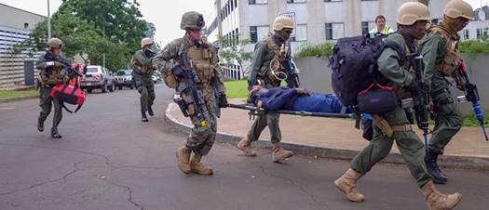

RSO
REMEMBER TO DO YOUR RADIO CHECKS!
RSO Needs YOU! Volunteer today for the 6th Annual Joint Readiness Exercise
Effective August 30th, radio checks may now be conducted 24/7, Monday through Sunday during each zone’s designated week.
POST ONE will notify personnel via email and a SAFE notification when itis their FBO/Zone’s week to conduct radio checks. Radio check response results will be forwarded to the Front Office on Monday mornings following the checks.
Zone 1-Fairfields, Lonetree, Rosslyn Ridge
Zone 2 -Runda, Gigiri, Kiambu Rd., Ruaka Rd.
Zone 3 -Nyari, Imperial Town Houses, Karura Ave, Muthaigi Rd, Ngecha Rd., Thigiri, Red Hill Rd.
Zone 4 –Brookside Lane, Kitisuru, Kyuna, Loresho, Kileleshwa, Riverside, Spring Valley, Shanzu, Lavington.
During your check, simply key the radio and call the MSG at POST ONE, call-sign “Quarter”. Use your FBO number as your call sign. A typical radio check is:
You -“Quarter...Quarter...this is FBO 647, radio check, over”
POSTONE-“FBO 647 this is Quarter, I read you loud and clear, how me? over”
You -“Quarter, you are loud and clear, over and out.”–or—“Quarter, you are weak but readable, out.”
If there are transmission/reception problems, please contact POST ONE at 020-363-6170.
On Saturday October 30th, RSO/ATA/SPEAR is sponsoring the sixth annual Joint Readiness Exercises (JRE) involving RSO staff, MSG’s, the Embassy’s SPEAR team, and other Kenyan first responders. Many of these Kenyan first responders deployed to the DusitD2 Hotel on January 15, 2019 to stop the al-Shabaab attackers and safeguard COM employees and American citizens. The JRE will include realistic simulated explosions, gunfire, and casualties to test our collective ability to respond to future soft target terrorist attacks. Casualties will be evacuated to local hospitals to also test emergency room procedures. They are seeking volunteers willing to serve as role players, including casualties. Volunteers must be willing to commit to up to eight hours of service during the day, at the Embassy and Rosslyn Academy. Box lunches will be provided and all volunteers will receive a SPEAR Certificate of Appreciation. If interested, please contact SPEAR Mentor Nick Teta at TetaN@state.gov with your name, Embassy office, and mobile number.
Radio checks for Zone 1
(Fairfields, Lonetree, Rosslyn Ridge)
NOTE: Zone 1 radio checks may be conducted beginning now through midnight on Sunday, September 19th. Please note that radio check results will be forwarded to the Front Office on Monday morning following the checks.
5

Slide 6



EMBASSY NOTICES
Nairobi Diplomacy Strong Status: Phase 1
COVID-19 VACCINE : 3RD DOSE
CDC states that patients with the following medical conditions should get a third dose:
Been receiving active cancer treatment for tumors or cancers of the blood.
Received an organ transplant and are taking medicine to suppress the immune system.
Received a stem cell transplant within the last two years or are taking medication to suppress the immune system.
Moderate or severe primary immunodeficiency (such as DiGeorge syndrome or Wiskott-Aldrich syndrome).
Advanced or untreated HIV infection.
Active treatment with high-dose corticosteroids or other drugs that may suppress your immune response.
If you have a condition that fits the above criteria, don't hesitate to contact the health unit to schedule an appointment.
Please remember, if you are sick with COVID-19 symptoms (cough, fever, new loss of taste or smell, sore throat, shortness of breath/difficulty breathing, fatigue, muscle aches, headache, congestion/runny nose, nausea/vomiting, or diarrhea), please stay home and call the HU for advice (020 363 6633). You will be triaged by phone and may be asked to come to the tent by the parking lot to get swabbed.
COVID-19 Weekly Snapshot
Note to readers: This chart from the Health Unit is a weekly snapshot of COVID-19 cases directly involving the US Mission. The numbers include US Direct Hires, Eligible Family Members and Locally Engaged Staff. We hope this will provide readers with a good idea of the extent of the C-19 outbreak currently active in our community, as well as from the start of the pandemic to date.
Mission Summary September 8, 2021
 | 104
 | 24
Current positives in home isolation | 1
Current positives hospitalized | 0
Current contacts in quarantine | 0
Total put in quarantine to date | 154
Total put in isolation to date | 99
Total hospitalized to date | 10
Total hospitalized (vaccinated) to date | 1
Total Persons testing positive for COVID-19 to date
Fully vaccinated positives
Please take a moment....
Management requests your participation in a brief Customer Survey. Completing this survey should take just a few minutes of your time, and will allow our team to plan and serve you better.
To date we have received responses from less than half of the mission. It is critical that we get to 100%.
Please complete one survey per household. If you reside in group accommodation (TDY housing or the MSGR, for instance), you do not need to complete this survey.
All personnel currently at post (with the exception of those in shared accommodation) must complete this survey. Many thanks for your participation.
Hail & Farewell
September 16th – September 23rd, 2021
Hails
Julius Johnson (USAID) spouse Ameena, and children Abel, Adam, Mariah and a newborn!
Rachel Weil (DEA)
Daniele Jean-Pierre (USAID)
Matthew McQueen (PolRA) and spouse Catherine
Farewells
 | 3
Total Covid Deaths
None until 9/29
We wish you all the best in your next adventure!
6

Slide 7

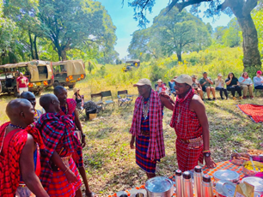


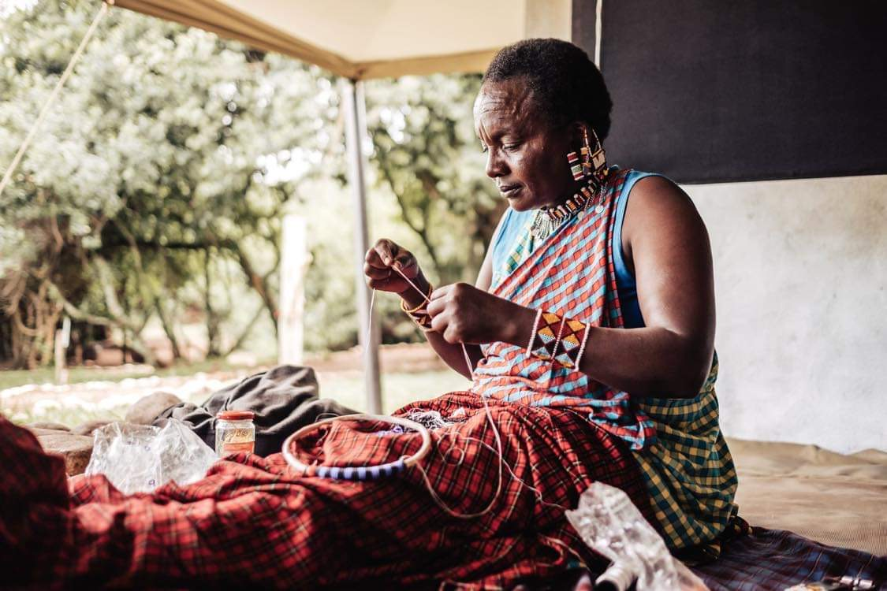
Importance of Conservancy Fees in the Mara
By Diosa Woods
EMBASSY NOTICES
Story written by Jenn Yan, photos contributed with permission by Cottar’s Wildlife Conservation Trust
I was completely overwhelmed by all the different choices when I first started researching places to stay as I considered our family’s first trip to the Mara. As a newcomer, I was more interested in staying inside the Maasai Mara National Reserve because I didn’t want to miss any of the animal action; especially since the Mara is such a huge area to explore. I didn’t really understand the difference between the Maasai National Reserve and the various conservancies that surround it.
The Maasai Mara National Reserve is government supported, which means that the National Reserve still runs even when there are no tourists (such as when tourist numbers were extremely down because of COVID). Conservancies, on the other hand, need tourists or other forms of revenue.
Until recently, I had no idea why I was paying a conservancy fee or where those fees were going. It wasn’t until a chance meeting turned friendship with Calvin Cottar, owner of Cottar’s safaris properties, that I began understanding the differences between National Parks, Reserves and Conservancies. This afternoon I had the opportunity to speak with Doug Braum, manager of Cottar’s Wildlife Conservation Trust (CWCT) , who shared with me even more information.
CWCT, like many others, is a non-profit organization working to conserve critical wilderness, wildlife corridors and areas bordering the Maasai Mara and Serengeti National Reserves. They work to protect biodiversity through empowering communities with wildlife conservation. This means that the per person, per night conservancy fee that you pay when staying at any of their safari properties is used to lease the Olderkesi Conservancy from the Maasai community
Uncontrolled grazing, poaching, slash and burn farming threaten free roaming wildlife and tourism, which is why Calvin Cottar initiated CWCT in 2006, to secure the land around Cottar’s safaris properties for wildlife and tourism.
Most conservancies outside the Maasai Mara National Reserve lease the land as well, but they typically lease land from private land-owners. CWCT leases 7000 acres of communally owned property. Individual plot holders can do as they please, but a one title deed for the entire community ensures that basic needs
such as health care and school fees are covered, benefiting the entire community of people who live on the conservancy. This vision is a difficult one, but one that is most sustainable by paying fair rates that exceed what could be earned by subdividing land with fences, which many of the individual landowners within conservancies do.
7

Slide 8
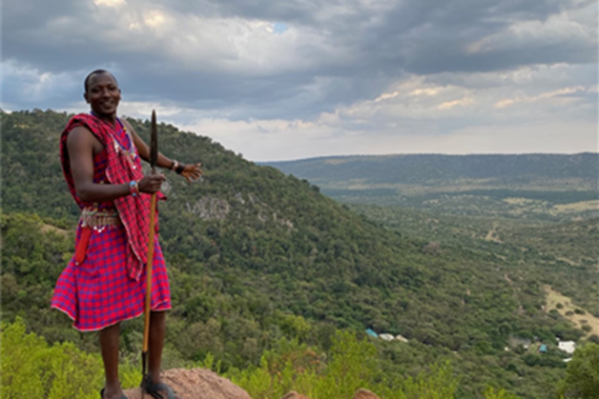




Importance of Conservancy Fees in the Mara (cont’d)
By Diosa Woods
EMBASSY NOTICES
Story written by Jenn Yan, photos contributed with permission by Cottar’s Wildlife Conservation Trust
Wildlife need free space to roam, and the communities also need a place to call home too. By benefiting the entire community (as a whole), rather than a few individual land holders, wildlife have an open-space habitat, and everyone gets an equal share. With monetary benefits and education, communities begin to take on more active roles in protecting their land and wildlife.
The threat to wildlife in the greater Mara ecosystem isn’t just the surrounding landowners. The impact of COVID-19 has caused revenue loss for lease fees for many of these conservancies. Without revenue from tourists, individual landowners might look to more intensive agriculture, pushing out the wildlife. The commitment to these communities by the prompt payment of lease fees is important, and many of these conservation efforts also rely on donor funding, whether it be from the Kenyan government or individual donors.
By booking your stay on one of these local conservancies and paying your per person, per night, conservation fee, you are ensuring that communities are strengthened every step of the way.
Yes, the lions and the leopards and the cheetahs are spectacular, but without a conscious awareness for its future, that magnificent Mara will not be the same in the years to come. So, keep in mind, when visiting facilities in many community-owned conservancies in Kenya, your tourism dollars are put to good use, directly supporting conservation of wildlife and the local community.
Learn More:
Learn more about Cottar’s Wildlife Conservancy Trust: https://cottarswildlifeconservationtrust.org/
Learn more about Masai Mara Wildlife Conservancy Association: https://maraconservancies.org/
Learn more about regional conservancy associations in Kenya: https://kwcakenya.com/regional-associations/
7

Slide 9

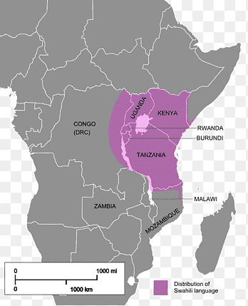



Kiswahili Corner: THE HISTORY OF KISWAHILI IN KENYA
By Diosa Woods
EMBASSY NOTICES
By Mwalimu Rose Nalo
The name Swahili comes from the Arabic word, “Sahil” which means “Coast”. It is a Bantu language but absorbed words from the Arabic, Portuguese, Persian, German, Hindu, and English and is spoken by tens of millions. The Swahili people (or Waswahili) are an ethnic and cultural group inhabiting East Africa. They mainly reside on the Swahili Coast, in an area encompassing the Zanzibar archipelago, coastal Kenya, the Tanzania seaboard, and northern Mozambique. Kiswahili was originally written in the Arabic script.
Kenya is a multilingual country. Kiswahili (used as a lingua franca in Kenya, Tanzania and some parts of the DRC and an official language for the East African community trading bloc) and English are the official languages in Kenya. Kiswahili, which is also the national language of Kenya, was upgraded to official language during the promulgation of the new constitution of Kenya in 2010. Initially, English was the only official language in Kenya. In Tanzania, Kiswahili is widely spoken due to the deliberate efforts that were made by the former head of state, Mwalimu (Teacher) Julius Nyerere to basically unite the Tanzanian people and promote the language in the whole nation. This is what contributed to the Tanzanian perfection in Kiswahili. In Uganda, Kiswahili is mostly spoken in the military, although currently the government introduced it in schools.
So, why did the government of Kenya choose Kiswahili among the over 44 local languages to be the national and official language in the country? This is because Kiswahili is traditionally a business language and trade and migration from the Swahili coast during the nineteenth- century helped spread the language to the interior of particularly Kenya.
For centuries, many people thought that Kiswahili was born in Tanzania, but little
did they know that Kiswahili was born in Kenya and spread to Tanganyika by the Arabs and the native Swahili people and remained as the language for the East African coast. Long time interactions with other people bordering the Indian Ocean spread the Swahili language to distant places, such as on the islands of Comoro and Madagascar and even far beyond to South Africa, Oman, and United Arab Emirates.
One of the key steps in spreading Kiswahili was creating a standard written language. In June 1928, an inter-territorial conference attended by representatives of Kenya, Tanganyika, Uganda, and Zanzibar took place in Mombasa. The Zanzibar dialect was chosen as standard Swahili for those areas, and the standard orthography for Swahili was adopted.
Christian missionaries also helped a lot in the spread of this beautiful language. They used Kiswahili to spread the Gospel in East Africa. German missionary Ludwig Kraft, who travelled to Kenya in 1844, wrote the first dictionary of the Swahili language and translated the Bible into Kiswahili and other languages. Kiswahili was the language used for communication with the local inhabitants during colonial times.
Swahili spread to Tanzania, Uganda, Rwanda, Congo, Central African Republic, and Mozambique. Even today, we still have different stations where the Arabs and the Swahili people used to camp. For example, in Nairobi, we have Shaurimoyo, Starehe, and so on. Initially, these regions were predominantly inhabited by Christians, but the majority converted to Islamic religion during the 19th century.
Kenyans also speak other local languages depending on one’s tribe. For example, if you are a Maasai, the mother tongue or first language is Kimaasai (Maasai language in Kiswahili). Sheng, (Swahili + English) is the Kenyan slang and is
predominantly common among the youth. Sheng is Swahili words peppered with English words, for example “Mjienjoy” (enjoy yourselves), “hawayuni” (how are you all?), TO LIKE can be conjugated as follows in slang; “ninalike” (I like), “unalike” (you like), “analike” (he/she likes), “mama analike” (the mother likes) “tunalike” (we like), “mnalike” (you all like) “wanalike “(they like), “watoto wanalike” (the children like). The proper verb for to LIKE or LOVE in Kiswahili is “KUPENDA”. So, “ninapenda” (I like/love), unapenda (you like/love), ‘anapenda” (he/she likes/loves), “tunapenda” (we like/love), “mnapenda” (you all like/love) and “wanapenda” (they like/love). NI (I), U (YOU), A (HE/SHE), TU (WE), M (YOU ALL), WA (THEY), NA (PRESENT TENSE) and PENDA is like/love. NAKUPENDA (I like/love you) Please note you can Swahililize all verbs the same way.
Children born mostly in the cities like Nairobi speak Kiswahili as their first language and their mother tongue (their tribal language) or English as the second or third language, depending on their families. Most children born in the rural areas speak their mother tongue first and Kiswahili is the second language. English is mostly learned in schools and is the language for instruction in the schools. Kiswahili is one of the subjects taught in schools and the government made it a mandatory subject in all Kenyan schools in 1985.
You, too, can learn to speak it!
7

Slide 10
GCLO Connection Special Edition: Navigating the Virtual Learning Landscape
Academic Resources and Support
GCLO Resources GCLO's Virtual Learning and Homeschooling page provides numerous virtual learning and homeschool resources, as well as recorded webinars focusing on virtual learning. The Office of Overseas Schools The Office of Overseas Schools (OS) is aware of the shifting nature of virtual versus in person learning across the globe. OS completed a survey in mid-August with assisted schools and found that 75 percent of respondents were striving for in-person school. Still, every school had back-up plans and alternative arrangements should they be required to return to virtual. Just in the eight weeks between OS sending two identical surveys, four times more schools said they would have to begin the school year virtually rather than in person.
In an ideal world all schools would be able to open in person and stay open all year. Please know that the schools are monitoring local situations and following the appropriate host country guidance for operating and abiding by guidelines set forth. Determining Adequacy of Schools At Post Adequacy of schools at post is determined after much research and deliberation. It cannot be changed on a quick basis. OS has not determined any schools to be inadequate because of virtual schooling. Please keep in mind schools are delivering the best education as is available. The local context can change rapidly. Just because a school is virtual right now does not mean it will not change. Similarly, boarding schools and public schools in the U.S. also may need to return to virtual status based on local context. Getting Help with Virtual School The first place to go for getting help with virtual schooling is to speak with the school! The schools should be your first stop. If you have trouble connecting with the school or the administration, please reach out to your Regional Education Officer (REO). REOs are happy to make connections. REOs are not experts in the day-to-day managing of virtual learning; however, REOs can connect you to resources on social emotional learning and other supports. Please reach out directly to your REO with your post’s situation to begin a dialogue. Additional Resources and Allowances If you are wondering about allowances for tutoring, boarding schools, Away from Post education allowance, ISMA, VSMA, etc., please reach out to the Office of Allowances with your questions AllowancesO@state.gov.
The Office of Allowances provided several FAQs regarding the virtual learning situation about which so many families have inquired. What is the difference between a “virtual” classroom associated with the school a child attends in person at post and “virtual schooling” under the Home Study/Private Instruction/Virtual Schooling educational method? A virtual classroom associated with a school a child would normally attend in person at post comes under the “School at Post” educational method. “School at Post” education allowance rates are on the Office of Allowances’ internal (Opennet) and external (Internet) websites under “Allowances by Location” and allowable expenses are found in the government-wide Standardized Regulations (maintained by the Department of State and commonly referred to as the DSSR) in DSSR 277.1. Virtual Schooling under the Home Study/Private Instruction/Virtual Schooling educational method is totally online and includes both synchronous (interactive, two-way online education that happens in real-time with a teacher) and asynchronous (prepared resources without real-time teacher-led interaction) instructional delivery. Allowance rates for Virtual Schooling are at DSSR 274.12b and allowable expenses are at DSSR 277.3. Please note, educational methods cannot be combined; a child is under only one educational method at a time – either “At Post”, “Away from Post” or “Home Study/Private Instruction/Virtual Schooling”. If the “school at post” has started the school year with a virtual classroom can my child attend the virtual classroom from any location? Yes, with limitations: (1) The employee has to have arrived at the foreign post of assignment; (2) If the child is in the U.S. and a parent is also in the U.S. an education allowance shall not be paid since the child could go to a U.S. public school free of charge; (3) the child needs to be physically at the post prior to the end of the school year or the employee will be responsible to repay the ‘at post’ education allowance; and (4) transportation to/from wherever the child is attending the virtual classroom is not covered under the ‘at post’ education allowance.
8

Slide 11




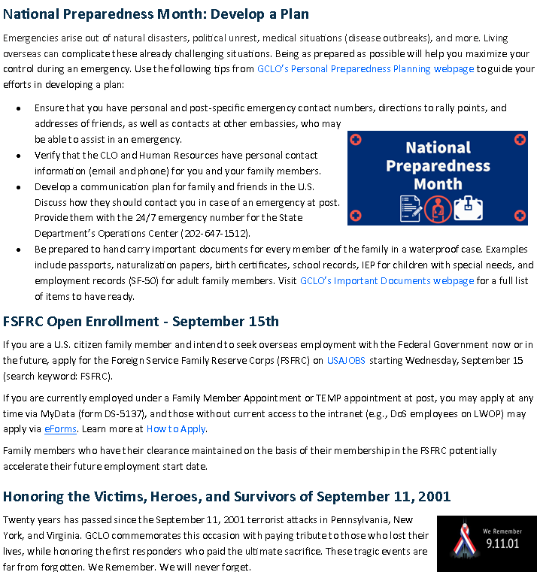
GCLO Weekly Newsletter
September 7, 2021
Call GCLO at 800-440-0397 or 202-647-1076 | Subscribe to GCLO Weekly at eepurl.com/6iYlr
13

Slide 12





CLO & AEA
CLO UPDATES
CLO UPDATES
AEA Community Small Grants Open Season Starts September 15
Time to get creative!
Do you have a good idea to improve life at post but need support? Need seed funding to start up a social activity or club? AEA offers a limited number of small grants of up to $500 to members in support of community-oriented or philanthropic activities. E-mail Association Manager Eric Kivayilu at NairobiAEA@state.gov for an application. Open season ends October 31.
AEA Recycling Bins
Recycling Bins ourtside Rosslyn Ridge accept:
PET Plastic
Metal
Paper/Cardboard
Plastic Containers
X NO GLASS RECYCLING
* Please do not stack glass next to the recycling bins. You may bring your glass recycling to the UN or to the glass recycling station at Shamba.
11
14
11

Slide 13

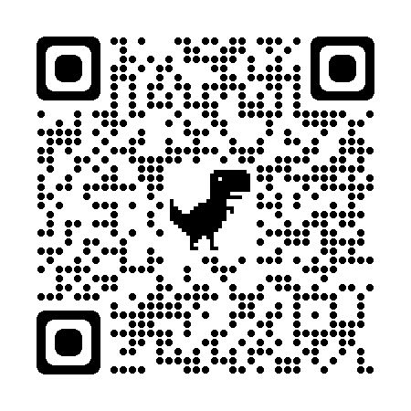
AEA UPDATES
Chancery Commissary / AEA Morale Store
Contact: 020-363-6182 or 020-363-6272 Hours: Mon-Thurs, 8:30 am – 4:30 pm Fri, 8:30 am – 2 pm
Rosslyn Ridge Commissary
Contact: 020-363-6799 Hours: Wed, Thurs & Fri, 11:30 am – 6:30 pm
Sat and Sun,
10:30 am – 5:30 pm
Watering Hole Contact: 0112 145 720 or 0706 311 516 thewateringhole2019@gmail.com
Hours: Tues-Sunday, 10 am – 8:30 pm Closed Monday
*in-person alcohol sales end at 6:45pm- only take-away afterwards.
View the Watering Hole Menu here!
AEA Facebook Group
https://www.facebook.com/groups/274130230857993/
Stay up to date on all AEA, cafeteria and Watering Hole happenings!
New things are coming! Use this QR code to join the AEA Nairobi Facebook Group to get info about commissary updates, new products and Café and Watering Hole food specials!
If you placed a special order and have not yet collected it, please pass by the Rosslyn Ridge commissary.
Check out the new Watering Hole menu!
SEPTEMBER 2021 MENU | Monday | Tuesday | Wednesday | Thursday | Friday
Main Course | Chinese Braised Beef [ginger & soy] Mediterranean Baked Fish w/ Parsley Butter Sauce Boiled Ossobuco w/carrots & spinach Mushroom & Vegetable Patties w/creamy parmesan sauce [gluten, soy] | BBQ Lamb Cubes [dairy] Sp: Taco Tuesday w/pico di gallo, chedar, guac, chicken and beef options as well as hard tacos Chickpea Vegetable nuggets w/a sweet & sour tamarind sauce | Jamaican Jerk Chicken Braised Ossobucco [health option] Oven Grilled Fish Filet (Tillapia or whole deep fried fish w/tartar sauce) Githeri Special Squteed Bean w/Garlic, Sage & tomatoes | Sp: Teriyaki Boneless Chicken Tossed Beef Medalians Vegan Rice Paper Rolls w/siracha & soy [soy] | Kenyan Mbuzi Choma w/Kachumbari Tossed Chicken Wings Palak Paneer
Accompaniments | Jeweled Fried Rice Ugali Roasted Butternut infused with Fresh Garlic Rosemary Oven-Roasted Ratatouille [eggplant, onions, bell peppers, basil, thyme, zucchini, soy, garlic, ginger] | BBQ Corn on the Cob w/a chili & lime butter Sweet Garden Pea Rise Tossed Market Vegetables | Onion Fried Rice Ugali Paprika Potaqto Wedges Tossed Market Veggies | Steamed Rice Mashed Potatoes Tossed Mange-tout (French beans & julienne carrots) | Vegetable Biriyani Rice Ugali Kachumbari
Soup of the Day | Pumpkin | Cream of Spinach | Carrot & Ginger | Creamy Vegetables | Cauliflower
Smoothies now Available!
12

Slide 14


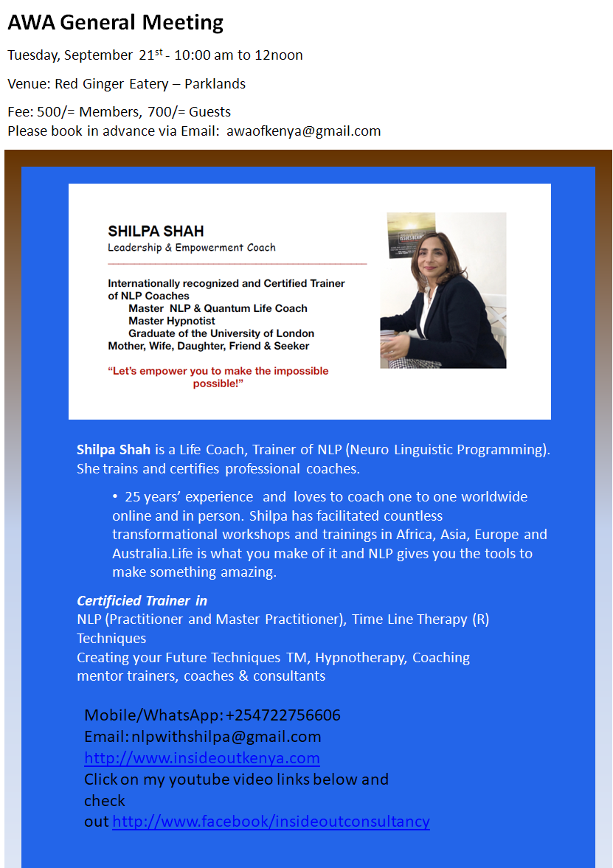
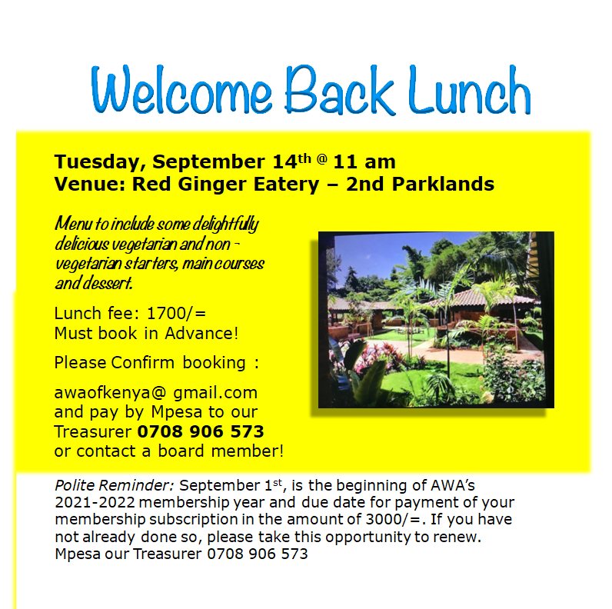


14

Slide 15

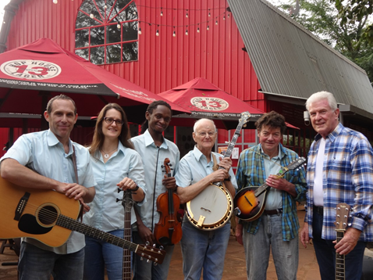


Nairobi’s only bluegrass band, The Elephant Grass Musical Chairs, will be playing (again, outside) at Shamba in Loresho on October 2, from 2pm. Featuring Tom Wolf on the 5-string banjo, the group specializes in fast-paced instrumentals and harmony singing. Feel free to bring your own lawn (not “musical”!) chairs if you want to control your own ‘social distance’.. And whether or not you can come, if you’re a bluegrass picker do make yourself known, as we can always use more band members.
For more information about the above or booking us for any future event, contact Tom Wolf: tpwolf1944@gmail.com / 0733-637023
14

Slide 16





Looking for something to do
with your beautiful
African fabric?
Sewing class is
back in
session!
Now offering Saturday AM quilting class too! Sign up today for either virtual or in-person instruction (outdoors) in Runda.
Contact Diosa on WhatsApp: 0746 966 323, or visit www.deladiosa.com
15

Slide 17

EMPLOYMENT
Current Vacancies
Questions? Reach out to NairobiHRAmericanServices@state.gov
Position Title: Pay Controls Assistant (FMC) - In-house Applicants Only
Announcement Number: Nairobi-2021-067
Series/Grade: FSN-08; FP-6
Clearance: Local Security Certification Hours: Full Time, 40 hours per week
Closing Date: 09/17/2021
For more information or to apply, visit the ERA website: https://erajobs.state.gov/dos-era/ken/vacancysearch/searchVacancies.hms
Position Title: Cashier
Announcement NumberNairobi-2021-054
Series/Grade: FSN – 0415
Clearance: Local Security Certification Hours: Full Time, 40 hours per week
Closing Date: 09/24/2021
For more information or to apply, visit the ERA website: https://erajobs.state.gov/dos-era/ken/vacancysearch/searchVacancies.hms
Position Title: Chauffeur (GSO) - In-house Applicants Only
Announcement Number: Nairobi-2021-061
Series/Grade: FSN 1015-04; FP-AA
Clearance: Top Secret Hours: Full Time, 40 hours per week
Closing Date: 09/20/2021
For more information or to apply, visit the ERA website: https://erajobs.state.gov/dos-era/ken/vacancysearch/searchVacancies.hms
Position Title: CCN PSC Project Management Specialist (Social Protection and HES Dreams)
Solicitation Number: 21-68
Series/Grade: FSN-PSC 11
Clearance: Local Security Certification Hours: Full Time, 40 hours per week
Closing Date: 9/22/2021
(4:30 pm East Africa time)
For more information or to apply, visit www.myjobsinkenya.com/usaid
Position Title: CCN PSC Project Management Specialist (HIV)–Field Epidemiologist
Solicitation Number: 21-66
Series/Grade: FSN-PSC 11
Clearance: Local Security Certification Hours: Full Time, 40 hours per week
Closing Date: 9/22/2021
(4:30 pm East Africa time)
For more information or to apply, visit www.myjobsinkenya.com/usaid
Position Title: CCN PSC Project Management Specialist (Biodiversity and Policy) Solicitation Number: 21-109
Series/Grade: FSN-PSC 12
Clearance: Embassy Security Certification Hours: Full Time, 40 hours per week
Closing Date: 9/28/2021
(4:30 pm East Africa time)
For more information or to apply, visit www.myjobsinkenya.com/usaid
Position Title: CCN Human Resources Assistant
Solicitation Number: 21-141
Series/Grade: FSN-PSC 11
Clearance: Local Security Certification Hours: Full Time, 40 hours per week
Closing Date: 9/23/2021
(4:30 pm East Africa time)
For more information or to apply, visit www.myjobsinkenya.com/usaid
Position Title:CCN PCS Project Management Specialist (BHA – Somalia)
Solicitation Number: 21-129
Series/Grade: FSN-PSC11
Clearance: Local & Embassy Security Certification Hours: Full Time, 40 hours per week
Closing Date: 10/19/2021
(4:30 pm East Africa time)
For more information or to apply, visit www.myjobsinkenya.com/usaid
Please Note: Given the current situation, as and when interviews are scheduled, they may be conducted remotely for ALL candidates for a specific position. *Closing dates are written Month/Day/Year.
16

Slide 18
FLO and the bureau of Global Talent Management Talent Services (GTM/TS) created an informative video to assist in the application process. Get more details and prepare for open enrollment by visiting FLO’s FSFRC webpage.
Please direct any questions that you may have to FSFRC@state.gov.
Upon acceptance to the FSFRC, AEFMs are appointed into a position without compensation or benefits, allowing the Department of State to improve efficiency in the hiring process when filling positions at posts abroad.
FLO and the bureau of Global Talent Management Talent Services (GTM/TS) created an informative video to assist in the application process. Get more details and prepare for open enrollment by visiting FLO’s FSFRC webpage.
Please direct any questions that you may have to FSFRC@state.gov.
Upon acceptance to the FSFRC, AEFMs are appointed into a position without compensation or benefits, allowing the Department of State to improve efficiency in the hiring process when filling positions at posts abroad.
FLO and the bureau of Global Talent Management Talent Services (GTM/TS) created an informative video to assist in the application process. Get more details and prepare for open enrollment by visiting FLO’s FSFRC webpage.
Please direct any questions that you may have to FSFRC@state.gov.
Upon acceptance to the FSFRC, AEFMs are appointed into a position without compensation or benefits, allowing the Department of State to improve efficiency in the hiring process when filling positions at posts abroad.
FLO and the bureau of Global Talent Management Talent Services (GTM/TS) created an informative video to assist in the application process. Get more details and prepare for open enrollment by visiting FLO’s FSFRC webpage.
Please direct any questions that you may have to FSFRC@state.gov.
Upon acceptance to the FSFRC, AEFMs are appointed into a position without compensation or benefits, allowing the Department of State to improve efficiency in the hiring process when filling positions at posts abroad.
FLO and the bureau of Global Talent Management Talent Services (GTM/TS) created an informative video to assist in the application process. Get more details and prepare for open enrollment by visiting FLO’s FSFRC webpage.
Please direct any questions that you may have to FSFRC@state.gov.
Upon acceptance to the FSFRC, AEFMs are appointed into a position without compensation or benefits, allowing the Department of State to improve efficiency in the hiring process when filling positions at posts abroad.
FLO and the bureau of Global Talent Management Talent Services (GTM/TS) created an informative video to assist in the application process. Get more details and prepare for open enrollment by visiting FLO’s FSFRC webpage.
Please direct any questions that you may have to FSFRC@state.gov.
Upon acceptance to the FSFRC, AEFMs are appointed into a position without compensation or benefits, allowing the Department of State to improve efficiency in the hiring process when filling positions at posts abroad.
FLO and the bureau of Global Talent Management Talent Services (GTM/TS) created an informative video to assist in the application process. Get more details and prepare for open enrollment by visiting FLO’s FSFRC webpage.
Please direct any questions that you may have to FSFRC@state.gov.
Upon acceptance to the FSFRC, AEFMs are appointed into a position without compensation or benefits, allowing the Department of State to improve efficiency in the hiring process when filling positions at posts abroad.
FLO and the bureau of Global Talent Management Talent Services (GTM/TS) created an informative video to assist in the application process. Get more details and prepare for open enrollment by visiting FLO’s FSFRC webpage.
Please direct any questions that you may have to FSFRC@state.gov.
CLASSIFIEDS
DOMESTIC EMPLOYEES
Cook/Housekeeper: I highly recommend Lydiah Gitau for FT/PT cook/housecleaner. In short, I can honestly say she was the best cook/housecleaner we have had in 16 years (five different posts). We have been extremely impressed with her work ethic, her proactiveness, her cooking skills and ability to always keep our house spotless. Please contact her directly at 0721-784-661, and if you would like any further information, please contact me, Stephen Fitzpatrick, at stepfitz4@gmail.com. (4)
Nanny/Cook/Housekeeper: Agnes Wangari Mweru is an exceptional nanny, cook, and housekeeper. She provided childcare four our two children for nearly four years. As a housekeeper, she kept the house very tidy and clean. She attended a cooking course and cooked meals for the family. She is kind, positive, and a good communicator. She has worked on Rosslyn Ridge for two families over six years. She can be reached at +254 729 348 597. Contact Molly Byrne with questions mollyhbyrne@gmail.com (4)
Nanny/House Manager: Catherine Nzioka is an exceptional nanny and house manager. She provided childcare for our two children over a two-year period. As a house manager, she was an incredible self-starter who worked quickly and efficiently. She took exceptional care of our home and dog. She has worked on Rosslyn Ridge for multiple families. She can be reached at +254 078174386. Contact Molly Byrne with questions mollyhbyrne@gmail.com
Housekeeper: Grace Njema is an excellent (badged) housekeeper. I give her very little direction and she always goes above and beyond. Employed with me for 6 months she works for me 3 days a week and is looking for more work on the other
days. Grace is dependable, honest, and is hygiene conscious including leaving shoes at the door, masks, and consistent handwashing. She cooks, cleans, does laundry, and irons. She is also available for babysitting. Contact Grace at +254 723 889 336. Ref: Garrett Garza at +254 729 629 689. (4)
Housekeeper: Rose Mutasia has been our housekeeper for the past two years and has been employed by embassy families for 8 Years. Rose is an extremely hard worker, very reliable, trustworthy, keeps the house spotless, is self directed and can shop, run errands and cook. Rose is RSO cleared and takes Covid very seriously. Please contact Rose at 0723 465 512. If you have any questions feel free to call me (Diane Jones) at 0705154592. (4)
Housekeeper/Cook: Brenda Otunga worked for our family for 2 yrs. Hard-working, never missed a day of work,
kind-hearted, and good natured. Took good care of our family and little dog. A self-starter, she doesn’t need much supervision. Cleans, does laundry, irons well. Makes SE Asian food and can also cook Western and Kenyan food. Ready to start her new job
immediately. Prefers live-out. RSO Cleared. Contact her (whatsapp or call) + +254 705 955203. Ref: Zarina Chanmugam ranazarina@gmail.com, 0711888387. (4)
Housekeeper: Rose Muliolo has worked for CDC and State families for several years. She cleans, cooks, and is happy to learn new skills. Rose can be reached at 0714 064 129.
Reference: Simon Hankinson at ext.6037.
Housekeeper/Nanny: Angelina Mawaka worked for me for 4 yrs & 22 yrs between two other expat families which speaks to her stability & trustworthiness. She is excellent
NANNIES/HOUSEKEEPERS/COOKS
Fully vaccinated and badged housekeeper available Tuesdays and Thursdays. Lucy Waweru is an excellent housekeeper who can cook as well. We used her twice a week and everything is always perfect when she leaves. She has worked for Embassy families for years and can help with kids occasionally if needed.
Contact danielrhicks@msn.com if you are interested.
Housekeeper/Nanny: Nancy Nganga has 15+ years of experience with American families and an impressive portfolio of recommendations. She has worked as a nanny and housekeeper and is known for her energetic personality and ability to engage with with kids — whether trampoline jumping, hide & seek, reading books, etc. Nancy can also do overtime shifts, dog-sitting and other tasks. She is RSO-badged and available now F/T (live-in or live-out). (2)
Contact Nancy at 0724-886-493.
Nanny/Housekeeper: Jane Kamau- outstanding nanny/housekeeper! Experience w/newborns, twins, all ages. Good balance of love, structure, and discipline. Trustworthy and level-headed. Exercised good judgement. Works very hard. Takes direction well. Our house was spotless. Made healthy snacks, and was available for errands and babysitting on weekends. Reliable, direct, reasonable. Contact Jane directly at +254 723 869908
Reference: Abby Townsend(4) Abzergaila@gmail.com
17
Join the FLO Team - Communications and Outreach Officer Vacancy Announcement
If you are in the DC area or will be soon, you may consider applying for the FLO Communications and Outreach Officer (GS-12) position. The incumbent for this position serves as the team lead, reports to the Division Chief, and is responsible for management of the Communications and Outreach portfolio in FLO. This includes developing and implementing new communication and outreach strategies and plans, content development and management for all platforms, and program evaluation. The incumbent advises FLO management on the best means to communicate with FLO’s diverse worldwide client base. The position is located in Washington DC, and may require some travel. The application deadline is 11:59 p.m. EDT, June 1.
Expeditious Naturalization of Foreign-Born Spouses
FLO worksU.S. Citizenship and Immigration Services (USCIS) to help U.S. Department of State foreign-born spouses navigate the naturalization process.319(b) naturalization, spouses do not need to meet residency requirements and may be eligible to apply for naturalization immediately after obtaining Lawful Permanent Resident (LPR) status. FLO’s assistance is limited to Department of State spouses.agency spouses should contact their respective Human Resources offices for possible assistance with 319(b) naturalization.liaisons with questions regarding the process may reach out toFLOAskNaturalization@state.govguidance.more information visitFLO’s Naturalization of Foreign-Born Spouses webpage.
AP vs. IB - A Practical Comparison for Your Child’s Education
The task of choosing between schools offering different educational objectives with long-term impact can present a challenge for Foreign Service families. This is the case when families are presented with the choice of Advanced Placement (AP) or International Baccalaureate (IB) coursework. Inpastof The Foreign Service Journal, FLOKristen, a featured college preparation speaker at conferences in the United States and abroad, explore some of the most frequently asked AP vs. IB questions.Read the online articlelearn how both programs offer strong preparation for higher university education - with differing approaches.
￼
￼
￼￼
￼
￼
￼
￼
￼
￼
￼
￼
￼
F￼
￼
￼
￼
￼￼
￼
￼
￼
￼￼
￼
￼
￼
￼
￼
￼
￼
￼
￼
￼
￼
￼
￼
￼

Slide 19

CLASSIFIEDS
DOMESTIC EMPLOYEES (CONT.)
Housekeeper: Elizabeth Wamaitha Njoroge has been our housekeeper for the past 6 yrs. She’s punctual, meticulous and works without supervision (after you explain what you want done). Can also prep food and has training to work as server at your events. Trustworthy with your house and belongings, pets and children. Can clean, cook, and do laundry/ironing. Available to work Tues/Thurs. (and weekend events). Contact Elizabeth, +254 726 136 455 (WhatsApp) or
Elizabethwamaithan@gmail.com. Ref: Patricia Bacchi, patricia.bacchi@otatreas.us.
Housekeeper: Grace Kamau (Zitoon) has been working for us as a housekeeper/cook and we have been extremely pleased with her honesty, work ethic, and eagerness to learn. Cleans, does laundry, grocery shopping, and cooks Kenyan and Indian dishes. Speaks good English. RSO badge pending (interview date is 6/15). We highly recommend her! Available after June 17th. Ref: Ghazi Mehmood at gm0895nbo@yahoo.com, or contact Grace directly at 0922851093.
Nanny/Housekeeper: Hellen Aduvaga is a DREAM! She is a self-starter, efficient, thorough, and drama free. We have 3 young boys and they all adore her. She is patient and kind, yet firm when needed. She requires minimal direction and always has a positive attitude. I truly do not know what I would have without Hellen! She is willing to live-in and has done so throughout COVID. Embassy badged. Available now. Hellen +254-798-530-350, Reference: Mary Boese - maryeboese@yahoo.com.
Housekeeper/Cook: Florence Syokau Kiswii is a housekeeper who
previously worked for a U.S. Embassy Nairobi family until the summer of 2020 when the family departed Kenya. She can cook and clean and is very trustworthy. She is available for work full- or part-time. Reach Florence at +254720590990. Ref: Kavita Kannan Kannan.kavita@gmail.com.
Gardener: Samson Munambi has been maintaining our TDY yard since 2010 and has done a tremendous job during his tenure. He maintains every aspect of our outdoor yard and notifies us of anything requiring maintenance in the timeliest of manners. Samson is thorough, reliable and trustworthy. Holds valid RSO badge, looking for full-time employment. Contact Samson at +254 788 402 802. Reference, Chad Thomas at EXT: 6522, or ThomasCC@state.gov.
Housekeeper/Cook/Pet Sitter: Maurine John is an excellent housekeeper who also cooks, shops, and pet-sits. I am her first Embassy employer, but she previously worked for Indian diplomats. She follows instructions well and is reliable and trustworthy. When she pet-sits, she send photos daily so I am confident in my cat’s happiness. She is available for work 2-3 days a week and is RSO-badged. Reach Maurine at +254738095620. Ref: Kavita Kannan, kannan.kavita@gmail.com.
Housekeeper/Cook/Pet Sitter: Maurine John is an excellent housekeeper who also cooks, shops, and pet-sits. I am her first Embassy employer, but she previously worked for Indian diplomats. She follows instructions well and is reliable and trustworthy. When she pet-sits, she send photos daily so I am confident in my cat’s happiness. She is available for work 2-3 days a week and is RSO-badged. Reach Maurine at +254738095620. Ref: Kavita Kannan, kannan.kavita@gmail.com.
with pets & kids. She handled cleaning, laundry, shopping, & cooking. She also stayed with my kids when I was out of the country, handled minor emergencies & kept me informed. I could always count on her to be at work. She helped alleviate much of the stress of being at post as a single parent. Call Angelina at 0722780977. For reference WhatsApp +1865 801-7626, or Kayle.Prince@gmail.com. (4)
Gardener/Housekeeper: Patrick Isalamba was our favorite former security guard, always greeted us with a smile. He’s now looking for a position in line with his experience Please contact Mark Harlan: markdavidharlan@gmail.com or +1-202-644-3852. (4)
Housekeeper (P/T): Catherine Omwamba is available for work 2 - 3 days a week. She is my housekeeper 3 days a week but needs more work. Catherine is dependable and honest and has experience cleaning, doing laundry, ironing, shopping for groceries, caring for children, and dealing with Embassy staff for home repairs. She has worked for Embassy families for 15 years and is RSO Badged. Contact Catherine at 0726 895 649. Ref: Diana Fernandez at 0797 549 033. (4)
Babysitter/Tutor: Beatrice Thinwa has tutored my kids and is both patient and smart. She offers babysitting, homeschooling, and tutoring services for kids age 4-16. Contact Beatrice, +254 717 676 039 or wangarithinwa@gmail.com. Reference: Annette Smith, +254 0758 696 888. (4)
18

Slide 20



CLASSIFIEDS
DOMESTIC EMPLOYEES
(CONT.)
Nanny/Housekeeper: Jane Lucy Kamau- outstanding nanny/ housekeeper! Experience w/ newborns, twins, all ages. Good balance of love, structure, and discipline. Trustworthy and level--headed. Exercised good judgement. Works very hard. Takes direction well. Our house was spotless. Made healthy snacks, and was available for errands and babysitting on weekends. Reliable, direct, reasonable. Contact Jane, +254 723 869908. Ref: Abby Townsend, Abzergaila@gmail.com.
Housekeeper/Nanny/Pet-Sitter: Eunice Omondi Owiti is available for full-time nanny/housekeeping work starting in early July. She’s a quick learner, a problem-solver, a pro withthe iron, and she never passes up a good game of hide-and-seek or a trip to the pool with the kiddos. She's also a great pet-caretaker and dog-walker. Please contact her at +254 721 832 567 or email Sarah Kraegel at sarah.lynn.smith1@gmail.com.
Housekeeper: Phieta King'oo beautifully managed our busy household for the last 3 yrs. Cleans, does laundry, shops for groceries, washes fruits/veg, cooks on request, and generally takes care of the many details we miss. Extremely hard-working and trustworthy, has stayed with our children for a weekend on occasion. Knows how to get things done, worked for USG families for a decade+. RSO-cleared. Ref: Heather Schildge, hschildge@aol.com or 0746510772 (WhatsApp); contact Phieta directly at 0720405908. -headed. Exercised good judgement. Works very hard. Takes direction well. Our house was spotless. Made healthy snacks, and was available for errands and babysitting on weekends. Reliable, direct, reasonable. Contact Jane, +254 723 869908. Ref: Abby Townsend, Abzergaila@gmail.com
Housekeeper (Part Time): Grace Njeri is the ultimate low-maintenance, high-performing housekeeper. Takes care of all of our inside cleaning needs, including laundry/ironing, and wonderful with pet care. Organizes vegetable delivery from local markets and manages other admin tasks as requested. Extremely trustworthy & reliable– watches our dogs when we go away. Prefers work in Spring Valley/Shanzu area; available Tues/Thur. RSO cleared. Reach her at 0726 997 140. Ref: Jennifer Wilson gdcollierwilson@gmail.com
Housekeeper: Agnes Nambuye Burare is available for full-time work. Very detailed with housework, punctual, self-organized and incredibly conscious of good hygiene. Established day/week/month cleaning routines that worked around our schedule. Reliable, honest and responsible. Open to feedback and offers helpful advice to take care of our space. An excellent housekeeper. Contact her on WhatsApp at: +254 710 154063. Reference, Tina Byenkya at abyenkya@usaid.gov
Housekeeper: Recommended with pleasure, Jenniffer Mukonyo Mwangangi, full or part-time. Jenniffer is a meticulous cleaner, does laundry, irons and folds clothes, and takes up other tasks at her own initiative. She has served Americans for years, and she cooks American and local dishes. She does shopping as directed. And she is willing to tend to children. Please phone Jenniffer 07 10 820 722. Reference, Maarit Alvarez 011 490 40 79.
Housekeeper/Nanny/Cook: Trustworthy & happy house help! Catherine Thanga has 22 yrs with COM families. We’ve employed Catherine for 3 yrs & trust her character; she is part of our family.
Housekeeper/Cook: Moses Angehi Elegerizoa hard-working, honest, caring and professional house worker available immediately for fulltime or part-time work. Completely
trustworthy! He has a long history of working for many COM families, with many letters of recommendations. Available immediately for full or part-time work. Contact Moses @ 0721540548 / 0112611757, Ref: Christian Leighton at calmma97@gmail.com
Nanny/Housekeeper: Emily Omondi's been the glue that kept our home running this tour. Fantastic with our school-aged sons, created a warm and nurturing environment. Kept our home immaculate and organized, excellent with meal prep, cared for dogs. Extremely observant, well-briefed on COVID, minimizes risks. We’re truly sad to part ways. RSO-badged, available May/June. Previously worked for UN families. Contact Emily, 0724 459 471 Reference, Cherisse Wilson, wilsontravel2018@gmail.com.
Housekeeper/Cook/Gardener: My domestic staff, Janet Momanyi is outstanding and available for work 2-3 days a week. Janet has taken great care of me and the house the last 4+
years. She does it all: cooks, cleans, cloths, shopping, Zuku internet, and yard/gardening. Janet knows the Embassy GSO/housing team well for home repairs. RSO Badged. I’d really like for her to get more experience (hopefully open future opportunities). Contact Janet, 0704.025.553. Ref: Doug Shaffer (ShafferDN@state.gov; 0729.982.785
19

Slide 21

CLASSIFIEDS
DOMESTIC EMPLOYEES
(CONT.)
rooms. Available days are Mon– Thur. She can be contact at: 0729079343. Ref. Keith Eblamo, keith.eblamo@yahoo.com.
Housekeeper/Cook/Nanny: Winny Chonelwa is a hard-working, honest, caring and professional domestic employee available immediately for fulltime or part-time work. Recently worked for a COM
family who relocated, meticulously
maintaining a large home and performing a wide range of cooking duties including minor grocery shopping. Dedicated and willing to live in if required. Contact Winny, +254714144706 (she can provide professional reference letter from last employer); personal reference Jon Foster, fosterusmc@hotmail.com.
Nanny/Housekeeper: Sheila Kaleha was a wonderful nanny to our 4yr old boy for 2 years. She kept our house clean, cooked excellent meals, and was great with our 75lb dog. She is honest, fun, hardworking, and an all-around special person. She has worked for USG families for 8 years and Indian families before that. She is RSO cleared, available full time. Contact Sheila at +254 713-215-800 (also on whatsapp). Reference, Maria Lantz, maria.placht@gmail.com; 202-725-2038.
Nanny/Housekeeper: Teresia (“Terry”) Wairimu is the best nanny ever! Far exceeded our expectations and made a lifelong impact to our home and lives of our children. Self-motivated, reliable, innovative, and warm. She helped our 2-yr old learn her letters & numbers, toilet train and how to compete daily tasks around the house. She is EXCELLENT with our older children as well. Terry is an exemplary employee who gives her best and is passionate about her work. Contact Terry, 0722989518. Reference, Michelle Pekins, msdickson84@gmail.com.
Housekeeper/Nanny Angelina Mawaka worked for me for 4 yrs & 22 yrs between two other expat families which speaks to her stability & trustworthiness. She is excellent with pets & kids. She handled cleaning, laundry, shopping, & cooking. She also stayed with my kids when I was out of the country, handled minor emergencies & kept me informed. I could always count on her to be at work. She helped alleviate much of the stress of being at post as a single parent. Call Angelina at 0722780977. For reference WhatsApp +1865 801-7626, or Kayle.Prince@gmail.com.
COOK Chris Khayega is available as a cook beginning June. His specialties are spaghetti & meatballs, chicken, and Ethiopian cuisine, but he easily follows any recipe you share and is comfortable with gluten free preparations. Chris also does our weekly shopping with ease and manages guard food. He is always smiling and happy to work! Contact Laurie Markle lauriemarkle@gmail.com for recommendation & to be connected.
Wonderful with kids for babysitting, helps them stay on task for school, helps with animals, food prep & recipes, too. Worked with Americans for a long time so she understands the culture. RSO badged, live-out. Available July 2021. Contact Catherine, 0723353465. Reference, Susan Munz, 0711893238.
Housekeeper: Dorine Ragot has provided house care services for us since last yr. She has been employed by Embassy personnel for many years; highly recommended by families. She has an outstanding work ethic; goes above and beyond. She is
trustworthy, attentive, and reliable. Her duties/responsibilities includes sweep/mop, laundry, and upkeep of rooms. Available days are Mon– Thur. She can be contact at: 0729079343. Ref. Keith Eblamo, keith.eblamo@yahoo.com.
Housekeeper/Cook/Nanny: Winny Chonelwa is a hard-working, honest, caring and professional domestic employee available immediately for fulltime or part-time work. Recently worked for a COM
family who relocated, meticulously maintaining a large home and performing a wide range of cooking duties including minor grocery shopping. Dedicated and willing to live in if required. Contact Winny, +254714144706 (she can provide professional reference letter from last employer); personal reference Jon Foster, fosterusmc@hotmail.com.
Housekeeper: Dorine Ragot has provided house care services for us since last yr. She has been employed by Embassy personnel for many years; highly recommended by families. She has an outstanding work ethic; goes above and beyond. She is
trustworthy, attentive, and reliable. Her duties/responsibilities includes sweep/mop, laundry, and upkeep of
The ROAR makes a conscientious effort to accept domestic staff advertisements for those who have parted in good standing with their American employers. It is the responsibility of the hiring individual to make certain that the prospective employee has positive references from their prior employer. It is always best policy to contact as many of the referencing previous employers as possible. If there is a break between positions that cannot be explained, be suspicious and do your research. Background checks from FSNI/RSO are required for domestic staff. Contact the FSNI office to initiate the process: call 020 3636 295 or email NairobiRSOFSNI@state.gov, or visit the FSNI office located on the second floor of the chancery building.
20

Slide 22

CLASSIFIEDS
DOMESTIC EMPLOYEES
(CONT.)
Claude can be reached at 0707703973. We are happy to answer any questions at atieno.taraz@gmail.com (Atieno or Taraz Samandari).
Driver: Reliable, safe driver. Jake Ayiro has driven for several EMB families, now looking for a new position. He is smart, reliable, and safe. Reach him at 0723511044. Reference: Heath Bailey (Nairobi ’15-’17) baileydh@state.gov / dheathbailey@gmail.com, +1(702)430-1919.
Gardener: John Momanyi has been my part-time gardener (two days a week) since I arrived to post last July. He has many years of experience working for the Embassy community. John is punctual, courteous, and attentive to your outdoor wants. He has managed our
very large yard keeping it tidy and clean; in addition to keeping our vehicle spotless. John is registered with the U.S. Embassy RSO. Contact John on 0701-388-231. Personal
reference: Doresa Robinson, RobinsonDT1@state.gov.
Driver with own vehicles: New to post without a vehicle? Don’t feel like taking on Kenyan roads yourself? Robert Kimumu has his own vehicles (large and small), is a safe driver, and is wonderful with kids. He is great for bringing people around Nairobi for errands or airport runs. He drove “the bus” of kids from Rosslyn Ridge to Lasona Preschool in 2019 and then drove our pod teacher this past year. He can be reached at 0721-248-502. Contact Stephen Law at stephenlaw@gmail.com for any questions or more information.
Gardener/Driver/Pet Sitter: Jackson Koiyange takes great care of our huge plot of plants, grass & big veggie garden! Former prof truck driver & extremely safe. Washes car weekly. Loves pets & took care of our
dog for 6 mo while we were on AD! Responsible, trustworthy & takes
pride in his work. Prefers to live in & has own equipment/housing items. RSO-badged. Available late June, but we are flexible. Contact him @ 0726 759 420. Ref: Daniel Gaines at rdanielgaines@gmail.com.
Gardener/Driver: James Omondi is a great gardener and a safe driver. He previously worked for an embassy couple from Aug 2018 to March 2020. Has a current Kenyan license. He’s dedicated and diligent, eager to help and will work weekends. Available 1 May 2021. Contact James, 0724-771-903, jamesonomondi@gmail.com. Ref: Helen Pace, apple.pace@gmail.com.
Gardener (P/T): If you need a P/T gardener I highly recommend John Mugwe. John has been working for us part-time for two years and over ten years for other Embassy families. John is available on T/W/F (we’re flexible if you need him other days). John is a hard worker, responsible, kind, and honest. He’s never missed a day, never been late, and keeps the yard looking great! John is badged and RSO cleared. If you need more info, please contact tatiana.pak@gmail.com or John directly 0720746620.
Driver (Full or Part Time): Fredrick Shanda Mwosh has been driving for COM staff for many years. Flexible and reliable to meet your needs, whether daily or on demand, errands in town or for road trips across Kenya. He can either drive your car or can organize a hired car. Extremely kind, friendly and low-drama -- excellent with children and pets (he has taken our pets to the vet on his own many times). RSO cleared. Reach him at 0721 981 079. Ref: Jennifer Wilson, gdcollierwilson@gmail.com.
GARDNERS/DRIVERS
Gardner/Handyman/Driver:
Collins Idage does it all. Honest, professional, energetic, and highly skilled. Available up to three days a week starting in September. (We depart Post in late September.)He does amazing work, has worked for Embassy families for years, and is cleared by RSO / has a badge. He has a wide range of skills and has made us a flower bed and vertical garden from our HHE shipment wood. I showed him a youtube video of what I wanted and he did it perfectly. He has a valid driver's license and can work as a driver/garden based on your needs. COVID precautions: He bikes to work, and he just received his first dose of the astrazeneca vaccine and will be fully vaccinated soon. You can contact Collins directly at +254743337659. For reference, please reach out to Alyssa +254790699422 or alyssa.mesich@gmail.com.
Driver/Handyman/Gardener; David Sudi is available for work immediately. David is a college educated, reliable, safe, and knows the city very well. David has been our driver/handyman/gardener since 2018 and is RSO Badged. He is excellent with kids and pets and can fix practically anything, including some electronics. I trust David to take my girl to school and other activities. Prefers live in but is extremely flexible. Please contact David at +254706467690. Reference, Steven Pastor, PastorSJ@state.gov. and 0701134962.
Gardener: Claude Ochieng worked for us as a gardener when we lived at the Stone House. He is a punctual, meticulous and knowledgeable gardener and is also good with dogs. We are happy to recommend him.
21

Slide 23




CLASSIFIEDS
DOMESTIC EMPLOYEES(CONT.)
Available now. Contact Peter at 0722841434. Reference, Adam Steckler, adamsteckler@gmail.com
Driver/Gardener: Daniel Gathage is an experienced and careful driver having worked for us for 5 years. He kept vehicles clean and in safe condition. He is flexible – doing airport pickups, driving staff and child to appointments, running errands, and driving us for many out-
of-town trips. He worked extra hours whenever needed, and maintained grounds when not driving. I recommend him highly. Call him at 0722443873 or 0748151002. Ref: Peter Young buynada@yahoo.com
Driver/Mechanic: John Kamau Njoki has been helping me over the last several months with maintenance of my vehicle. John has been great at finding and then installing quality genuine parts on the local economy at a fair price. John is also a licensed driver and is looking for full time work as a mechanic and/or driver. His driver ID is no-22212440 and he can be contacted by phone or SMS at 0798404543. For reference, email Jason Brown at brownjf@state.gov
Gardener: Pauline Waiti has been a gardener for embassy families for years. She is badged, extremely reliable, and has maintained large yards with perfection. Pauline is a female head-of-household, supporting a disabled husband and four children. She is available immediately for part-time and will be available for full-time (or two part-times) in December. I highly recommend her and am happy to provide references. Contact me at danielrhicks@msn.com.
Gardener: Bonface Amogola has been working for us as a part-time gardener for almost four years. He is a highly-recommended with years of experience working for U.S. Embassy staff. He has kept our big lawn in great
shape, washes our car and managed a small vegetable garden. Bonface has a RSO-issued badge and is available from June 16, M/W/F. Contact Bonface at 0720346812 or amogolabonface6@gmail.com. Ref: Ghazi Mehmood (gm0895-nbo@yahoo.com).
Gardener/Dog Walker/Driver: Barton Saiga is a dependable gardener, dog walker and drives frequent errands for me. He’s worked for several Embassy families and is trustworthy with shopping, errands and maintained our yard and garden.
He’s very amiable and would be a great addition to your home’s needs.
Contact Barton directly: 0721-981-578, Available end June. Ref: Kathryn Begeal, KBegeal@gmail.com or 011-190-663.
Gardener: Samson Munambi has been maintaining our TDY yard since 2010 and has done a tremendous job during his tenure. He maintains every aspect of our outdoor yard and notifies us of anything requiring maintenance in the timeliest of manners. Samson is thorough, reliable and trustworthy. Holds valid RSO badge, looking for full-time employment. Contact Samson at +254 788 402 802. Reference, Chad Thomas at EXT: 6522, or ThomasCC@state.gov.
Gardener/Driver: Ibrahim Odimo Odindo took great care of all my landscape and keeping my truck always clean. Trust him make your yard brilliant. Washes car weekly. Responsible, trustworthy & takes pride in his work. RSO-badged. Available ASAP full or part-time. Contact him @ 0726 6799. Ref: Christian at calmma97@gmail.com
Gardener (Part Time): Bernard Murunga Makumba is available to work in your yard and vegetable garden 2-3 days/week. An excellent yard man, knows his job well and
needs little instruction. Manages
everything outside and takes pride in a neat and tidy garden. Learning about vegetable gardening and will plant and tend whatever veg/herbs you like. Can manage small
construction and carpentry tasks. Enjoys playing with our dogs. RSO cleared. Reach him at 0722 510 901.
Gardener/Driver (Part-time): Cosmus Muthiani has been a hard-working and reliable gardener for us for 3 years. He follows directions well, helps with animals and is great with our children too. He is up for any task and has maintained a wonderful vegetable garden for us. Contact Cosmus, 0724930155. Reference, call/text Susan Munz at 0711893238.
Gardener/Pet-Care: Looking for a reliable, trustworthy green thumb who’s pet-friendly? Pauline Waiti has been our gardener for 3 yrs. Always prompt and keeps our large compound impeccable. Helps care for
our 9-yr old Goldendoodle, including
feeding, bathing, walks and dog-sitting. Available part-time now, full-time in July/Aug. RSO-badged (previously worked as embassy landscape contractor)/ Contact Pauline at +254725444947. Reference, Manu DeSisti, +254743030771.
Driver: Peter Asamba is the best driver around! Worked for COM families since 2004. Strong work ethic, safe driving and kind nature can’t be beat. We always felt safe, even in crazy Nairobi traffic! In 3 yrs, we never washed the car, filled it with gas,
checked tire pressure or drove it to a mechanic; Peter takes care of everything. RSO-badged. We can’t recommend him highly enough.
22

Slide 24





CLASSIFIEDS
DOMESTIC EMPLOYEES
(CONT.)
MISCELLANEOUS
Mechanic: Nicholas Mbai is a highly qualified mechanic that has served many embassy families. He is incredibly reliable, responsive, thorough and honest. Such a great resource to have in Nairobi!
He makes a point to clearly document
what needs to be done and provides detailed invoices. He will even come to your house! You can reach out to him directly at: 0735884473.
Ref: Emily Todd – 0110005434.
Treadmill/Elliptical Service & Repair: Michael Kimani is super knowledgeable and professional, and will keep your equipment running smoothly at a reasonable price.
Contact Michael, 0712 058 040 or sethm0911@gmail.com.
Handyman: Great Handyman for hire. Ben Waithaka is a Jack-of-All-Trades. He does plumbing, electrical work, construction, household repairs, tile repair, painting, glass replacement, door and screen installation, and can build just about anything you would like. He also does small jobs like hanging TVs and installing curtain rods. Fair prices and excellent service. On time and congenial. Call Ben Waithaka at 0708-788-794. Ref: D. Woods: 0746966323.
FOR TECHNICAL ASSISTANCE: Does your WiFi signal need boosting throughout your home? Need a VPN installed or help with a tablet or other device? Bronson Woods has a tech support team ready to help with all your IT needs! Text on WhatsApp Bronson Woods: 0794-306-049 or email bronsonwoods0@gmail.com or find him on COM Kenya and send him a text on FB Messenger.
Additional considerations when placing a domestic ad…
Would you hire your domestic employee again or recommend to a friend based on quality of work? If the answer is no, please don’t refer them to the embassy community.
Avoid exaggeration. Be honest in your assessment and highlight their best qualities!
Be brief! Ads should not exceed 400 characters (not including spaces). It’s okay if you don’t use full sentences- these are classifieds, after all. Cover your basics: how long they worked for you, overview of their work/duties, highlight any special qualities or relevant experience/trainings, availability, and whether RSO-badged.
Do they prefer to live-in/live out? Please be sure to mention special requirements/preferences.
Make sure you can be contacted as a reference after you depart post! Use a personal email address in the ad if you are departing (or have departed) post and may not have access to your work email.
Please help us keep the classifieds section of THE ROAR up to date. If you have hired any of the staff listed, or someone you submitted a listing for has been hired, please drop us a line and let us know! Email us at nairobiroar@state.gov
Looking to sell your vehicle?
Make sure you have the necessary permission from the embassy to sell your vehicle.
Include the most relevant information about your vehicle. Include the make/model/year, selling price (noting whether duty has been paid or not), mileage, any special features of the vehicle (e.g., roof rack, 7-seater, leather interior, extra tires, etc.), any work done (or improvements) on the car, when the vehicle is available, and the full name and contact information for the seller.
Include one photo. Send one jpeg photo to be included with your ad. We can publish an image which contains a collage of photos as long as it’s one jpeg, but remember, the ad photos are quite small.
23

Slide 25
Publishing
The Roar will be published every Thursday. To have your information or announcements considered for inclusion, please submit by COB on Monday the week of publication.
Advertising
The classifieds ad section of the Roar is intended for use by staff and families of those serving under Chief of Mission Authority. It is not a public bulletin board and with the exception of an occasional item to be considered of general interest, it is not open to commercial advertisements. Inclusion of an ad does not imply an endorsement from CLO or post.
Inclusion of any commercial advertisement in the Roar does not constitute an endorsement by CLO, the Department of State or the U.S. government. Nor does inclusion constitute any endorsement of any opinions or positions expressed by any advertising entity.
CLO reserves the right to not publish announcements that are inconsistent with the Mission’s Code of Ethics.
CLO reserves the right to not publish classified ads that do not conform to the Roar classifieds policy.
Community Submissions
Contributions to the Roar are welcome from all members of the community. The views and opinions expressed in the Roar are those of the authors and do not necessarily reflect the official policy or position of any agency of the U.S. government.
CLO reserves the right to vet and/or edit submissions.
Photography
All photos depicting community members are used with the express permission of those pictured therein.
Photos taken/submitted by the community will be attributed to the photographer.
Distribution
The Roar is distributed only to immediate members of the U.S. Mission to Kenya. Please do not share or forward it to anyone not authorized to receive it. If printed, please shred before disposing.
Environmental
Please do not print this newsletter unless it is necessary. It helps to keep the environment forested and litter-free.
Roar Disclaimer
Image Attribution: This newsletter was designed using resources from canva.com, pngegg.com, and other websites as noted underneath images.
27

