Slide 1
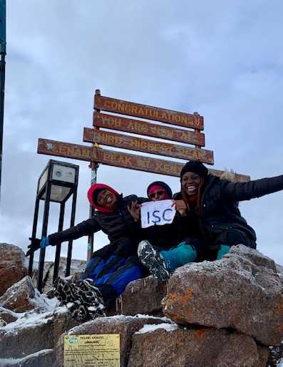

Nairobi Roar
Newsletter of the U.S. Embassy, Nairobi, Kenya
February 3, 2022
Issue 22-05
In This Update Edition:
Kiswahili Corner: M-Pesa 2
Calendar 4
Mission Somalia Spotlight 5
AEA Updates 6
AEA & CLO Updates 8
CLO Updates 9
GCLO 10
Health Unit Updates 12
Embassy Resources 13
EFM Directory 15
Community 17
Employment 18
Mission Classifieds 20
The Roar Newsletter is distributed only to immediate members of the U.S. Mission to Kenya. Please do not share or forward it to anyone not authorized to receive it. If printed, please shred before disposing.
Roar Editor
NairobiRoar@state.gov
IMPORTANT CONTACT INFO
POST ONE
020-363-6170
0722-204-445
Duty Officer Phone
0722-515-083
Medical On Call
0722-513-323
Maintenance Supervisor
On Call 0724-255-603
ISC Ladies Summit
Mount Kenya!
A story about friendship and determination
18
1

Slide 2
2

Slide 3
3

Slide 4




CALENDAR
FEBRUARY/MARCH 2022
SUN | MON | TUES | WED | THURS | FRI | SAT
13 | 14 | 15 | 16 | 17 | 18 | 19
20 | 21 | 22 | 23 | 24 | 25 | 26
27 | 28 | 01 | 02 | 03 | 04 | 05
Diversity & Inclusion Book Discussion
2:00 pm – Meet Irungu Houghton
3:00 pm – Raising of the BLM Flag
Brown’s Cheese
11:00am – 3:00pm
AEA High Tea
2:30 pm – 4:00 pm
Alvin Ailey Screening
1:00 pm – 4:00 pm
Hail & Farewell
Black History Month
February 17th–Febraary 24th, 2022
Hails
Farewells
None until end of February
We wish you all the best in your next adventure!
Remember your radio checks! This week: Zone 3: Nyari, Imperial Town Houses, Karura Ave, Muthaigi Rd, Ngecha Rd., Thigiri, Red Hill Rd.
If you are unable to get through to “Quarter” on your radio, call Post One over the phone so they may log the issue and your participation. Radio check results will be forwarded to the Front Office on the Monday morning following the checks. Please contact the RSO if you have any questions.
4

Slide 5
SPOTLIGHT ON BLACK HISTORY
5

Slide 6
SPOTLIGHT ON BLACK HISTORY
5

Slide 7
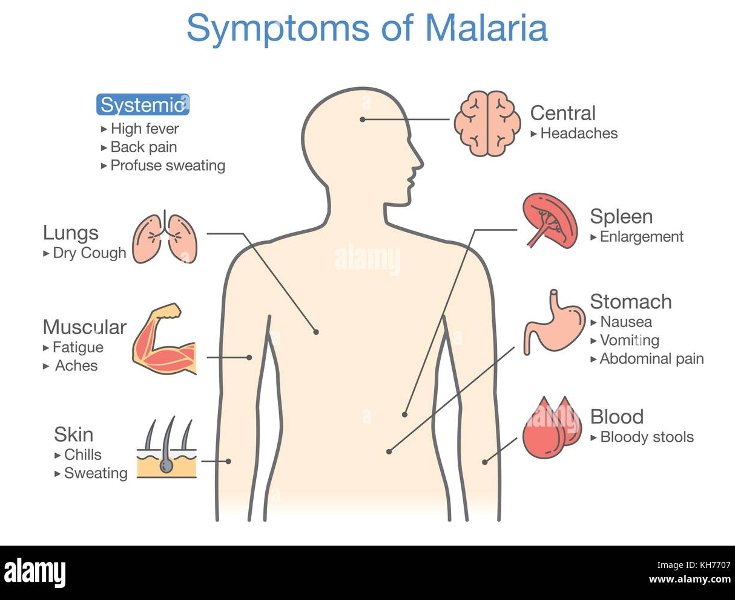




Malaria: A Deadly, BUT Preventable Disease
HEALTH UNIT UPDATE
Infection with Malaria
Steps to Prevent Malaria:
Take Preventative Medication
Contact the Health Unit (HU) if you have any questions about malaria prevention.
Medications offered at the Health Unit:
Malarone (Atovaquone/Proguanil)
Used for adults and children over 11lbs
Generally, very well tolerated
Mefloquine
Used for adults (including pregnant women)
and children (any weight))
Doxycycline
- Must be 8 years or older to take
Prevent Mosquito Bites
Pay attention to where you are sleeping: Stagnant water is a source for mosquitos
Use Mosquito netting over your bed
Stay inside between dusk and dawn if possible. The mosquito that transmits malaria is most active at night.
Keep doors and windows closed, at night especially.
Use EPA-registered insect repellents with 1 of the following active ingredients: DEET, picaridin, IR3535, oil of lemon eucalyptus (OLE), para-menthane-diol (PMD), or 2-undecanone
-Do not use products containing oil of lemon eucalyptus (OLE) or para-menthane-diol (PMD) on children under 3 years old
Keep skin covered by wearing long sleeves and pants as much as possible, especially at night.
Most important to remember…..it can be deadly!!
Symptoms may develop in 7 to 30 days, likely closer to 7 days in Kenya with the P. Falciparum parasite.
Consult the Health Unit if you suspect Malaria infection, especially if you have any of the following symptoms during or after travel: High fever, Shaking chills, Profuse sweating, Headache, Vomiting, or Diarrhea
You will need to be tested for malaria (blood test) immediately.
Treatment for malaria requires Medical interventions…do Not try to manage on your own.
Please communicate with HU to see which medication is right for you!
Email us: nairobihealthunit@state.gov
Or Call: 020-363-6633
11

Slide 8


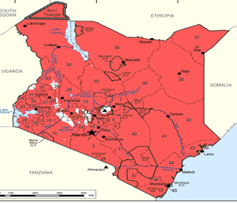
HEALTH UNIT UPDATE
Why is Malaria so common in Africa?
What is Malaria?
South of the Sahara, the principal malaria mosquito, Anopheles gambiae, transmits malaria very efficiently.
Plasmodium falciparum: Most common type of malaria parasite most often found in Africa
An acute febrile illness caused by Plasmodium parasites
Spread to people through the bites of infected female Anopheles mosquitos.
There are 5 parasite species that cause malaria in humans, and 2 of these species – P. falciparum and P. vivax – pose the greatest threat.
P. falciparum is the deadliest malaria parasite and the most prevalent on the African continent!
Highest risk are people who have little or no immunity to malaria
Young children (Children under 5)
Pregnant women (and the fetus)
Older adults
Travelers coming from areas with no malaria
Those who’s immunity has waned
Residents of a malaria region may be exposed to the disease enough to acquire a partial immunity, which can lessen the severity of malaria symptoms. This partial immunity can disappear if you move to a place where you're no longer frequently exposed to the parasite.
Is it recommended to take Malaria preventative medication if we live in Nairobi?
Yes, The CDC and Travax both recommend taking prophylactic malaria medications in Nairobi as well as any area in Kenya below an elevation of 8200 feet. The Health Unit policy encourages all patients to take one of the 3 available anti-malarial prophylactic medications.
Does anyone really get Malaria from going on Safari or to the beach for just a few days?
Yes, it can happen to you if you do not take the proper steps to prevent it. The risk in some locations is higher than others. The incidence of contracting Malaria in our population is low mostly because of our prevention strategy and because risk is lower in Nairobi. However, it does happen to our patients, so do what you can to prevent it because it is a terrible disease that can be fatal!
I am going to a game park at the same or similar altitude as Nairobi, should I take malaria prevention medications?
Yes, according to the CDC Malaria preventative medication should be taken in “All areas (including game parks) below 2,500 m (~8,200 ft) elevation”
Please read these cases of people who didn’t take proper precautions, and contracted malaria:
https://www.cdc.gov/malaria/stories/index.html
WHO (World Health Organization) Stats:
The WHO African Region carries a disproportionately high share of the global malaria burden.
In 2020, the region was home to 95% of malaria cases and 96% of malaria deaths.
Children under 5 accounted for an estimated 80% of all malaria deaths in the Region
Malaria in Kenya … it is EVERYWHERE
12

Slide 9

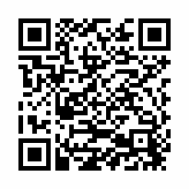



EMBASSY UPDATES
Volunteers Needed
Hey, Mission – here’s your chance to show off your acting skills! The RSO is looking for able-bodied volunteers to serve as role players to support a special on-compound drill to take place between Noon and 3PM on Friday, February 25th. Volunteers would likely play vandals and intruders, and should expect to be detained and possibly handcuffed at some point in the drill. To sign up, email Jason Bierly: bierlyje@state.gov and David Silva: silvadm@state.gov
The ICASS survey is a valuable tool in helping Management improve service delivery.
Are you happy with the services? Is there room for improvement? We want to hear from you! Click on the link or use QR code below to complete the survey.
https://survey.alchemer.com/s3/6650799/ICASSCustomerSatisfactionSurvey2022
6

Slide 10


CLO UPDATES
Treat yourself with a day on the farm, Sunday, March 6th! This is a private event for our U.S. Embassy group. Learn about Mlango Farm, enjoy picking your own vegetables, visit with the farm animals, and finish with a lovely outdoor lunch! Sign up here, now through February 25th: https://forms.gle/t12qJGzNJ7V34Z1j9.
Calling all tea lovers! Get out of Nairobi for a day and enjoy a tour and lunch at Kiambethu Tea Farm. Learn more about tea and tea production, taste locally produced tea, and explore the beautiful property and nearby forest. Sign up here, now through February 25th: https://forms.gle/EBA2KgGK3fVNcWTc8.
*If either event is oversubscribed, we will hold a lottery.
7

Slide 11






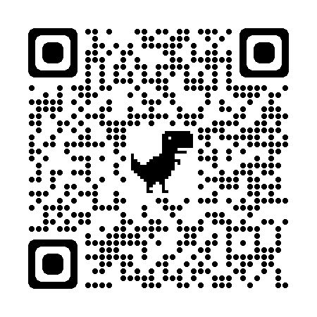

AEA UPDATES
Chancery Commissary /
AEA Morale Store
Contact: 020-363-6182 or 020-363-6272 Hours: Mon-Thurs, 8:30 am – 4 pm Fri, 8:30 am – 2 pm Rosslyn Ridge Commissary
Contact: 020-363-6799 Hours: Wed, Thurs & Fri, 11:30 am – 6:30 pm
Sat and Sun,
10:30 am – 5:30 pm
PROMO RUNS THRU FEB
Watering Hole
0112 145 720 or 0706 311 516
thewateringhole2019@gmail.com
Hours: Tues-Friday, 10 am – 8:30 pm
Sat and Sun, 8 am – 8:30 pm
AEA Dry Cleaning
Tuesdays & Thursdays
Drop off/Collection of Laundry & Dry Cleaning at the embassy short term parking 8:30 am – 10:30 am
Use this QR code to join the AEA Nairobi Facebook Group to get info about commissary updates, new products and Café and Watering Hole food specials!
https://www.facebook.com/groups/274130230857993/
Join us Sunday 20 February at the Old CMR House! The tasting will include four exclusive teas which will invigorate your taste buds and take you through a journey of Africa and its tea growing regions, along with food pairings of Scones, Tea Sandwiches and Tea Treats. We hope to showcase the beauty and appreciation of Mother Africa’s truly Magical world of Tea. Sign up:
https://forms.gle/zHhrmeQjHdreb7RLA
13

Slide 12

GCLO WEEKLY NEWSLETTER
10

Slide 13
Malaria: A Deadly, BUT Preventable Disease
HEALTH UNIT UPDATE
Infection with Malaria
Steps to Prevent Malaria:
Take Preventative Medication
Contact the Health Unit (HU) if you have any questions about malaria prevention.
Medications offered at the Health Unit:
Malarone (Atovaquone/Proguanil)
Used for adults and children over 11lbs
Generally, very well tolerated
Mefloquine
Used for adults (including pregnant women)
and children (any weight))
Doxycycline
- Must be 8 years or older to take
Prevent Mosquito Bites
Pay attention to where you are sleeping: Stagnant water is a source for mosquitos
Use Mosquito netting over your bed
Stay inside between dusk and dawn if possible. The mosquito that transmits malaria is most active at night.
Keep doors and windows closed, at night especially.
Use EPA-registered insect repellents with 1 of the following active ingredients: DEET, picaridin, IR3535, oil of lemon eucalyptus (OLE), para-menthane-diol (PMD), or 2-undecanone
-Do not use products containing oil of lemon eucalyptus (OLE) or para-menthane-diol (PMD) on children under 3 years old
Keep skin covered by wearing long sleeves and pants as much as possible, especially at night.
Most important to remember…..it can be deadly!!
Symptoms may develop in 7 to 30 days, likely closer to 7 days in Kenya with the P. Falciparum parasite.
Consult the Health Unit if you suspect Malaria infection, especially if you have any of the following symptoms during or after travel: High fever, Shaking chills, Profuse sweating, Headache, Vomiting, or Diarrhea
You will need to be tested for malaria (blood test) immediately.
Treatment for malaria requires Medical interventions…do Not try to manage on your own.
Please communicate with HU to see which medication is right for you!
Email us: nairobihealthunit@state.gov
Or Call: 020-363-6633
10

Slide 14
HEALTH UNIT UPDATE
Why is Malaria so common in Africa?
What is Malaria?
South of the Sahara, the principal malaria mosquito, Anopheles gambiae, transmits malaria very efficiently.
Plasmodium falciparum: Most common type of malaria parasite most often found in Africa
An acute febrile illness caused by Plasmodium parasites
Spread to people through the bites of infected female Anopheles mosquitos.
There are 5 parasite species that cause malaria in humans, and 2 of these species – P. falciparum and P. vivax – pose the greatest threat.
P. falciparum is the deadliest malaria parasite and the most prevalent on the African continent!
Highest risk are people who have little or no immunity to malaria
Young children (Children under 5)
Pregnant women (and the fetus)
Older adults
Travelers coming from areas with no malaria
Those who’s immunity has waned
Residents of a malaria region may be exposed to the disease enough to acquire a partial immunity, which can lessen the severity of malaria symptoms. This partial immunity can disappear if you move to a place where you're no longer frequently exposed to the parasite.
Is it recommended to take Malaria preventative medication if we live in Nairobi?
Yes, The CDC and Travax both recommend taking prophylactic malaria medications in Nairobi as well as any area in Kenya below an elevation of 8200 feet. The Health Unit policy encourages all patients to take one of the 3 available anti-malarial prophylactic medications.
Does anyone really get Malaria from going on Safari or to the beach for just a few days?
Yes, it can happen to you if you do not take the proper steps to prevent it. The risk in some locations is higher than others. The incidence of contracting Malaria in our population is low mostly because of our prevention strategy and because risk is lower in Nairobi. However, it does happen to our patients, so do what you can to prevent it because it is a terrible disease that can be fatal!
I am going to a game park at the same or similar altitude as Nairobi, should I take malaria prevention medications?
Yes, according to the CDC Malaria preventative medication should be taken in “All areas (including game parks) below 2,500 m (~8,200 ft) elevation”
Please read these cases of people who didn’t take proper precautions, and contracted malaria:
https://www.cdc.gov/malaria/stories/index.html
WHO (World Health Organization) Stats:
The WHO African Region carries a disproportionately high share of the global malaria burden.
In 2020, the region was home to 95% of malaria cases and 96% of malaria deaths.
Children under 5 accounted for an estimated 80% of all malaria deaths in the Region
Malaria in Kenya … it is EVERYWHERE
10

Slide 15








EMBASSY RESOURCES
EMBASSY RESOURCES
Nairobi Roar
Nairobi Roar
EMERGENCY
POST ONE: 020-363-6170 or 0722-204-445
RSO: Call Post One
020-363-6170 or 0722-204-445
Duty Officer: 0722-515-083
Main switchboard: 020-363-6000
USAID Main switchboard: 020-862-2000
After Hours Dispatcher: 0728-608-284
Please note that all service hours are subject to change.
Photos & Story by Jill Chiasson
Photos & Story by Jill Chiasson
MISSION KENYA OFFICE HOURS
Official Office Hours: 7:15am to 4:30pm Monday through Thursday with 30 minutes for lunch, and from 7:15am to 12:15pm on Friday.
Please be aware that office hours are subject to further adjustments at any time to meet Mission requirements.
BANKING
Monday-Thursday: 8:30 am-3:30 pm, Friday: 8:00 am- 2:00 pm
TRAVEL
Express Travel Office: 020-363-6229 or 020-363-2415
Emergency Hotlines - after office hours & Airport Office: (open 24 hours): +254 709 195 400
MEDICAL
Med Unit Duty Officer:
0722-513-323; If you do not get a response, call POST ONE. Do not text or email in an emergency.
Reception: 020-363-6633 7:15am - 4:30pm, Mon-Thurs; 7:15am-12:15pm, Fri Email: NairobiHealthUnit@state.gov
Walk –in Hours: M-F, 7:30 – 9:00 am
Please do not walk-in for the following symptoms- CALL first! Fever, cough, runny nose, sore throat, diarrhea.
BANK HOURS:
UPDATED CASHIER HOURS:
Chancery Lobby
Monday-Thursday:
8:00 am – 11:15 am & 12:00 pm – 2:00 pm;
Friday:
8:00 am – 12:30 pm
USAID Annex Lobby
Monday-Tuesday:
8:30 am – 12:00 pm & 1:00 pm – 2:30 pm; Wednesday: 8:30 am – 1:00 pm; Thursday/Friday:
8:00 m – 12:30 pm
CONSULAR SERVICES
Consular Section: General Info: 020-363-6011 The office is closed on all American/Kenyan holidays and the last Wednesday of the month.
American Citizen Services (Mission Personnel): The consular section can process U.S. passport (both official and personal) applications, Consular Reports of Birth Abroad, and provide notarial services for Mission employees and their families. To schedule an appointment for any of these services please email Kenya_ACS@state.gov or call ext. 6451. For specific American Citizen Services questions, please contact ACS Chief Robyn Luffman at LuffmanRN@state.gov.
American Citizen Services (General Public):
Please note that while service appointments have resumed, wait times are extensive. Passport and notarial services are available for the general public here. For Consular Report of a Birth Abroad appointments, email the ACS unit at Kenya_ACS@state.gov. For after-hour emergencies, contact 020-363-6170. For other services, email Kenya_ACS@state.gov.
Non-Immigrant Visa: https://ke.usembassy.gov/visas/
Immigrant/Diversity Visa: https://ke.usembassy.gov/visas/
DHS Citizenship & Immigration Services (CIS):
363-6111; Fax: 363-6103
Mission Personnel Email uscis.nbo.public@uscis.dhs.gov for an appointment. General Public Tues & Thurs: 1:30-3:30 pm; Wed: CLOSED; Fri: 9-11 am
MAINTENANCE
Maintenance Supervisor
During Office Hours: 020-363-6443
After Hours On Call: 0724-255-603
MAIL
Customer Service Hours
Monday- Wednesday: 8am – 4pm;
Thursday: 8am – 12pm;
Friday: 8am – 12:30pm
Updated Hours/Services
Now outgoing mail once a week; advise dropping outgoing mail by Tuesday to ensure it goes out in that week’s shipment
UN FUEL STATION
Updated Hours:
Mon-Fri: 7 am-6 pm
Sat-Sun: 9 am–5 pm
Questions about obtaining/renewing a UN fuel sticker? Contact GSO Customs and Shipping: NairobiGSOCustomsAndShipping@state.gov.
13
2

Slide 16




EMBASSY RESOURCES
GUIDELINES
Mission External Facilities Guidelines
Swimming Pool Guidelines
Pools will remain open without reservation or capacity constraints.
Adult swim (for lap swimming only) at Rosslyn Ridge is Monday-Friday at 6:00-8:00a.m.
Swimming pools are closed for daily cleaning from 8:00-9:30 a.m.
Maps:
Rosslyn Ridge Pool: https://goo.gl/maps/VLaANE31L2qJnnDf7
R-2 (former CMR) Pool: https://goo.gl/maps/RM9ntvZwU4v6ztWU7
Shanzu Gardens Pool: https://goo.gl/maps/4NgNCrZPwwZa4knj8
Fairfields Pool (Rosslyn Lone Tree): https://goo.gl/maps/pmSv83KmoppENo3d7
General Rules & Regulations for Facilities:
Outside guests are not permitted at this time to use any shared facilities.
Pools and playgrounds may not be reserved for parties.
For those days/facilities requiring advance booking, bookings may be made up to 2 weeks in advance. Reservations outside this window will be deleted.
Mask requirements will mirror those of the Chancery compound. Currently, mask use is mandatory indoors and optional but encouraged for vaccinated community members using outdoor facilities.
Patrons should continue to physically distance and avoid overcrowding at facilities.
Do not use the facilities if you are sick. Contact the MED Unit.
To avoid vermin and monkey infestation, personnel using embassy facilities must dispose of food waste in covered trash bins.
When making a reservation, you may not exceed the number of your own family members who will be accessing the selected facility. If you intend to meet others, they must make their own concurrent booking on the calendar, subject to facility capacity restrictions.
Playgrounds:
Playgrounds will remain open without reservation or capacity constraints.
Children aged five and under and other unvaccinated community members must wear a mask covering their nose and mouth at all times while using the playground since it is difficult for younger kids to physically distance in this area.
All children aged six and under must be always accompanied by a responsible adult (18+) at all times.
Gym Guidelines
NOTE: The Embassy gyms will be closed on Friday, February 18th from 12:00 pm - 4:00 pm for inspection and maintenance. More info in Management Notice 22n-024.
Maximum occupancy in the indoor gyms is five people.
The USAID gym is available for all to use, subject to maximum occupancy at time of arrival.
The Chancery outdoor gym is available for all to use, subject to the AEA gym class schedule and availability at time of arrival.
Chancery indoor gym available for all to use, subject to capacity limits at time of arrival.
Gym showers are reserved for gym users only and due consideration should be shown to fellow users by limiting changing room time use to 15 minutes and showering times to five minutes.
Lockers are for gym users only and should not be reserved for long-term individual use. You are permitted to leave a lock fastened only during the time you are using the gym facilities. Locked padlocks will be cut open and any contents discovered will be passed to the CLO Lost and Found to be claimed later.
The Chancery indoor gym is closed for cleaning DAILY at the following times: 10:00-11:00 am; and 3:00-4:00pm. The USAID Gym is closed for cleaning at the following times: 7:15 – 8:00am; 10:45 – 11:00am; and 3:00 – 3:45pm. The Chancery Outdoor Gym is closed for daily cleaning at the following times: 9:00 – 9:30 a.m.; and 1:00 – 1:45 p.m.
Other Shared Facility Guidelines
The Rosslyn Ridge field and basketball court are available for general use daily without reservation.
Tennis Courts
Tennis courts require booking and may not be used for any activity other than tennis. Please note that there is a separate calendar for each Rosslyn Ridge tennis court.
Rosslyn Ridge Tennis Courts: https://goo.gl/maps/VLaANE31L2qJnnDf7
R-2 (former CMR) Tennis Court: https://goo.gl/maps/RM9ntvZwU4v6ztWU7
17

Slide 17

EFM BUSINESS DIRECTORY
Amber Silva Photography
Wedding & Portrait Photographer
WhatsApp: 072-527-8688
Hello@ambersilvaphoto.com
Counseling Services
Jennifer Miller, MSW, LCSW
Mobile: 011-530-7000
Jmiller.lcsw@gmail.com
Digital Consultant – Michelle Melo
079-768-8788
michelle@michelleMeloDigital.com
MichelleMeloDigital.com
Double Bridge Fitness
Pilates
Swim lessons & training
doublebridgefitness@gmail.com
Kacey Bollrud
011-515-9010
Diplo-Macs
Stephanie Njenga
thediplomacs@gmail.com
079-214-0480
Gentle Yoga Stretch Classes (500 ksh)
Tues & Fri @8:15AM, Rosslyn Ridge
Health Coaching (Individual or Group)
For more info contact Jill Schroeder
011-449-1165 or jillschroeder2010@hotmail.com
inspirebyjillwellness.com
Laura Merz Photography - portraits and fine art
www.lauramerzphotography.com
lauramerzphotography@gmail.com
Life Coaching w/Courtney
011-502-3362
WinsWithCourtney@gmail.com
Sewing Lessons at
The Happy Sewing Café
Sewing & Quilting Classes
Diosa Woods: 0746-966-323 (call or WhatsApp) Email: 4diosab@gmail.com
Website: thehappysewingcafe.com
Special Needs Educator - Private Tutoring
25+ years experience working with children ages birth to 12, specializing in infants and toddlers, Autism Spectrum Disorders, and children with ADD/ADHD struggling with home/classroom organization.
Available for teens seeking support with essay-writing, including college-entrance essays.
Will work with your child (and caregivers needing support) in the privacy of your home.
nomadeducator.com
jenniferanders87@gmail.com
What’sApp: +1-253-252-6548
NEW!
Click here to access the full online EFM business directory!
To Order, contact Diplo-Macs
079-214-0480 thediplomacs@gmail.com
18

Slide 18



COMMUNITY UPDATES
Dear KSPCA Friends and Supporters,
Following our recent exciting announcement about our upcoming 9 days campaign in partnership with TNR Trust, we really need your help. We intend to conduct vaccination and sterilization campaigns at Ruai, Kayole and Kibera.
We are kindly asking for your assistance to help us set-up and run this campaign. We are asking for your generous donation to help us:
1. Cover the funding for DHLP vaccines that we are adding for the first time and usual dewormers for dogs and cats.
2. Cover the cost of hiring tents, including transportation and labor cost of setting them up.
Anyone who can donate the tents or provide at a very affordable price, we would be happy to hear from you. The tents required are: a) 3 by 3 meters tents (5) and b) 20ft by 40ft tents (4).
3. Cover the cost of printing our posters, flyers and vaccination cards.
4. Cover for catering and getting additional fresh drinking water for all our lovely volunteers who will be sacrificing so much time to help us run the campaign.
Kindly use the Mpesa paybill 681727, account name 'sterilization'. You can also click HERE to donate,
Many thanks for your continued support.
KSPCA
Lang'ata Road, Nairobi
Kenya
Come worship with us at International Christian Fellowship.
We meet every Sunday morning at 10 AM in the Auditorium at Rosslyn Academy. Our congregation is based on biblical teachings, and it includes many families from the embassy and UN, expats, locals, missionaries, teachers, etc. There is Sunday school for children while adult worship in service. Please join us for worship and fellowship.
Any questions: please send an email to: admin@icf-nairobi.org
17

Slide 19


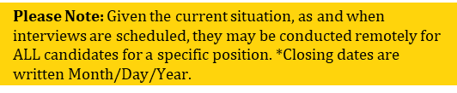
EMPLOYMENT
Current Vacancies
Questions? Reach out to NairobiHRAmericanServices@state.gov
Position Title: AEA Event Coordinator, COM EFMs
Solicitation Number: AEA-Nairobi
Series/Grade: N/A
Clearance: None Hours: 15 to 25 hours per week
Closing Date: 2/18/2022
To Apply: Applicants must email a cover letter and resume to the AEA Manager, Eric Kivayilu, at KivayiluES@state.gov by COB February 18th, 2022. Applicants must be available for an interview by AEA Board Members, who will make the final selection
Position Title: Housing Coordinator – GSO (USEFMs)
Solicitation Number: Nairobi-2022-019
Series/Grade: FSN-820-7; FP-7
Clearance: Secret Hours: Full Time, 40 hours per week
Closing Date: 02/22/2022 (4:30 PM East Africa time)
To Apply: https://erajobs.state.gov/dos-era/vacancy/viewVacancyDetail.hms?_ref=tdzdndn3pt0&returnToSearch=true&jnum=31305&orgId=25
Position Title: Community Liaison Office Coordinator
Solicitation Number: Nairobi-2022-018
Series/Grade: FP-0105-5
Clearance: Top Secret Hours: Full Time, 40 hours per week
Closing Date: 2/21/2022 (4:30 PM East Africa time)
To Apply: https://erajobs.state.gov/dos-era/vacancy/viewVacancyDetail.hms?_ref=vkfqtu9rpt0&returnToSearch=true&jnum=31225&orgId=25
Position Title: Housing Coordinator – GSO (USEFMs)
Solicitation Number: Nairobi-2022-019 (S)
Series/Grade: FSN-820-7; FP-7
Clearance: Secret Hours: Full Time, 40 hours per week
Closing Date: 02/22/2022 (4:30 PM East Africa time)
To Apply: https://erajobs.state.gov/dos-era/vacancy/viewVacancyDetail.hms?_ref=tdzdndn3pt0&returnToSearch=true&jnum=31601&orgId=25
Position Title: HR Assistant (Performance & Analytic Team Lead)
Solicitation Number: Nairobi-2022-017
Series/Grade: FSN - 0305/ FSN-8; FP-6
Clearance: Local Security Certification Hours: Full Time, 40 hours per week
Closing Date: 2/25/2022 (4:30 PM East Africa time)
To Apply: Interested candidates for this position must submit their application to the following for consideration: https://erajobs.state.gov/dos-era/ken/vacancysearch/searchVacancies.hms
Position Title: American Center Director – Public Diplomacy Section
Solicitation Number: Nairobi-2022-020
Series/Grade: FSN – 6510 / FSN-9; FP-5
Clearance: Local Security Certification Hours: Full Time, 40 hours per week
Closing Date: 03/03/2022 (4:30 PM East Africa time)
To Apply: https://erajobs.state.gov/dos-era/ken/vacancysearch/searchVacancies.hms
Position Title: HR Assistant
Solicitation Number: Nairobi-2022-022
Series/Grade: FSN - 0305/ FSN-305-09; FP-05
Clearance: Local Security Certification Hours: Full Time, 40 hours per week
Closing Date: 2/25/2022 (4:30 PM East Africa time)
To Apply: Interested candidates for this position must submit their application to the following for consideration: https://erajobs.state.gov/dos-era/ken/vacancysearch/searchVacancies.hms
Interested in EFM Employment in the New Year? Need assistance with Electronic Recruitment Application (ERA) or deciphering Vacancy Announcements?
Throughout January, Human Resources Assistant Stephanie Windus will be available to meet virtually to answer your questions. Reach out to schedule your one on one over WebEx at WindusSR@State.Gov.
21

Slide 20
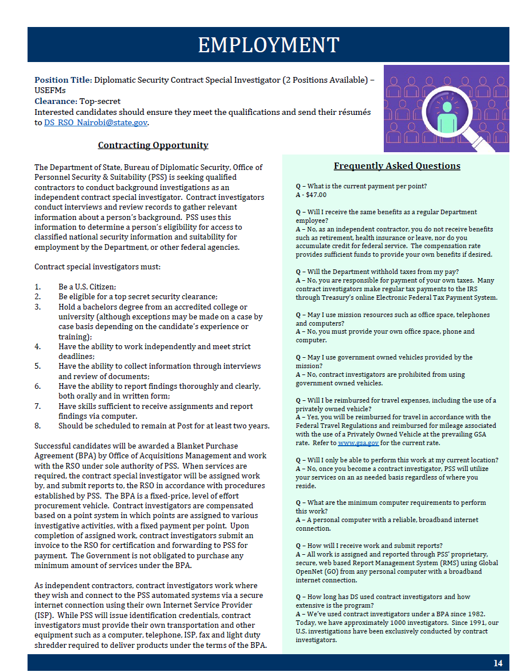
AEA UPDATES
19

Slide 21

EMPLOYMENT
EFM PREVIEW: COMING SOON……
Hey, EFMs! Keep an eye out for these job listings below – opening soon! One of these could be perfect for you!
Community Liaison Office Coordinator (Open NOW!)
The CLO is responsible for developing and managing program based on community demographics and post-specific needs. The CLO develops evaluation criteria and conducts periodic surveys to assess program efficacy. Based on analysis of formal and informal surveys, the CLO develops and implements a long-range program plan that outlines goals to maintain and enhance moral at post.
Housing Coordinator (Open NOW!)
The Housing Coordinator proposes housing assignments in accordance with U.S. Government regulations and guidelines and is the point of contact for incoming personnel concerning all aspects of housing. Coordinates housing board meetings and all related issues.
Residential Security Coordinator (Opens in mid February)
The Residential Security Coordinator provides administrative oversight of post's residential security program. Serves as the point of contact on all residential security matters between the RSO, General Service Office (GSO), Facilities Maintenance (FAC), and landlords. Conducts security surveys of all current housing to ensure residential security standards are maintained and conducts security surveys on all proposed housing to ensure security suitability can be obtained and compliance with the Overseas Security Policy Board’s OSPB standards before occupancy.
Information Management Assistant (Opening Spring)
The Information Management Assistant (IMA) is assigned to support the classified or unclassified computer networks and messaging systems as needed. The IMA also assists with telephone and radio management, circuit and network management, emergency communication testing and maintenance, property management, user training, and direct customer support.
Diplomatic Courier Escort (Opening Spring)
The Diplomatic Courier Escort supports the Regional Courier Operations from the Frankfurt Regional Diplomatic Courier Division (FRDCD). Serves as the classified pouch clerk for the Embassy; preparing outbound pouches, receiving inbound material and distributing that material and ensuring accountability using the pouch module in the Integrated Logistics Management System (ILMS).
Cultural Affairs Assistant – YALI Coordinator (Opening Spring)
The Cultural Affairs Assistant Serves as principal advisor to the Public Affairs Officer (PAO) and Cultural Affairs Officer (CAO) and overall program manager for the Young African Leaders Initiative (YALI). Plans and executes all recruitment, selection, and predeparture activities for all Kenyans applying to and participating in YALI programs. S/he actively participates in the Inter-Agency Working Group (IAWG) for YALI. Develops recruitment outreach prior to and during the Mandela Washington Fellowship application period.
Housing Supervisor (Make Ready) (Opening Early Summer)
The Housing Supervisor provides overall coordination of the Facilities Maintenance Management (FMM) Housing Office which consists of over 200 short term leases and almost 100 government-owned properties. Incumbent is in charge of coordinating the make-ready process for the FMM team in partnership with the coordinator for the GSO Housing team, working closely with facilities team, supervisors, POSHO's and make ready team. After housing assignments are made, the incumbent is the point of contact for incoming personnel concerning facilities.
23

Slide 22


FLO and the bureau of Global Talent Management Talent Services (GTM/TS) created an informative video to assist in the application process. Get more details and prepare for open enrollment by visiting FLO’s FSFRC webpage.
Please direct any questions that you may have to FSFRC@state.gov.
Upon acceptance to the FSFRC, AEFMs are appointed into a position without compensation or benefits, allowing the Department of State to improve efficiency in the hiring process when filling positions at posts abroad.
FLO and the bureau of Global Talent Management Talent Services (GTM/TS) created an informative video to assist in the application process. Get more details and prepare for open enrollment by visiting FLO’s FSFRC webpage.
Please direct any questions that you may have to FSFRC@state.gov.
Upon acceptance to the FSFRC, AEFMs are appointed into a position without compensation or benefits, allowing the Department of State to improve efficiency in the hiring process when filling positions at posts abroad.
FLO and the bureau of Global Talent Management Talent Services (GTM/TS) created an informative video to assist in the application process. Get more details and prepare for open enrollment by visiting FLO’s FSFRC webpage.
Please direct any questions that you may have to FSFRC@state.gov.
Upon acceptance to the FSFRC, AEFMs are appointed into a position without compensation or benefits, allowing the Department of State to improve efficiency in the hiring process when filling positions at posts abroad.
FLO and the bureau of Global Talent Management Talent Services (GTM/TS) created an informative video to assist in the application process. Get more details and prepare for open enrollment by visiting FLO’s FSFRC webpage.
Please direct any questions that you may have to FSFRC@state.gov.
Upon acceptance to the FSFRC, AEFMs are appointed into a position without compensation or benefits, allowing the Department of State to improve efficiency in the hiring process when filling positions at posts abroad.
FLO and the bureau of Global Talent Management Talent Services (GTM/TS) created an informative video to assist in the application process. Get more details and prepare for open enrollment by visiting FLO’s FSFRC webpage.
Please direct any questions that you may have to FSFRC@state.gov.
Upon acceptance to the FSFRC, AEFMs are appointed into a position without compensation or benefits, allowing the Department of State to improve efficiency in the hiring process when filling positions at posts abroad.
FLO and the bureau of Global Talent Management Talent Services (GTM/TS) created an informative video to assist in the application process. Get more details and prepare for open enrollment by visiting FLO’s FSFRC webpage.
Please direct any questions that you may have to FSFRC@state.gov.
Upon acceptance to the FSFRC, AEFMs are appointed into a position without compensation or benefits, allowing the Department of State to improve efficiency in the hiring process when filling positions at posts abroad.
FLO and the bureau of Global Talent Management Talent Services (GTM/TS) created an informative video to assist in the application process. Get more details and prepare for open enrollment by visiting FLO’s FSFRC webpage.
Please direct any questions that you may have to FSFRC@state.gov.
Upon acceptance to the FSFRC, AEFMs are appointed into a position without compensation or benefits, allowing the Department of State to improve efficiency in the hiring process when filling positions at posts abroad.
FLO and the bureau of Global Talent Management Talent Services (GTM/TS) created an informative video to assist in the application process. Get more details and prepare for open enrollment by visiting FLO’s FSFRC webpage.
Please direct any questions that you may have to FSFRC@state.gov.
CLASSIFIEDS
Where did the Classified Ads
go?
We’ve Moved Online!
Curious where the classified section went? We’ve moved them to the cloud!
CLO is working on developing a new website, where classified ads and other CLO resources will be available.
To access the site, you must have a FAN account or gmail account to access it, and it is best viewed in Google chrome. To request access, email us at NairobiRoar@state.gov or CLONairobi@state.gov .
Click here to view the classified ads and stay tuned for more to come!
Roar Disclaimer
Publishing
The Roar will be published every Thursday. To have your information or announcements considered for inclusion, please submit by COB on Monday the week of publication.
Advertising
The classifieds ad section of the Roar is intended for use by staff and families of those serving under Chief of Mission Authority. It is not a public bulletin board and with the exception of an occasional item to be considered of general interest, it is not open to commercial advertisements. Inclusion of an ad does not imply an endorsement from CLO or post.
Inclusion of any commercial advertisement in the Roar does not constitute an endorsement by CLO, the Department of State or the U.S. government. Nor does inclusion constitute any endorsement of any opinions or positions expressed by any advertising entity.
CLO reserves the right to not publish announcements that are inconsistent with the Mission’s Code of Ethics.
CLO reserves the right to not publish classified ads that do not conform to the Roar classifieds policy. Community Submissions
Contributions to the Roar are welcome from all members of the community. The views and opinions expressed in the Roar are those of the authors and do not necessarily reflect the official policy or position of any agency of the U.S. government.
CLO reserves the right to vet and/or edit submissions.
Photography
All photos depicting community members are used with the express permission of those pictured therein.
Photos taken/submitted by the community will be attributed to the photographer.
Distribution
The Roar is distributed only to immediate members of the U.S. Mission to Kenya. Please do not share or forward it to anyone not authorized to receive it. If printed, please shred before disposing.
Environmental
Please do not print this newsletter unless it is necessary. It helps to keep the environment forested and litter-free.
21
Join the FLO Team - Communications and Outreach Officer Vacancy Announcement
If you are in the DC area or will be soon, you may consider applying for the FLO Communications and Outreach Officer (GS-12) position. The incumbent for this position serves as the team lead, reports to the Division Chief, and is responsible for management of the Communications and Outreach portfolio in FLO. This includes developing and implementing new communication and outreach strategies and plans, content development and management for all platforms, and program evaluation. The incumbent advises FLO management on the best means to communicate with FLO’s diverse worldwide client base. The position is located in Washington DC, and may require some travel. The application deadline is 11:59 p.m. EDT, June 1.
Expeditious Naturalization of Foreign-Born Spouses
FLO worksU.S. Citizenship and Immigration Services (USCIS) to help U.S. Department of State foreign-born spouses navigate the naturalization process.319(b) naturalization, spouses do not need to meet residency requirements and may be eligible to apply for naturalization immediately after obtaining Lawful Permanent Resident (LPR) status. FLO’s assistance is limited to Department of State spouses.agency spouses should contact their respective Human Resources offices for possible assistance with 319(b) naturalization.liaisons with questions regarding the process may reach out toFLOAskNaturalization@state.govguidance.more information visitFLO’s Naturalization of Foreign-Born Spouses webpage.
AP vs. IB - A Practical Comparison for Your Child’s Education
The task of choosing between schools offering different educational objectives with long-term impact can present a challenge for Foreign Service families. This is the case when families are presented with the choice of Advanced Placement (AP) or International Baccalaureate (IB) coursework. Inpastof The Foreign Service Journal, FLOKristen, a featured college preparation speaker at conferences in the United States and abroad, explore some of the most frequently asked AP vs. IB questions.Read the online articlelearn how both programs offer strong preparation for higher university education - with differing approaches.
￼
￼
￼￼
￼
￼
￼
￼
￼
￼
￼
￼
￼
F￼
￼
￼
￼
￼￼
￼
￼
￼
￼￼
￼
￼
￼
￼
￼
￼
￼
￼
￼
￼
￼
￼
￼
￼

